Slide 1
Communication protocols and network security
Introduction and repetition of the basics

Slide 2
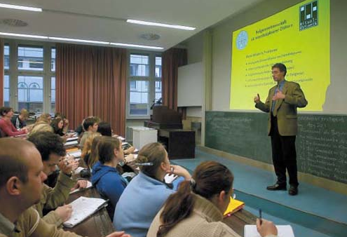
Communication protocols and network security
Professor:
dr. Andrej Brodnik (Ljubljana)
Teaching Assistant:
as. dr. Gašper Fele Žorž
Implementation of course :
  3 hours of lectures –consisting of two parts, 2 hours of lab work per week
  contact : e-mail, consultation hours, forum on the course web page

Slide 3

Content of the course
Repetition of the basics of communications
(ISO/OSI, TCP/IP,
protocols, services, security),
control and management of networks,
distribution (multicasting),
real-time applications,
security: authentication, authorization, records, safe transfers, VPN, certification, firewalls, IDS systems,
information for network operation, LDAP,
IEEE 802.

Slide 4
Content of the course – an indicative plan
week | lecture | HW | SEM
8.10. | Introduction | 1
15.10. | Starting your computer, network configuration | 1
22.10. | Managment and control of the networks | 1
29.10. | Circulation and real-time aplications | 2
5.11. | Distribution | 2
12.11. | Distribution/Preparation for the test | 2
19.11. | MIDTERM TEST 1 |  | SEM1
26.11. | Elements of network security | 3
3.12. | Authentication, authorization, records (AAA) | 3
10.12. | Authentication, authorization and records (AAA) / avtorizacija in beleženje (AAA) / Data for network operation (LDAP) | 3, 4
17.12. | Visiting lecturer
24.12. | <<< Christmas holidays >>>
31. 12. | <<< Christmas holidays >>>
7.1. | Družina IEEE 802 | 4
14.1. | MIDTERM TEST 2 |  | SEM2

Slide 5
Obligations
Final grade(≥50):
4 pieces of homework: 20%
2 seminar papers: 40%
written exam or 2 midterm tests: 40%
100%
Obligations :
notes : 2 x per lecture, 1x laboratory work
homework≥ 40, each homework ≥ 20
seminar paper ≥ 40, each seminar paper ≥ 20
written exam ≥ 50, each of the midterm tests≥ 40

Slide 6
Obligations
The grade also takes into account:
participation in the forums
Complementing the notes
assistance to the colleagues
...

Slide 7
Literature
J. F. Kurose, K. W. Ross: Computer Networking, 5th edition, Addison-Wesley, 2010.
A. Farrel: The Internet and Its Protocols: A Comparative Approach, Morgan Kaufmann, 2004.
E. Cole: Network Security Bible, Wiley, 2nd edition, 2009.
Mani Subramanian: Network Management: An introduction to principles and practice, Addison Wesley Longman, 2000
RFC
…

Slide 8
Repetition of the basics of computer communications

Slide 9
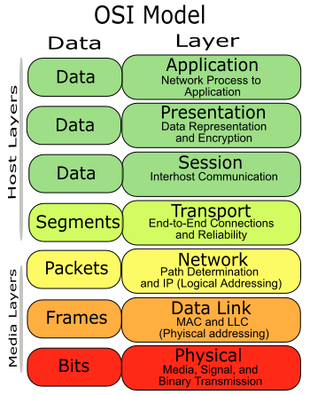
ISO/OSI model
The model consists of seven layers, which define the layers of related functions of the communication system.
Application layer
Presentation layer
Session layer
Transport layer
Network layer
Data link layer
Physical layer

Slide 10
ISO/OSI model
layer N provides services (serving) for layer N +1
layer N requires services (deliverability) from layer N-1,
Protocol: rules of communication between processes on the same location,
Entity pair: pair of processes that communicate on the same layer
layers
N
N-1
.
.
.
2
1
System A
System B
Entity pair
of processes
->Direction of communication ->

Slide 11
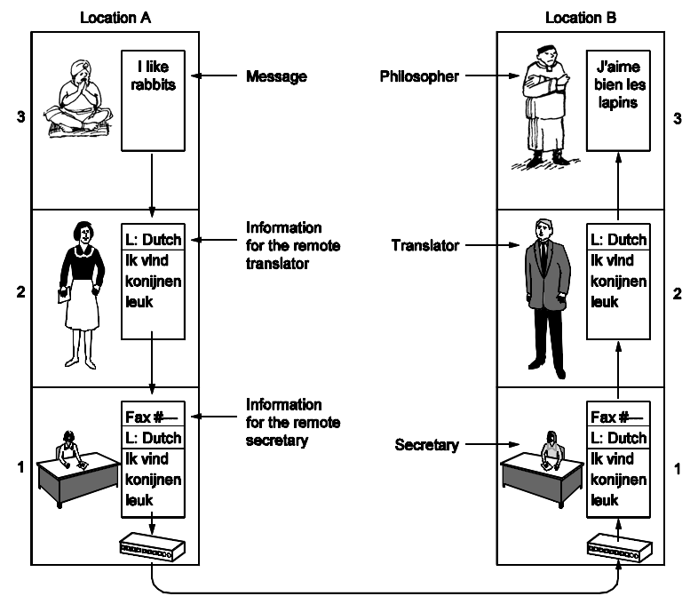
Analogy : conversation between two philosophers
Why layers?
  systematic concept of system architecture,
  The change of implementation of one part of the system is independent from the rest of the system.

Slide 12
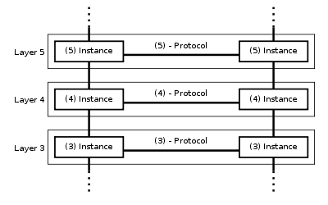
ISO/OSI model
In other words:
Each layer has its own protocols(the language used for communication by the processes on the same layer)
The protocols are specific for the services provided by the layer

Slide 13

OSI layers: detailed
Application layer
  closest to the user,
  Allows application interaction with
  network services.
  standard services : telnet, FTP,
  SMTP, SNMP, HTTP

Slide 14
OSI layers
Presentation layer
  Determines the meaning of the data between the entity pair of the application layer,
  syntax and semantics,
  provides coding, data compression, security mechanisms
Session layer
  controls conversations between applications,
  logical connection between applications,
  usually it's built into the applications.

Slide 15
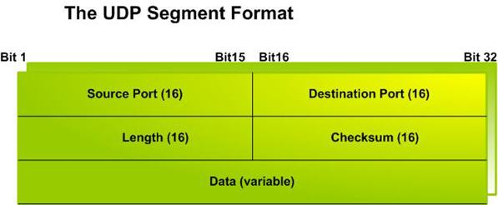
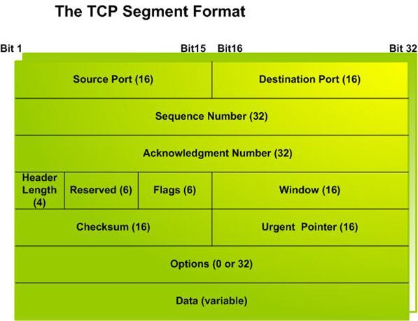
OSI layers
Transport layer (unit: SEGMENT)
  effective, reliable and transparent data transfer between users; Provide these services to higher layers,
  Mechanisms: control of the flux, segmentation, control of the errors.,
  Connection and connectionless oriented transfers,
  TCP, UDP, IPSec, GRE, L2TP, PPP

Slide 16
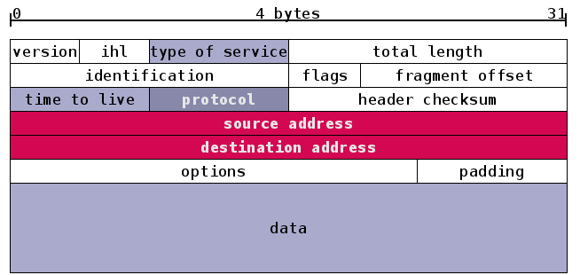
OSI layers
Network layer (unit: PACKAGE)
  routing(Connection and connectionless oriented services)
  transmission of packages from the source to the target computer,
  can provide : guaranteed delivery, correct sequence, fragmentation, avoiding of clogging,
  routing, r outers, routing algorithms,
  protocols : IP, ICMP, IPSec, IGMP, IPX

Slide 17
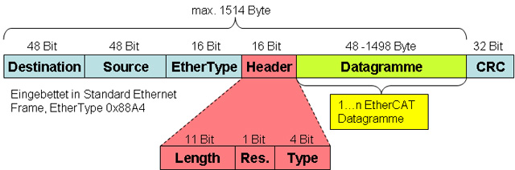
OSI layers
Data link layer (unit: FRAME)
  asynchronous / synchronous comunication,
  physical addressing : MAC address,
  detection and debugging of errors(parity, CRC, checksum)
  Control of the flux, framing
  protocols : Ethernet, PPP, Frame Relay

Slide 18

OSI layers
Physical layer
  transmission of bits through the channels(copper/optics/wireless),
  digital, analog media,
  UTP, optics, coaxial cables, wireless networks,
  RS-232, T1, E1, 802.11b/g, USB, Bluetooth

Slide 19
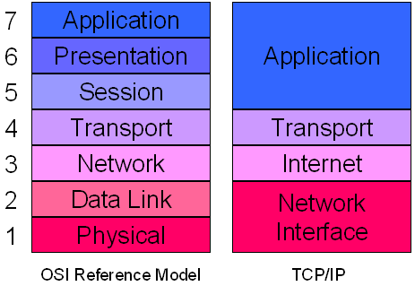
OSI model and model TCP/IP
Comparison of models :
  ISO OSI: de iure, theoretical, systematic, lack of implementations(products),
  TCP/IP: de facto, adjustable, unsystematic, many products

Slide 20
E ncapsulation
message
M
application
transport
network
data link
physical
segment
H_{t}
M
H_{t}
datagram
H_{n}
H_{t}
M
frame
H_{l}
H_{n}
H_{t}
M
data link
physical
switch
M
application
transport
network
Data link
physical
H_{t}
M
H_{n}
H_{t}
M
H_{n}
H_{t}
M
H_{l}
H_{n}
H_{t}
M
network
data link
physical
H_{n}
H_{t}
M
H_{l}
H_{n}
H_{t}
M
router

Slide 21
Network and transport layer: detail

Slide 22
Network layer functions
Network layer:
transportna layer: TCP, UDP
routing
Choice of the root
RIP, OSPF, BGP
Protocol IP
addressing
Shape of datagrams
working with packages
network
layer
functions
Intermediary
table
Protokol ICMP
signaling errors
additional notices
Data link layer
Physical layer

Slide 23
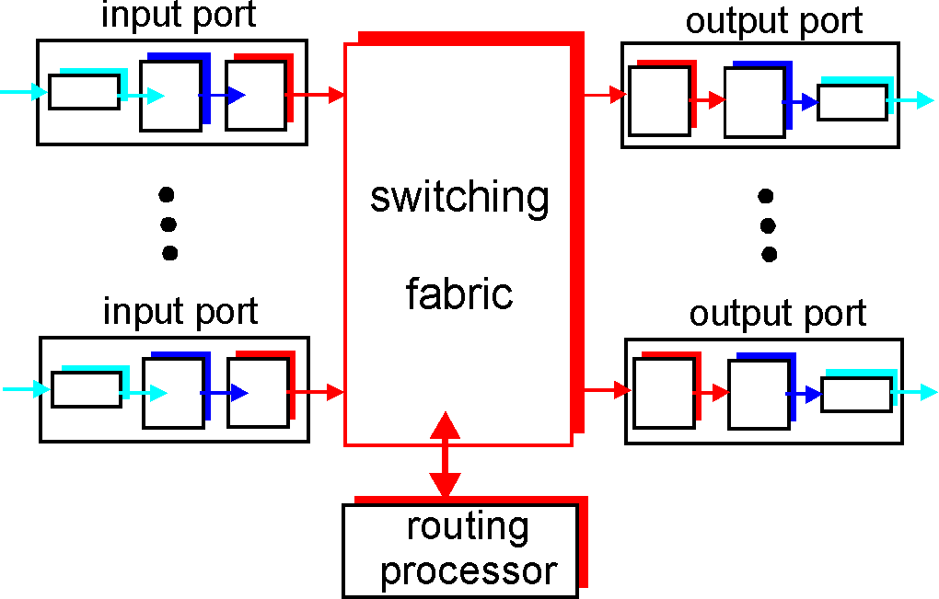
Routers
Network layer:
Use of routing protocols (RIP, OSPF, BGP)
forwarding datagrams between the input and output ports

Slide 24
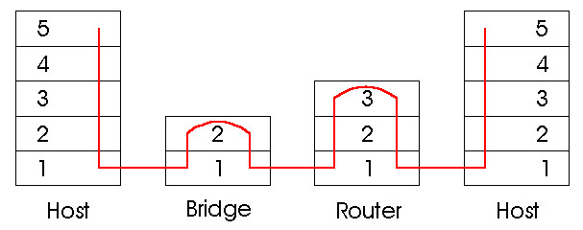
Comparison of active equipment
Network layer:
router:
  device that works on the NETWORK layer
  maintains arp tables, perform directional algorithms
switch:
  Device that works on DATA LINK layer,
  maintains the switching table, perform filtration and network detection
hub:
  device that operates at the PHYSICALlayer, it is no longer in use

Slide 25

IPv4
Network layer:
Protocol on network (3.) layer OSI model
IPv4 address is 32-bit address interface. Example :
11000001 00000010 00000001 01000010
or
193.2.1.66
Subnetwork is a crowd of IP addresses that are accessible among each other without the intercession of the router. Mask (32 bits) provides part of the IP address that represents the subnet address. example:
11111111 11111111 11110000 00000000 (255.255.255.240)
means that the first 20 bits of the IP address represents the network address and the remaining 12 bits are address of the interface.

Slide 26
Exercise!
Network layer:
The IP address of some interface and mask of the subnetwork are given
193.90.230.25 /20
  What is the address of the subnetwork?
  What is address of interface?

Slide 27
IPv6
Network layer:
Advantages :
  larger address space : 128 bites
  Quick direction and intercession and QoS is enabled by the format of the head, there is no fragmentation,
  The implementation of IPSec within IPv6 is obligatory
Address : consisting of 64 bits for the subnet ID + 64 bites for interface ID
0010000111011010 0000000011010011 0000000000000000 0010111100111011
0000001010101010 0000000011111111 1111111000101000 1001110001011010
Written hexadecimal, separated by colons
21DA:00D3:0000:0000:02AA:00FF:FE28:9C5A or(without leading zeros)
21DA:D3:0:0:2AA:FF:FE28:9C5A or(omit blocks of zeros)
21DA:D3::2AA:FF:FE28:9C5A

Slide 28
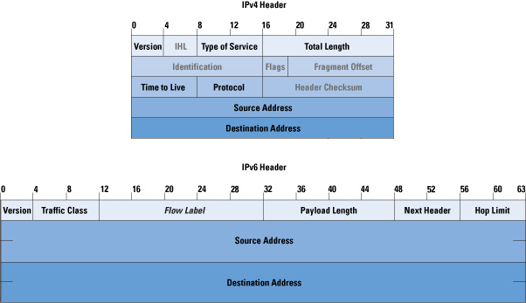
Comparison of IPv4 and IPv6
Network layer:

Slide 29

IPv6 - types of addressing
Network layer:
UNICAST:
addressing each network interface
MULTICAST:
addressing of a group of network interfaces, delivery to all interfaces in the crowd
ANYCAST:
is the address of the crowd of the interfaces, the delivery is performed to one of the interfaces of the crowd(the closest one?)
Each interface can have multiple addresses of various types.(BROADCAST addresses – in IPv6 they ore no longer there!)

Slide 30
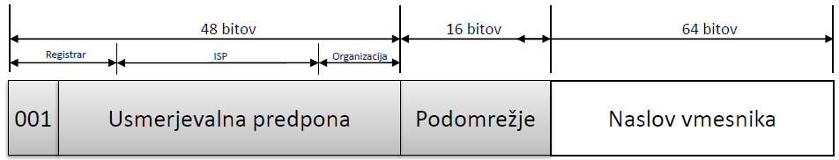
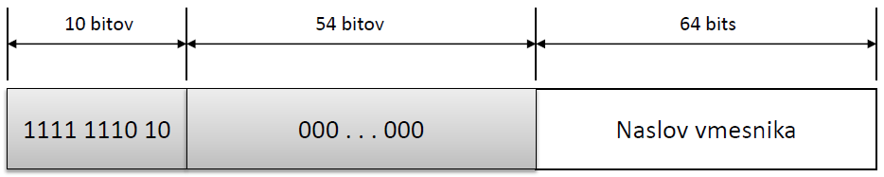
IPv6 - types of unicast addresses
Network layer:
1.) global unicast (= public addresses)
2.) specific addresses(localhost ::1, undefined 0::0, IPv4 addresses)
3.) link-local addresses(within 1 connection, adhoc network)
4.) site-local (Private addresses, within the org. they are not performed, FEC0::/10)
5.) unique-local (private addresses, allocated by the registrar, they're better structured, FC00::/7)
FE80::/64

Slide 31
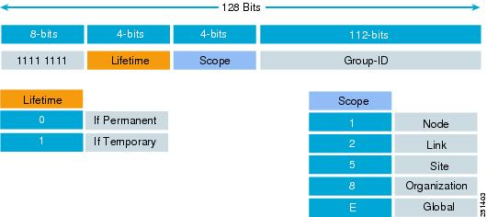
IPv6 – distribution (multicast)
Network layer:
1.) FF02::1 (link local: all interfaces)
2.) FF02::2 (link local all routers)
3.) address structure :

Slide 32
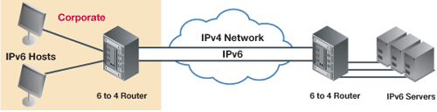
IPv6 in IPv4 networks
Network layer:
1.) dual-stack: routers known IPv4 and IPv6
2.) tunneling: IPv6 packet packed in one or more IPv4 packets as data.

Slide 33
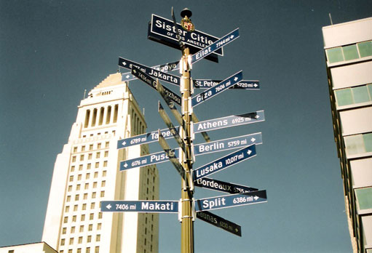
Routing
Network layer:
MODES
  static / dynamic (consideration of conditions in the network)
  centralized / distributed(according to the knowledge of the whole network status)
  one way / by multiple pathways
IMPLEMENTATION :
  With the distance vector(RIP, IGRP, EIGRP)
  according to the network status(OSPF, IS-IS)

Slide 34
Functionalities
Transport layer:
Task :
  Receiving a message from application
  Assembling segments in the message to the network layer
  Transferring to application layer
plug
  interface between the transport and application layer,
  We address the process with the IP number and the port number
  (www: 80, SMTP: 25, DNS: 53, POP3: 110).
process
process
plug
socket
connection
Internet
connection

Slide 35
Connection and connectionless oriented
Transport layer:
Connection and connectionless oriented comunication
  TCP and UDP, and other protocols
  establishment, transmission, demolition – connection
  Validation
  in the protocol(TCP)
  in the application(UDP)
  directly(ACK and NACK)
  indirectly(only ACK, we conclude according to the number of packages)
  Simultaneous confirmation: the next package is sent only after the receival of the confirmation
  Fluent sending: no waiting for the confirmation

Slide 36
TCP and UDP
Transport layer:

Slide 37
Application layer:
Classic services – client-server
  telnet, ssh; rdesktop
  ftp, sftp
  WWW in HTTP,
  SMTP, POP3, IMAP, MAPI
  DNS,
  SNMP, LDAP, RADIUS, ...
  ...

Slide 38
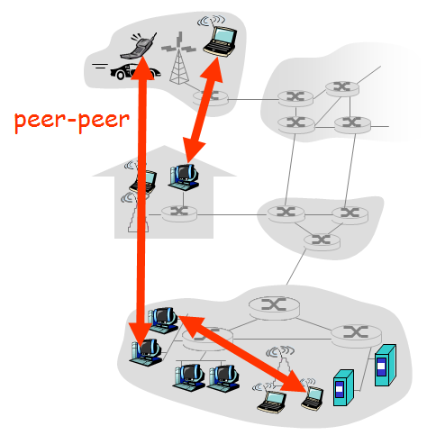
Application layer:
newer services– P2P:
  Communication of two random final systems
  servers are not constantly switched on,
  broken connections/ changes to IP addresses,
  examples: BitTorrent, Skype

Slide 39
From the past to the future
Network and transport layer:
Problem: lack of IPv4 addresses
  The efficiency of private address spaces
  NAT gateways - usually at the same time firewalls too
  simply in client-server systems
  In P2P we need a copy address in the outer world
In IPv6 NAT gateways are not required

Slide 40
An example of communication

Slide 41

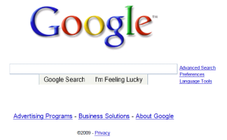
Example of communication: Web browsing
browser
DNS
server
Internet provider
68.80.0.0/13
faculty network
68.80.2.0/24
Web page
Web server
Google network
64.233.160.0/19
64.233.169.105

Slide 42
Example of communication: Web browsing
When it connects to the network, the laptop needs an IP address, and the data of connection and DNS server: It uses DHCP.
The request DHCP encapsulates: UDP -> IP -> 802.1 Ethernet
ethernet frame transmits(broadcast) itself to the network , it is received by the router, which carries out the DHCP server's task
DHCP server reads the content of DHCP request
DHCP
DHCP
UDP
IP
Eth
Phy
DHCP
DHCP
DHCP
DHCP
DHCP
UDP
IP
Eth
Phy
DHCP
DHCP
DHCP
DHCP
router
(uses DHCP)

Slide 43
Example of communication: Web browsing
DHCP answers to the client (laptop) with the DHCO ACK package, which contains its IP address and the addresses of the transition and DNS server
The answer encapsulates the DHCP server (router) and passes it on to the clienet which decapsulates.
The DHCP client receives the answer DHCP ACK
The result: The client is ready for communication
DHCP
DHCP
UDP
IP
Eth
Phy
DHCP
DHCP
DHCP
DHCP
DHCP
UDP
IP
Eth
Phy
DHCP
DHCP
DHCP
DHCP
router
(uses DHCP)

Slide 44
Example of communication: Web browsing
Before sending off the http request we need the IP of the server www.google.com: use DNS
Encapsulation of the DNS request: UDP ->IP -> Ethernet. We need MAC address of the router: use ARP
We send off the ARP request, the router answers with the ARP answer, which keeps its MAC address
The client now knows the MAC address of the gateway, which can send the DNS request to it.
DNS
DNS
UDP
IP
Eth
Phy
DNS
DNS
ARP query
ARP reply
Eth
Phy

Slide 45
Example of communication: Web browsing
The IP datagram with DNS request is passed on the router.
IP datagram is passed on the DNS server, which is in the network of internet provider (RIP, OSPF, IS-IS ali BGP),
DNS server decapsulates the request and sends to user the IP address of the network server www.gooogle.com
DNS
UDP
IP
Eth
Phy
DNS
DNS server
DNS
UDP
IP
Eth
Phy
DNS
DNS
DNS
DNS
DNS
DNS
DNS
DNS
network provider

Slide 46
Example of communication: Internet browsing
HTTP
HTTP
TCP
IP
Eth
Phy
To send the HTTP request, to the client first addresses the TCP plug of the web server
TCP SYN segment direct itself through the network to the web server
The web server answers with TCP SYNACK (confirmation of the handshake),
The TCP connection is now established!
SYNACK
SYN
SYNACK
SYN
SYNACK
SYN
SYN
TCP
IP
Eth
Phy
routing....
SYNACK
SYN
SYNACK
SYN
SYNACK
SYNACK
SYN
Web server

Slide 47
Example of communication: Internet browsing
HTTP
HTTP
TCP
IP
Eth
Phy
HTTP request is sent to the TCP plug of the web server,
IP datagram, which contains the internet request for the website www.google.com is directed to the web server
The internet server answers with HTTP REPLY, which contains the contents of the webpage
The IP datagram with the webpage is directed to the client,
WWW page is finnaly shown!
HTTP
HTTP
HTTP
HTTP
HTTP
HTTP
HTTP
TCP
IP
Eth
Phy
routing....
HTTP
HTTP
HTTP
HTTP
HTTP
Web server

Slide 48
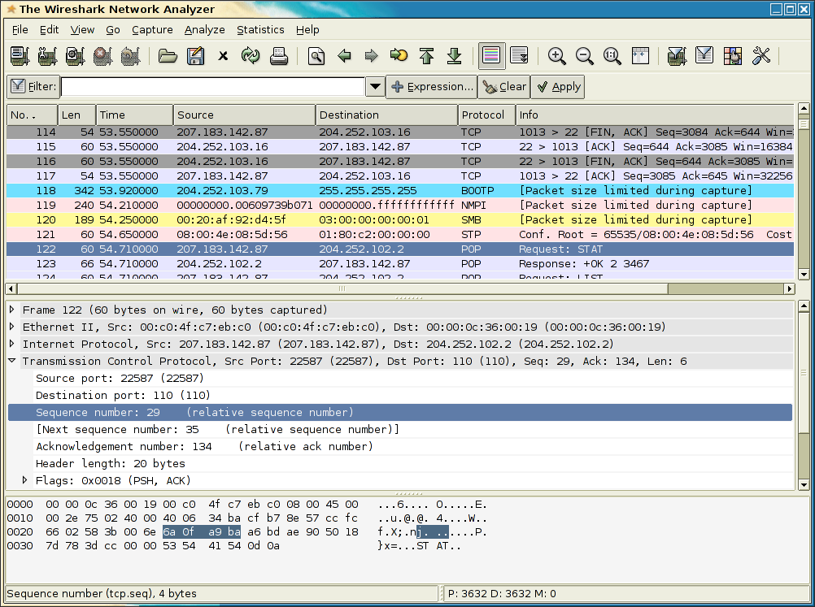
Capturing data from the network
Notes:
slika

Slide 49
Capturing data from the network: DHCP example
request
response
Message type: Boot Request (1)
Hardware type: Ethernet
Hardware address length: 6
Hops: 0
Transaction ID: 0x6b3a11b7
Seconds elapsed: 0
Bootp flags: 0x0000 (Unicast)
Client IP address: 0.0.0.0 (0.0.0.0)
Your (client) IP address: 0.0.0.0 (0.0.0.0)
Next server IP address: 0.0.0.0 (0.0.0.0)
Relay agent IP address: 0.0.0.0 (0.0.0.0)
Client MAC address: Wistron_23:68:8a (00:16:d3:23:68:8a)
Server host name not given
Boot file name not given
Magic cookie: (OK)
Option: (t=53,l=1) DHCP Message Type = DHCP Request
Option: (61) Client identifier
Length: 7; Value: 010016D323688A;
Hardware type: Ethernet
Client MAC address: Wistron_23:68:8a (00:16:d3:23:68:8a)
Option: (t=50,l=4) Requested IP Address = 192.168.1.101
Option: (t=12,l=5) Host Name = "nomad"
Option: (55) Parameter Request List
Length: 11; Value: 010F03062C2E2F1F21F92B
1 = Subnet Mask; 15 = Domain Name
3 = Router; 6 = Domain Name Server
44 = NetBIOS over TCP/IP Name Server
……
Message type: Boot Reply (2)
Hardware type: Ethernet
Hardware address length: 6
Hops: 0
Transaction ID: 0x6b3a11b7
Seconds elapsed: 0
Bootp flags: 0x0000 (Unicast)
Client IP address: 192.168.1.101 (192.168.1.101)
Your (client) IP address: 0.0.0.0 (0.0.0.0)
Next server IP address: 192.168.1.1 (192.168.1.1)
Relay agent IP address: 0.0.0.0 (0.0.0.0)
Client MAC address: Wistron_23:68:8a (00:16:d3:23:68:8a)
Server host name not given
Boot file name not given
Magic cookie: (OK)
Option: (t=53,l=1) DHCP Message Type = DHCP ACK
Option: (t=54,l=4) Server Identifier = 192.168.1.1
Option: (t=1,l=4) Subnet Mask = 255.255.255.0
Option: (t=3,l=4) Router = 192.168.1.1
Option: (6) Domain Name Server
Length: 12; Value: 445747E2445749F244574092;
IP Address: 68.87.71.226;
IP Address: 68.87.73.242;
IP Address: 68.87.64.146
Option: (t=15,l=20) Domain Name = "hsd1.ma.comcast.net."
Notes:
slika

Slide 50
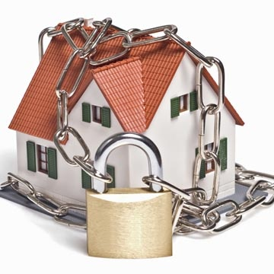
Network security

Slide 51
Network security
Is an area that :
  analyzes the potential attacks on systems,
  Plans the techniques of the defence from the attacks,
  Forms safe architectures, which are resistant to the invasions
The Internet wasnt’ buid considering the safety!
  First the vission of the internet was: “This was a group of people, thet trust each other and are connected to a common network”
  At the making of the protocol, the manufacturers made it with the methodology of ,, patching’’,
  The safety mechanisms should be considered at all layers of OSI model

Slide 52

How can the intruder harms the system?
There are many possible approaches and techniques!
  tapping : intercepting of messages,
  Active forging of messages in some communication,
  Theft the identity(impersonization): forges the original address or any other content of the package
  Taking-over the connection (hijacking): removes the real sender or receiver from the communication and takes-up his role
  Disabling of the service providence (denial of service): Disables the use of the regular service (ex. With overloading it)
Notes:
slika

Slide 53
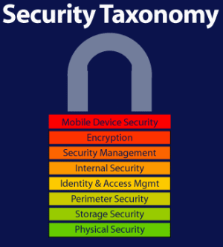
Security: ensure the reliability

Slide 54
Elements of safe communication:
Confidentiality– who is allowd to read? (encryption)
Authentication – prove that it is really you (identification, tell who you are, without proof)
Availability and control of acess – prevention of illegitimate use of sources (authorization – finding out if you can do something, accounting – who used what)
Integritiy of the message – was it changed during the transmission?
Disabling of disclaiming (nonrepudiation) you really sent/received it
Practice showed:
  firewalls, intrusion detection systems,
Safety on application, transport, network and data link layer

Slide 55
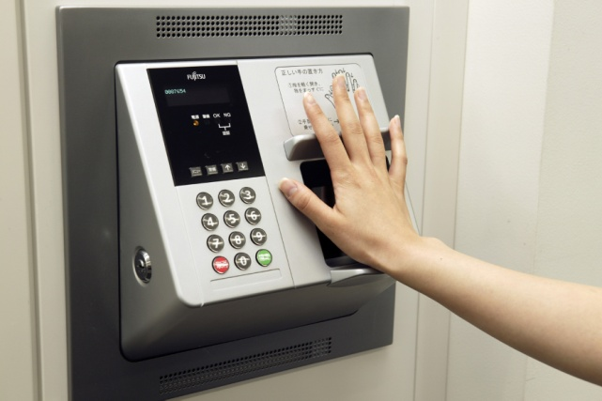
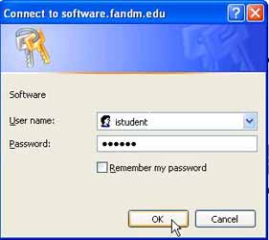
Authentication
We make sure of the true identity of the person – co-speaker.
APPROACHES :
Challenge-response,
We trust the third side,
Authentication with the system of public keys

Slide 56
Confidentiality of messages: crypting (concealing) the content
This is a form of defence from passive intruders (eavesdroppers) and active intruders (forgers).
We encrypt message P with the E key – we get cryptogram E(P). We process the cryptogram E(P) into the original for with the D() key and what we get is original message D(E(P))-P.
Different methods::
Substitution (change of symbols) / transposition (sequence of the symbols)
Symmetric (E=D, ex. DES, AES) / asymmetric(E≠D , ex. RSA, ECC)

Slide 57

Types of cryptography
Cryptography that uses keys:
  Algorithm is usually known to everybody,
  Only the keys are secretive
  encryption : hiding the content
  Crypto-analysis(,,crashing’’ of the code)
Cryptography with public key
  E() ≠ D(): two keys– public and private
Symmetric cryptography
  E() = D(): onlyone key
Thickening functions – they are not cryptography. Don’t use keys. How can they be useful?
Notes:
slika

Slide 58
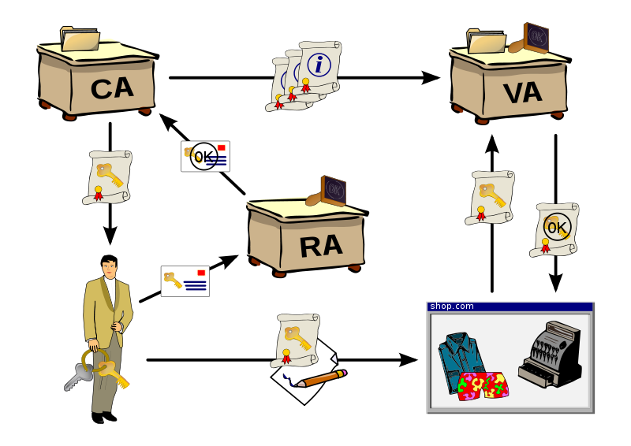
Cryptography with public keys
PKI (Public Key Infrastructure) is a system that defines the production, management, distribution, saving and cancelling of digital certificates.
Users are authenticated with the help of public keys, which are certified by the certificate authority – CA)

Slide 59
Cryptography with public keys
The algorithms for encrypting with public keys are asymmetric, E=encryption key, D=decryption key E≠D
Key E and D must satisfy the following requirements encryption of message S :
  D(E(S)) = D(E(S)) = S
  From known E and E(S) it must be impossible to figure out D
  From E it must be very hard / impossible to figure out D
The most known algorithm is RSA(Rivest, Shamir, Adelman). RSA uses big prime numbers to define D and E; the procedure of encrypting/decrypting is the same as calculating the mod of divide by the product of these two numbers.
Problem: distribution of keys, slowness
.
Notes:
slika

Slide 60


Cryptography with public keys
E_{B}
Branko’s public key E_{B}
D_{B}
Branko’s private key D_{B}
Message
S
Encryption
Algorithm
Cryptogram
Decryption
algorithm
Readable message
E_{B}(S)
S = D_{B}(E_{B}(S))

Slide 61
Why is RSA safe?
Let’s say that we know the public key of some person (defined by a pair of numbers (n, e)). To figure out the private key we have to know the denominators of the number n. But searching the denominators of a large number is hard or impossible with current computational capacities.
How to find big enough prime numbers?
  We carry out “guessing” for several times: we generate a large number and test it, if it is a prime number,
To test the prime numbers there exist efficient algorithms.
Notes:
slika

Slide 62
Integrity
The integrity of users : Proves who sent the message and that the message is read only by the real receiver. We encrypt the message S, which is sent by A to B
E_{B}(D_{A}(S)) = XXX
and decrypt: D_{B}(XXX) = D_{B}(E_{B}(D_{A}(S))) = D_{A}(S); E_{A}(D_{A}(S)) = S
The integrity of message: proves that the message (also not crypted!) hasn’t been changed. To achieve that we use thickening functions, which calculate the signature of the message SIG (S). We sign this value with the mechanism of electronic signing
D_{A}(sig(S)) = sss
And we send SSS along with the (encrypted) original message xxx: (xxx, sss). The receiver decrypts XXX into S, recalculates the sig (S) and checks is SSS=sig(S)

Slide 63
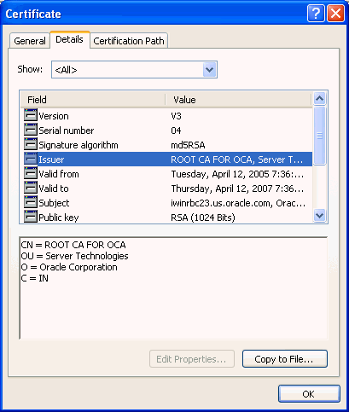
Certificates
  System PKI includes cetification authorities, which issue, save and cancell the certificates.
Certificates are defined by the standard X.509 (RFC 2459)
The certificate contains:
  The name of the Issuer,
  The name of the person, the address, the domain name and other personal information,
  The owners public key,
  The digital signature(signed by the private key of the issuer)
Notes:
slika

Slide 64
Next time we move on!
connect a computer to to the network
boot your computer : protocols DHCP and BOOTP
architecture server– client,
protocol: operation, its functions,
protocol trace

