Slide 1
Communication protocols and network safety
Network control and management

Slide 2
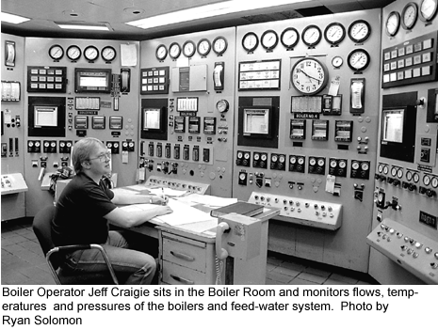
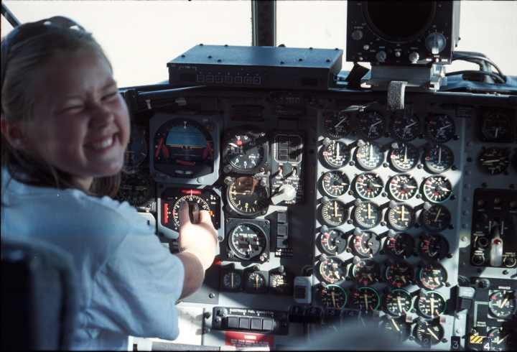
Network management
What is network management??
Why is it needed?

Slide 3
Mani Subramanian, Network Management: An introduction to principles and practice, Addison Wesley Longman, 2000

Slide 4
Network management
Growth of internet and local networks caused small networks to connect into one LARGE infrastructure. With it increased the need for SISTEMATIC management of hardware and software components of this system. Frequent questions:
Which resources are available in the network?
How much traffic is traveling through a certain network equipment?
Who uses network connections that cause their director to receive his email too slowly?
Why cant I send data to a certain computer?
Definition: Managing a network involves deployment, integration and coordination of hardware, software and human resources for the purpose of observation, testing, configuration, analysis and control of network resources, for which we want to provide operation in real-time (or operation with appropriate quality - QoS ) at an affordable price.

Slide 5
Examples of management activities
detection of errors on the computer or router interface: administrator can be notified by the software that the interface has a problem (even before it fails! )
controlling computer operation and network analysis
controlling network traffic: administrator can observe frequent communications and direction finding bottlenecks,
detection of rapid changes in routing tables: this phenomenon may indicate problems with routing or error in the router,
controlling levels of service provision: network service providers are able to guarantee availability, latency and certain service throughput; administrator can measure and verify,
intrusion detection: administrator can be notified if certain traffic arrives from suspicious sources; he can also detect a particular type of traffic (eg, a set of SYN packets intended for one single interface)

Slide 6
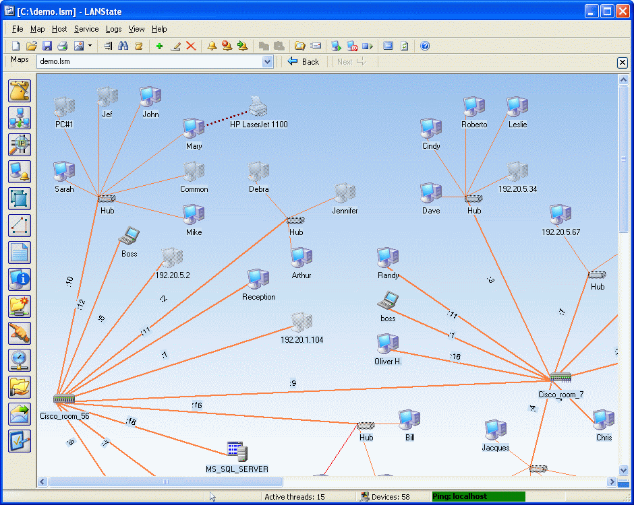
Examples of activities
controlling computer operation and network analysis (detection of network topology)

Slide 7
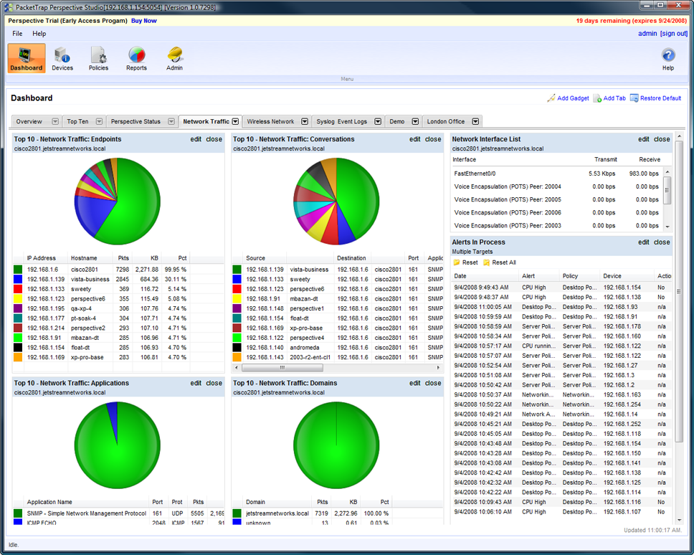
Examples of activities
controlling network traffic (profiling)

Slide 8
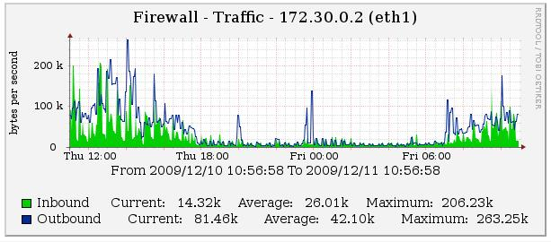
Examples of activities
controlling the level of service provision ( data flow)

Slide 9
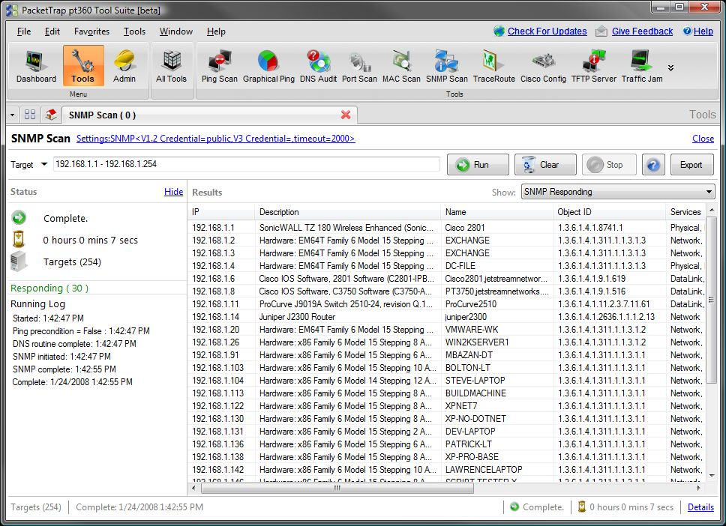
Examples of activities
controlling computer operation and network analysis (list of IP addresses)

Slide 10
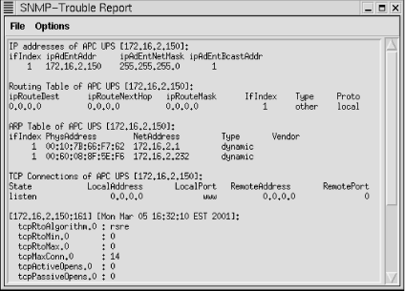
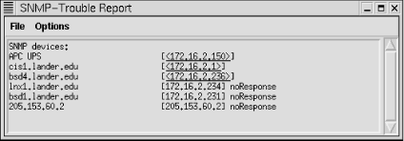
Examples of activities
controlling computer operation and network analysis (diagnostics and fault detection)

Slide 11
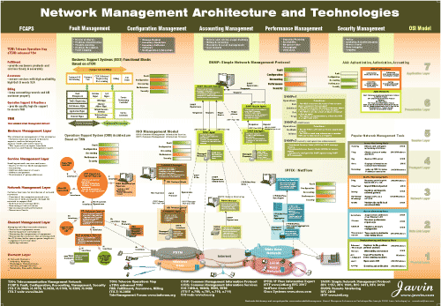
Areas of management

Slide 12
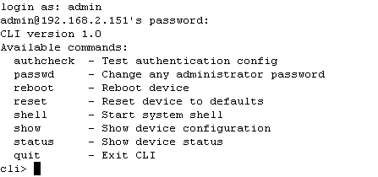
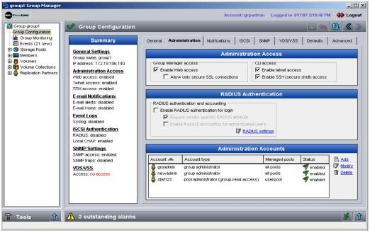
Management software
CLI (Command Line Interface):
  precise control,
  possibility of using command lines (batch),
  problem of syntax knowledge, storage configurations difficulty, less general – specific to a particular network equipment
GUI (Graphical User Interface) applications:
  visually beautiful, provides an overview of the whole system/network, uses its own (concise) protocol to communicate with a device – speed,
  we loose the ability of readable configuration storage (binary), it can mask all configuration options

Slide 13
Management infrastructure
Management system components:
operator = entity (application + human), BOSS,
controlled device (contains NMA agent and controlled OBJECTS containing controlled PARAMETERS),
management protocol (eg, SNMP).
agent
data
operator
data
controlled device
management
protocol
agent
data
controlled device
agent
agent
data
data
controlled device
controlled device

Slide 14
History: management protocols
OSI CMIP
Common Management Information Protocol,
ITU-T X.700 standard created in 1980: first management standard,
standardized too slow, never implemented in practice
SNMP
Simple Network Management Protocol,
IETF standard
very simple first version,
rapid deployment and expansion in practice
currently: SNMP V3 (added safety!),
de facto standard for network management.

Slide 15
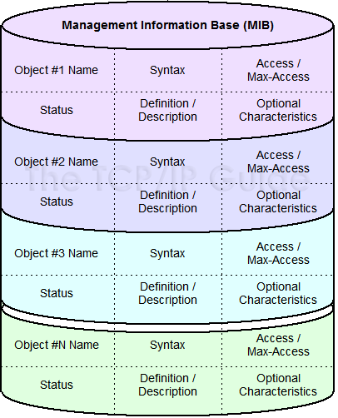
Management data
For each type of controlled device we have our own MIB (Management Information Base) where information regarding managed OBJECTS and their PARAMETERS is stored.
The operator has his own MDB (Management Database), where he stores concrete values for MIB objects/parameters for each managed device.
A language that defines how OBJECTS and PARAMETERS are written is needed: SMI (Structure of Management Information)

Slide 16
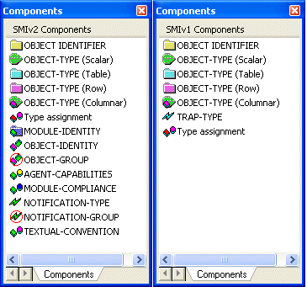
SMI: language for defining objects in MIB
basic data types: INTEGER, Integer32,Unsigned32, OCTET STRING, OBJECT IDENTIFIED, IPaddress, Counter32, Counter64, Gauge32, Time Ticks, Opaque
structured data types:
  OBJECT-TYPE
  MODULE-TYPE

Slide 17
SMI: object definition
object definition: it contains data type, status, and meaning description
  ipSystemStatsInDelivers OBJECT TYPE
  SYNTAX Counter32
  MAX-ACCESS read-only
  STATUS current
  DESCRIPTION
  “The total number of input datagrams successfully
  delivered to IP user-protocols (including ICMP)”
  ::= { ip 9}

Slide 18
SMI: grouping objects into modules
MODULE: content-related group of objects
  ipMIB MODULE-IDENTITY
  LAST-UPDATED “941101000Z”
  ORGANZATION “IETF SNPv2 Working Group”
  CONTACT-INFO “ Keith McCloghrie ……”
  DESCRIPTION
  “The MIB module for managing IP and ICMP implementations,
  but excluding their management of IP routes.”
  REVISION “019331000Z”
  ::= {mib-2 48}
MODULE
OBJECT TYPE:
OBJECT TYPE:
OBJECT TYPE:

Slide 19
MIB modules: standardization
MODULES:
  “standardized”,
  vendor-specific
IETF (Internet Engineering Task Force) responsible for standardization of MIB modules for routers, interfaces and other network equipment
  -> naming (labeling) of standard components is required!
  ISO ASN.1 (Abstract Syntax Notation 1) designation is used

Slide 20
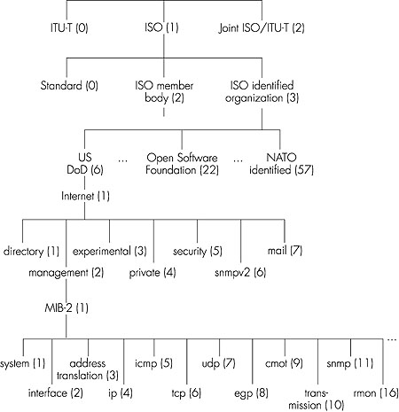
MIB modules: standardization
standardization companies
hierarchical arrangement of objects with tree identifiers
each object has a name consisting of a sequence of number identifiers from the tree root to a leaf
  example: 1.3.6.1.2.1.7 means UDP protocol
challenge: what is on the second and third level of the tree identifiers?
controlled objects/parameters

Slide 21
MIB: naming, example
Example:
  1.3.6.1.2.1.7 provides protocol UDP
  1.3.6.1.2.1.7.* provides the observed parameters of the UDP protocol
1.3.6.1.2.1.7.1
ISO
ISO-ident. Org.
US DoD
Internet
udpInDatagrams
UDP
MIB2
management

Slide 22
MIB: naming, example
Object ID Name Type Comments
1.3.6.1.2.1.7.1 UDPInDatagrams Counter32 total # datagrams delivered
at this node
1.3.6.1.2.1.7.2 UDPNoPorts Counter32 # underliverable datagrams
no app at portl
1.3.6.1.2.1.7.3 UDInErrors Counter32 # undeliverable datagrams
all other reasons
1.3.6.1.2.1.7.4 UDPOutDatagrams Counter32 # datagrams sent
1.3.6.1.2.1.7.5 udpTable SEQUENCE one entry for each port
in use by app, gives port #
and IP address

Slide 23
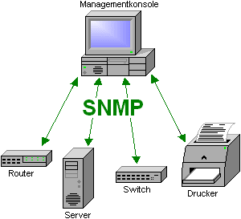
SNMP protocol

Slide 24
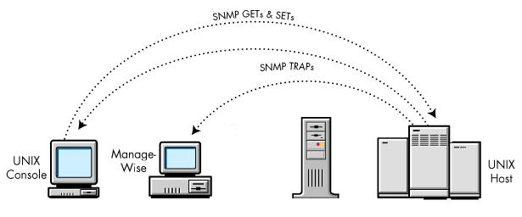
SNMP protocol
Simple Network Management Protokol
protocol for exchanging control information between the operator and monitored objects.
information of controlled objects is being transferred between controlled equipment and the operator with accordance to the MIB definition.
Two operating modes:
  request-response: reading and setting values
  trap message: the device informs the operator about the event

Slide 25
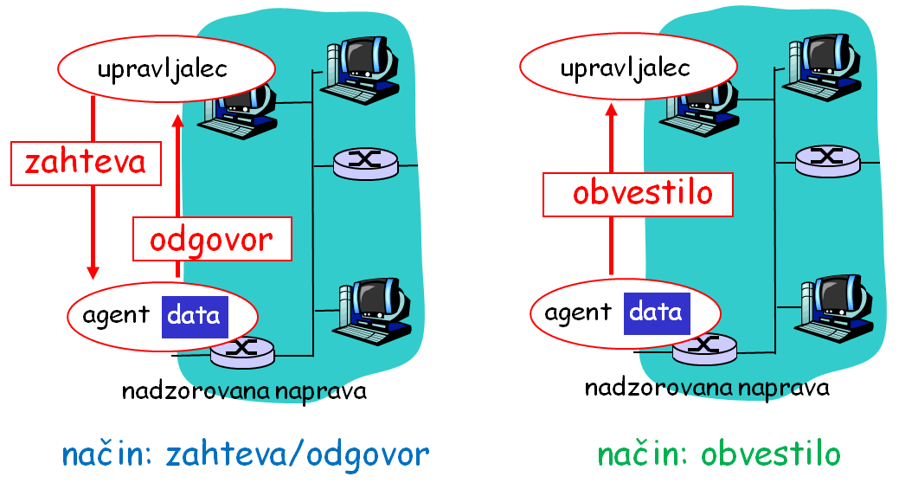
SNMP protocol
two operating modes

Slide 26
SNMP: message types
Message | Direction | Meaning
GetRequest GetNextRequest GetBulkRequest | operator -> agent | "give me information" (value, next in list, data block-table)
InformRequest | operator -> operator | mutual transmission of values from MIB
SetRequest | operator -> agent | set the value in MIB
Response | agent -> operator | "here is the value", response to Request
Trap | agent -> operator | notification to operator about the incident

Slide 27
SNMP protocol
    challenge: find RFC documents about SNMP and find differences between them
SNMP uses UDP transport protocol
  port 161: “general" SNMP port, where devices listen for SNMP requests
  port 162: notifications port (traps), usually where systems listen for control and management of a network
SNMP implementation must address the following problems:
  package size: SNMP packets can contain extensive information about objects in MIB, UDP on the other hand has an upper limit for the size of the segment (TCP doesn't),
  resending: since UDP is used, delivery and confirmation is not guaranteed. Delivery control should therefore be addressed at a higher OSI level.
  problem with lost notifications: if a notification is lost during transfer, the sender doesn't know anything about it; the recipient also doesn't receive it
    challenge: how does SNMPv3 address these problems?

Slide 28
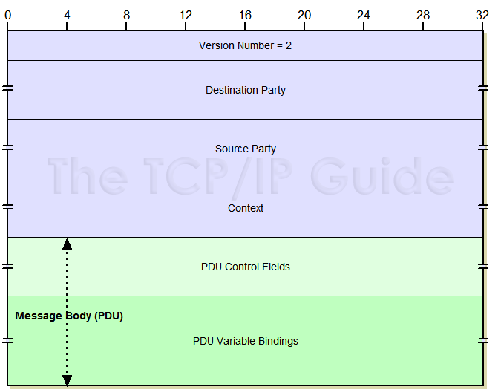
SNMP: message form
head
PDU( protocol data unit )
Verzija | SNMP protocol version
Destination Party | Recipient identifier
Source Party | Sender identifier
Context | Defines a set of MIB objects that entity can obtain
PDU | Main content of the message, data from the MIB

Slide 29
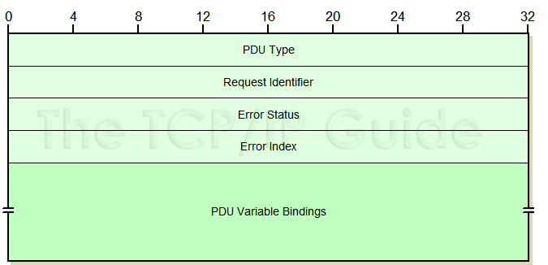
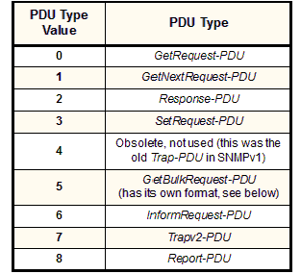
SNMP: request-response message type
Request ID | Integer | Number that relates a request with response. A device that answers, when it stores into a package of Response type. It is also used for artificial control of received packets ( SNMP uses UDP transport protocol which doesn't provide this!)
Error Status | Integer | Error code which agent forwards with a Response type package. Value 0 means that there was no error and any other value defines a specific error. challenge: look at different types of errors
Error Index | Integer | If there was an error, this value is the index of an object that caused the error.
Variable Bindings | Variable | Name-value pairs, that define objects and their values.

Slide 30
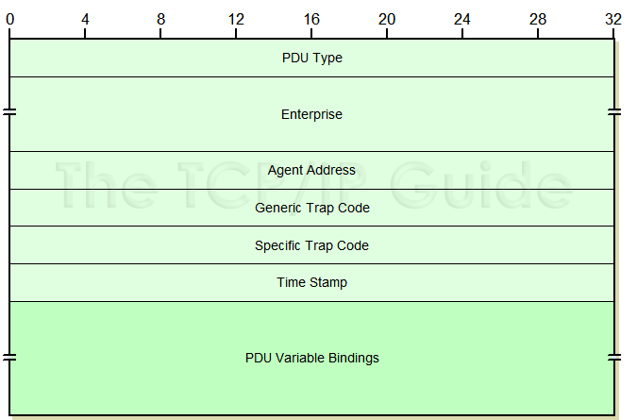
SNMP: notification type message
PDU Type | Integer | Value that defines the type of message. Value 4/7 means notification (trap message).
Enterprise | Sequence of Integer | Group identifier.
Agent Address | Network Address | IP address of the agent that generated a notification.
Generic Trap Code | Integer | General error code – from predefined coding.
Specific Trap Code | Integer | Specific error code (depends on the manufacturer equipment)
Time Stamp | TimeTicks | Time since the last time the device initialized. Used for recording.
Variable Bindings | Variable | Name-value pairs that define objects and their values.

Slide 31
Verzije SNMP
SNMPv1
  defined in the late 80s
  turned out to be too weak to implement all the necessary requirements ( limited in composition of PDU)
SNMPv2
  improved SNMPv1 in speed (added GetBulkRequest),safety (but too complex implementation), communication between operators,
  RFC 1901, RFC 2578
  uses SMIv2 (improved standard for structuring information)
SNMPv3
  improved SNMPv2 – added safety mechanisms,
  enables cryptography, assures safety, integrity, authentication
  also uses SMIv2

Slide 32
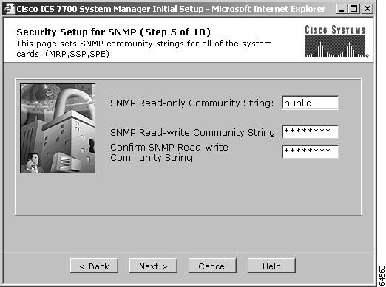
Safety
Why is it important?
  SetRequest adjusts controlled devices. Request can be sent at any time?
    challenge: find 3 more examples of other possible SNMP abuses.
Safety elements are only introduced in SNMPv3, previous version did not have it. SNMPv3 has built-in security based on user names
    challenge: read RFC 3414 and find information about which kind of intrusions does SNMPv3 enable protection against. How about Denial of Service attacks and eavesdropping on traffic?

Slide 33

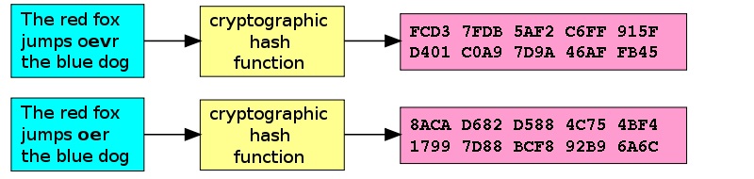
SNMP. Safety mechanisms
packets content encryption (PDU): DES is used (exchange of keys is required prior to use)
integrity: used for message densification with a key which is known to both sender and recipient. With examination of sent densified value we have control over active message counterfeiting

Slide 34
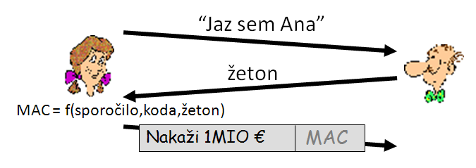
SNMP: Safety mechanisms
protection against repetition of already completed communication (replay attack): use of one-time chips (nonce, žeton): the sender must encode the message according to the nonce which is defined by the receiver (this is usually the number of system start-ups and the time passed since the last start-up)

Slide 35
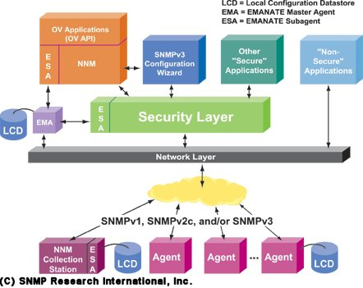
SNMP: Safety mechanisms
access control: access control based on user names. The user rights specify which users can read/change which information. User data is stored in Local Configuration DataStore database which also contains controlled objects s SNMP!
    challenge: examine RFC 3415. What is a View-based Access Control Model Configuration MIB?

Slide 36
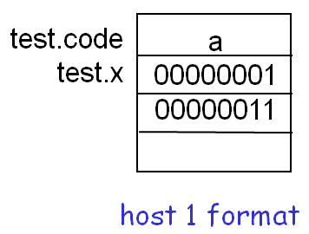
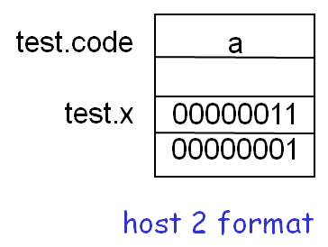
Encoding PDU content
How to encode packet content so that it is understood on all platforms (different data types are of different lengths, thick/thin end)?
we need a uniform coding or some demonstration level of this data
  ASN.1 standard in addition to data types also defines encoding standards.
  we will see that TLV notation is used for presentation of these operators.
test.x = 256;
test.code=‘a’
How to make this transfer?

Slide 37



Encoding PDU content
Similar problem:
teenager
Hmmm???
Hmmm???
grandma
This is absolutely groovy!

Slide 38
Encoding PDU content
Similar problem:
teenager
Aha!!!
Aha!!!
grandma
Straight-forward sweet!
Cool!
This rocks!
This is absolutely groovy!
Pleasant!
Pleasant!
Presentation service
Presentation service
Presentation service

Slide 39
Presentation service: possible solutions
Sender accounts the data form used by the recipient: he converts data into the correct form for recipient and only then sends it.
sender sends data in his own form, precipient converts into his own form
Sender converts into independent form and then sends. Recipient transforms independent form into his own.
    challenge: what are advantages and disadvantages of these three approaches?
ASN.1 uses the (3). third solution(independent form).
BER rules are used when writing types (Binary Encoding Rules). They define the recording of data according to TLV principle (Type, Length, Value).

Slide 40
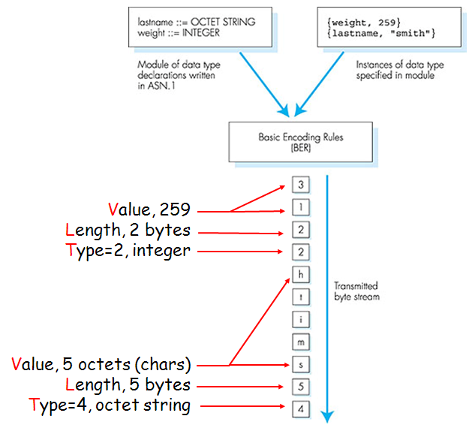
Example of BER encoding according to TLV principle
Basic ASN.1 data type | Type No. | Use
BOOLEAN | 1 | Model logical, two-state variable values
INTEGER | 2 | Model integer variable values
BIT STRING | 3 | Model binary data of arbitrary length
OCTET STRING | 4 | Model binary data whose length is a multiple of eight
NULL | 5 | Indicate effective absence of a sequence element
OBJECT IDENTIFIER | 6 | Name information objects
REAL | 9 | Model real variable values
ENUMERATED | 10 | Model values of variables with at least three states
CHARACTER STRING | * | Models values that are strings of characters from a specified character set

Slide 41
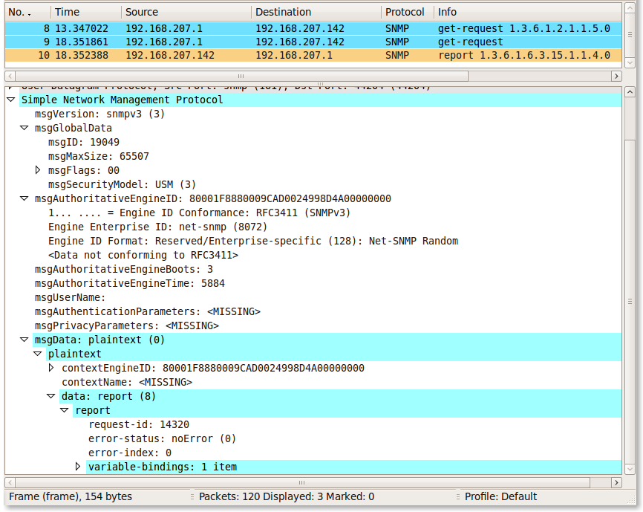
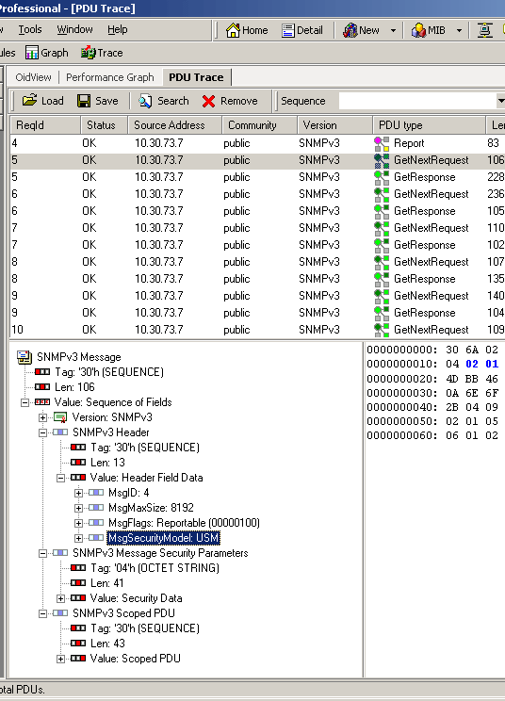
SNMP package capture

Slide 42
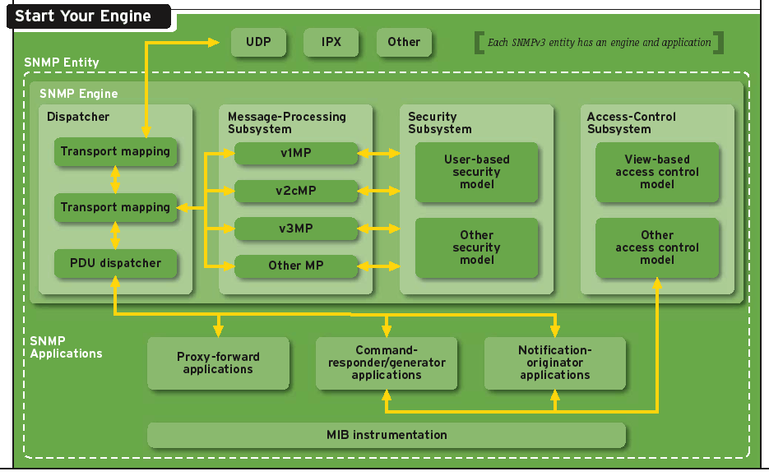
SNMP program structure

Slide 43
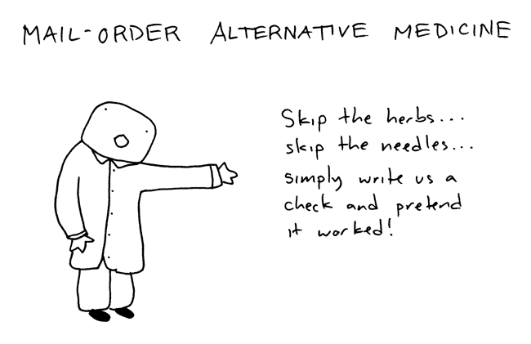
Other monitoring approaches

Slide 44
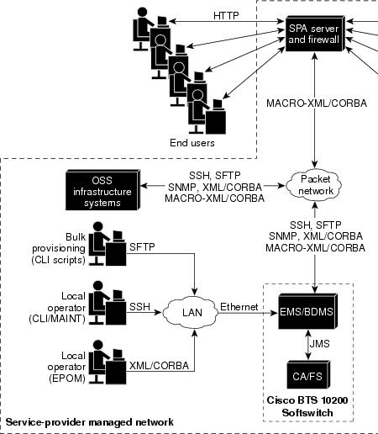
Alternative boutique solutions
XML & SOAP (application level): XML enables graphic and hierarchical way of encoding data which represent elements and content of controlled objects in the network. SOAP is a simple protocol that enables exchange of XML documents in the network.
  easy reading and understanding of content on the receiver side.
  large overhead compared to binary data encoding
CORBA (Common Object Request Broker Architecture) (application level): architecture that defines inter-utility of objects of different programming languages and on different architectures.
protocol combination!

Slide 45
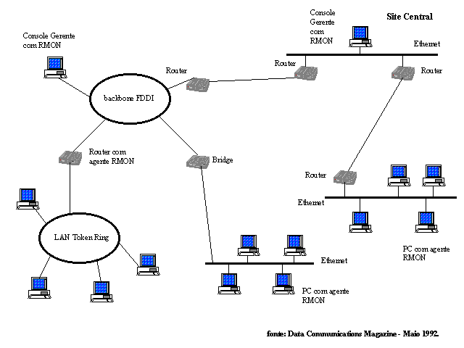
Event-driven monitoring
RMON (Remote Monitoring) (additional mechanism): Classical SNMP can control the network from a control station. RMON collects and analyses measures locally and sends the results to a remote control station. It has it's own MIB with extensions for different media types.
  every RMON agent is responsible for local control,
  sending already completed analysis reduces SNMP traffic between sub-networks
  It isn't necessary that agents are always visible from the central control system side.
  longer establishment and installation time of system is required.

Slide 46
Homework
Assignment for additional points with homework’s:
  Read RFC 789 which describes a known ARPAnet network failure which happened in 1980.
  How could the network failure be avoided or it’s recovery time improved if the network administrators would have today’s tool for network management and control at their disposal?

Slide 47
Next time we are moving on!
traffic for applications in real time!

