Slide 1
Communication protocols and network security
Security elements: IPsec, SSL and infrastructure

Slide 2
IPSec
IP security protocol (security on the network layer)
used to secure the link between two entities, used for VPN (virtual private network)!
Security on network layer:
  Hide all types of data
  (TCP segment, UDP segment, ICMP message, OSPF message etc.)
  Ensuring source authentication
  Integrity of data before the change
  Protection from re-establishing communication
RFC 2411: review of mechanisms and IPSec operation

Slide 3
Virtual Private Network(VPN)
Companies on different geographic locations want high communication security . Solutions:
  Establishing a PRIVATE network: the company builds its own network completely separate from the Internet (expensive establishment and management – routers, links, infrastructure needed !)
  The company establish a VIRTUAL PRIVATE network (VNP) with the infrastructure of the public network:
    Data on local (private) parts of the network is transmitted normally (IP),
    Data sent on public parts of the network is protected (IPSec)

Slide 4
VPN: example
IP
header
IPsec
header
Data to be
SECURED
Computer with IPSec
Public network
Worker on field
IP
header
IPsec
header
Data to be
SECURED
IP
header
IPsec
header
Data to be
SECURED
Router with
IPv4 and IPsec
Router with
IPv4 and IPsec
IP
header
data
IP
header
data
Main office
Branch office

Slide 5
Pisec implementation
IPSec mechanism offers two protocols for protection:
  AH - Authentication Header
    ensures source authentication and data integrity
  ESP - Encapsulation Security Payload
    ensures source authentication, data integrity AND confidentiality
For each way of the IPSec communication it needs to be established a SA (Security Association)
  example: the main and branch offices are using two-way communication. The main office also uses two-way communication with n workers on the field. How many SA they need to establish?
2 + 2n

Slide 6
Establishing SA
200.168.1.100
193.68.2.23
SA
IPsec
IPsec
Router has the SAD database(Security Association Database) where it keeps data about SA:
  32 bit ID SA, called SPI (Security Parameter Index)
  Source and destination IP SA
  Type of encryption(e.g .3DES) and key
  Type of integrity test(e.g. HMAC/MD5)
  Authentication key

Slide 7
2 ways of communication
transport mode – implemented between the end-users (computer interfaces), protects protocol‘s upper layers. Transparently to the interface, it encrypts only data in the package.
tunnel mode – Transparent to the end-user, router-router or router-user. It encrypts data and header.
Transport mode with AH | Transport mode with ESP
Tunnel mode with AH | Tunnel mode with ESP
Most common!

Slide 8
IPsec Transport Mode
IPsec
IPsec
IPsec travels between end systems
We protect only the upper layers

Slide 9
IPsec – tunneling mode
IPsec
IPsec
IPsec
IPsec
IPsec is used at the end routers
for customers is not necessarily to implement IPsec

Slide 10
IPsec datagram: tunnel mode and ESP
Let's look at how the most common IPsec usage works
Original data:
original
IP header
original IP
data

Slide 11
IPsec datagram: tunnel mode and ESP
The ESP header is added to the end of the datagram (the fill is needed for block coding, next header is a protocol, contained in the data)
Result is encrypted (algorithm and key define SA!)
kriptirano
original
IP header
original IP
data
ESP
rep
padding
pad
length
next
header

Slide 12
IPsec datagram: tunnel mode in ESP
ESP header is added: result is "enchilada"
(SPI - index SA, which is used to determine the setting, Seq # - protection against recurrence of communication)
"enchilada"
encrypted
ESP
header
original
IP header
Original IP
data
ESP
rep
SPI
Seq
#
padding
pad
length
next
header

Slide 13
IPsec datagram: tunnel mode in ESP
ESP auth field is added, which is the calculated hash value of the whole "enchilada". Algorithm and key set the SA.
"enchilada"
encrypted
ESP
header
original
IP header
Original IP
data
ESP
rep
ESP
auth
SPI
Seq
#
padding
pad
length
next
header

Slide 14
IPsec datagram: tunnel mode in ESP
New IP header is built, which is added befor the data
A new IP packet is created, which is sent normally over the network
"enchilada"
encrypted
New IP
header
ESP
header
Original IP
header
Original IP
data
ESP
rep
ESP
auth
SPI
Seq
#
padding
pad
length
next
header
header
DATA

Slide 15
IPsec datagram: tunnel mode in ESP
What is in the new packet header?
  protocol = 50 (means, that the data is ESP)
  IPsec takes place between the source and destination IP nodes (routers R1 and R2)
What does the receiver do(R2)?
  from SPI in the packet header takes the data about SA, checks MAC enchilada, checks Seq#, decrypts enchilada, removes the fill, extracts the data, sends to the target computer
200.168.1.100
193.68.2.23
SA
R1
R2
172.16.1/24
172.16.2/24

Slide 16
How to choose the datagrams for IPsec protection?
This is defined by the Security Policy Database (SPD): it definesif the datagram should be protected based on the source IP, destination IP and type of protocol
Defines which SA should be used
SPD defines “WHAT” to do with the datagram
SAD defines „HOW" to do it!

Slide 17
What level of protection does the Ipsec offer?
Let`s say that Janez is our man-in-the-middle between R1 and R2. Janez doesn`t know the keys. What can he do?
  Can he see the datagram content, source, destination, protocol, port?
  Can he change bits in the packet?
  Can he send in the name of R1?
  Can he repeat the communication?

Slide 18
Protocol IKE
IKE (Internet Key Exchange), protocol for key exchange over the internet
With IPsec we need to establish the SA between clients, for example:
        Example of an established SA:
          SPI: 12345
          Source IP: 200.168.1.100
          Dest IP: 193.68.2.23
          Protocol: ESP
          Encryption algorithm: 3DES-cbc
          HMAC algorithm: MD5
          Encryption key: 0x7aeaca…
          HMAC key:0xc0291f…
Specifying the SA by hand is impractical and time-consuming: it needs to be set for every way of communication and for every client pair!
Solution: IPsec IKE protocol

Slide 19
IKE has 2 fases
IKE uses PKI or PSK (pre-shared key) for client authenthication. It has two fases:
  Fase 1: Establish a two-way IKE SA
    IKE SA is a separated SA from IPsec SA, which is used only for key exchange (it is also called ISAKMP SA)
    in IKE SA the key is established to protect further communications of key exchange(authenthication is performed with PSK, PKI or signature)
    Two ways: Aggressive mode (shorter, but it reveals the identity of the client) and Main mode (longer, hide identity)
  Fase 2: IKE generates keys for other services like Ipsec for example. Therefore IPsec SA is established:
    Only way: Quick Mode

Slide 20
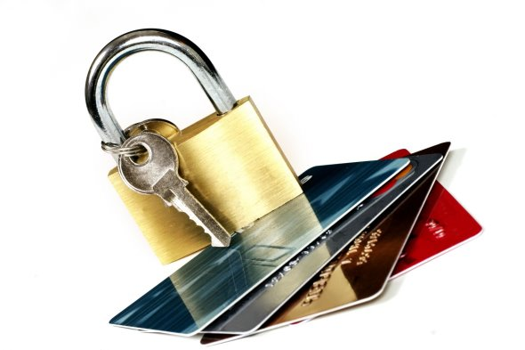
SSL

Slide 21
SSL: Secure Sockets Layer
Widely used security protocol
  supported in almost all browsers and on all servers (https)
  Using SSL over 10 billion dollars of purchases are made annually
Developed by Netscape in 1993
Several types
  TLS: transport layer security, RFC 2246
Ensures confidentiality, integrity, authentication
Developing objectives:
  use in online transactions
  concealment of information (especially credit card numbers)
  web server authentication
  client authentication
  minimize the efforts in carrying out the purchase of other vendor

Slide 22
SSL and TCP/IP
Accessible to all TCP applications over SSL API
Application
Application
SSL
TCP
TCP
IP
IP
Common application
Applocation withSSL

Slide 23
SSL design
We could design it based on PKI encryption (encryption with the public key of the recipient, sender's private key, use of hash functions), but...
We want to send streams of BYTES and interactive data, not static messages,
For one link we want to have a MULTITUDE of keys, which changes,
Despite that we want to use certificates (idea: we use theme at handshake)

Slide 24
Simplified SSL
Let`s first look at a simplified idea of an SSL protocol. This has 4 phases:
1. HANDSHAKE: Ana and Brane use certificates to authenticate to one another and exchange keys
2. KEY DERIVATION: Ana and Brane use the exchanged key to make a multitude of keys
3. DATA TRANSMISSION: The data to be transferred is merged into RECORDS.
4. END OF TRANSMISSION: To ensure a safe end of transmission, special messages are sent

Slide 25


Simplified SSL: Handshake
hello
certificate
K_{B}⁺(MS) = EMS
MS = master secret
EMS = encrypted master secret
K_{B}⁺ - public key of the receiver B

Slide 26
Simplified SSL: key derivation
It is a bad practice to use the same key for several cryptographic operations, so : we use a special key to hide and a special key for integrity check(MAC)
So we use 4 keys:
  K_{c} = key to hide data sent from client to server
  M_{c} = key for data hashing, sent from client to server
  K_{s} = key to hide data sent from server to client
  M_{s} = key for data hashing, sent from servert to client
Keys are made using a special function. This uses the Master Secret and additional (random) data to generate the other keys

Slide 27
Simplified SSL: Data sending
How to chech for data integrity?
  If we send in bytes, where do we attach the MAC (hash value of the message)?
  Even if we send the mac MAC at the end of the transmissin (all bytes), we do not have the mid-term integrity tests!
SOLUTION: Break the data stream in RECORDS
  We attach MAC to every record
  The receiver can act to integritete (in)validity of any record

Slide 28
Simplified SSL: Data sending
Problem 1: packet number is unencrypted in the TCP packet header. What can an attacker do?
  Can the attacker intercept and repeat the communication?
  Can he change the packet numbers?
  Can he intercept and remove the packet?
SOLUTION: account feo the packet number when calculationg MAC
  MAC = MAC(key M_{x}, serial_number || data)
  we do not have separate packet number
  protection against recurrence of communication : a one-time use token

Slide 29
Simplified SSL: Data sending
Problem 2: attacker prematurely terminates session
  One or both parties may feel that the data is missing.
SOLUTION: introducing a special "type of record", which has a particular value in case of the final message
  example: 0 means data, 1 means end
  We use this value when calculation MAC
  MAC = MAC(key M_{x}, serial_number||type||data)
length
type
data
MAC

Slide 30
Simplified SSL: Example
hello
certificate, token
K_{B}⁺(MS) = EMS
type 0, seq 1, data
type 0, seq 2, data
type 0, seq 1, data
hidden
type 0, seq 3, data
type 1, seq 4, close
type 1, seq 2, close

Slide 31
Real SSL: details
What are the lenghts of the protocol fields?
Which protocol should be used for hiding? Agreement for using the protocol:
  We want to allow the client and server to choose about cryptographic algorithms(negotiation, client offers, server choose)
  Most common simetric algorithms
    DES – Data Encryption Standard: block
    3DES – Triple strength: block
    RC2 – Rivest Cipher 2: block
    RC4 – Rivest Cipher 4: stream
  Most common algorithms for PKI criptography
    RSA

Slide 32
Real SSL: Handshake
Simplified SSL: hello->, <-certificat, encrypted MS->
Real SSL actually do: server authentication, algorithm selection, key determination, client authentication (optional)
Process:

Slide 33
Pravi SSL: Rokovanje
Why MAC exchange in steps 5 and 6?
  Client usually offer mor than one algorithm, some of them are weaker, other are stronger. An attacker could delete from the offer the stronger ones.
  The last two messages ensure the integrity of all the other messages that have been sent so they prevent an attack like that
Why the use of tokens?
  Let`s say, that Zelda is listening to the messages between Ana and Brane and saving them. The next day Zelda sends to Brane exactly the same messages Ana sent to him the day before:
    If Brane has a shop, he will think that Ana is buying again
    Brane is using a different token for every communication, so Zelda can`t replicate the same conversation

Slide 34
SSL: conversion to records
data
data fragment
MAC
data fragment
MAC
record
header
hidden data
and MAC
record
header
hidden data
and MAC
RECORD header: type of content(1B); SSL version (2B); length (3B)
MAC: serial_number; MAC key M_{x}
FRAGMENT: max length is 2¹⁴ bytes (~16 Kbytes)

Slide 35
Example of a real handshake
handshake: ClientHello
handshake: ServerHello
handshake: Certificate
handshake: ServerHelloDone
handshake: ClientKeyExchange
ChangeCipherSpec
handshake: Finished
From here on
everything is hidden
ChangeCipherSpec
handshake: Finished
application_data
application_data
Alert: warning, close_notify

Slide 36
SSL: key derivation
Client and server token and the PMS is used in the function, which calculates the pseudo-random numbers. We get MS (master secret).
MS and new tokens areused in a second random generator, we get a BLOCK. BLOCK is cut in 6 pieces, so we get:
  MAC client key
  MAC server key
  Client encryption key
  Server encryption key
  Client initialisation vector (IV)
  Server initialisation vector (IV)
Like with the simplified SSL!
WHAT IS THIS?
They are needed, when we use a symmetric algorithm z block cypher criptography(3DES or AES), which needs initialisation!

Slide 37

Operational security: firewalls and intrusion detection systems

Slide 38

Network security
An administrator can divide users into:
  Good guys: users who legitimately use network resources, belong to the organization
  Bad guys: everyone else, their access must be closely monitored
The network has normally only one access point, there we control the accesses :
  firewall
  IDS, intrusion detection system
  IPS, intrusion prevention system

Slide 39
Požarni zid
An isolated network allow some packets to pass, others it blocks. It has 3 tasks:
Filter ALL traffic,
leaves only traffic that is ADMISSABLE according to policy,
Is IMMUNE to attacks
internal
network
public
network
FIREWALL

Slide 40
Firewal: filtering options
stateless, traditional
stateful filter
application gateways

Slide 41
Stateless filtering
Naj dovolim dohodnemu
paketu vstop? Naj dovolim izhodnemu paketu izstop?
Usually it`s allready done by the router, which is adjacent to a public network. Based on the contents of the packets, it decides whether to pass any single package. Decision is based on:
  Source/destination IP
  IP protocol number: TCP, UDP, ICMP, OSPF etc.
  TCP/UDP source and destination ports
  Type of ICMP
  TCP SYN (connection establishment!) and ACK bits (ACK=1 stands for the first segment when connecting)

Slide 42
Stateless filtering: examples
Example 1: block ingoing datagrams with IP protocol 17 (UDP) and source or destination port 23 (telnet)
  result: we filter all ingoing and outgoing UDP connections and telnet connections.
Example 2: Blokiraj ingoing TCP segments with flag ACK=0.
  result: block external clients from connecting with internal clients and allow in the opposite direction (outward)

Slide 43
Stateless filtering: example
We want to achieve: | Firewall settings
Deny access to any external web server. | Reject all packets with any IP address on port 80
Deny all TCP connections except the ones which are intended for the public web server on 130.207.244.203. | Reject all incomming TCP SYN packets, except the ones with the IP 130.207.244.203, port 80
Prevent Smurf DoS attack (using broadcast to overload the service). | Reject all ICMP pakete with a broadcast network adress(eg. 130.207.255.255).
Deny network analysis with traceroute | Reject all outgoing ICMP packets with the message "TTL expired"

Slide 44
Stateless filtering: access lists
ACL, access control list
Table of rules
Records in pairs: (condition, action)
Example: deny all traffic except outgoing WWW and DNS in both ways
Source adress | Destination adress | Protocol | Source port | Destination port | flag | action
222.22/16 | From outside 222.22/16 | TCP | > 1023 | 80 | any | allow
From outside 222.22/16 | 222.22/16 | TCP | 80 | > 1023 | ACK | allow
222.22/16 | From outside 222.22/16 | UDP | > 1023 | 53 | --- | allow
From outside 222.22/16 | 222.22/16 | UDP | 53 | > 1023 | ---- | allow
all | all | all | all | all | all | deny

Slide 45
Statefull filtering
It takes into account the connection and its current state
  Isolated filtering can allow to pass pointless packets (e.g.. port = 80, ACK =1; although internal client has not established a connection) :
IMPROVEMENT: Stateful packet filtering monitor and keep a record of the status of each TCP connection established
  record the start of a connection (SYN) and it‘s end (FIN): based on this it determines if the package makes sense
  after a certain time treat the connection as invalid (timeout)
  Use a similar access list that determines when it is necessary to control the validity of links (check connection)

Slide 46
Context packet filtering
Source adress | Destination adress | protocol | Source port | Destination port | flag | action | Check connection
222.22/16 | From outside 222.22/16 | TCP | > 1023 | 80 | any | allow
From outside 222.22/16 | 222.22/16 | TCP | 80 | > 1023 | ACK | allow | X
222.22/16 | From outside 222.22/16 | UDP | > 1023 | 53 | --- | allow
From outside 222.22/16 | 222.22/16 | UDP | 53 | > 1023 | ---- | allow | X
all | all | all | all | all | all | deny

Slide 47
Application gateways
Gateway establish
The remote connection
allow further filtering by selecting users that can use a particular service
Allow filtering based on data on the application layer rather only on fields IP/TCP/UDP.
Client establish a telnet
connection with the gateway
app.
gateway
router and filter
1. All clients establish a connection over the gateway,
2. The gateway establish the remote connection with the destination server only for authorised clients. The gateway forwaeds data between 2 connections,
3. Router block all telnet connections except the ones that originate from the gateway

Slide 48
Application gateways
Even application gateways have limitations:
If users need more applications(telnet, HTTP, FTP etc.), every application needs its own application gateway,
Clients need to be configured in order to be able to connect with the gateway (e.g.. IP address of the browser server)

Slide 49
Intrusion detection system
Firewall as a packet filter filters only based on IP, TCP, UCP and ICMP heads, which does not provide detection for all attacks – for this, the data in the packet also needs to be checked
  Attack examples: port scan, TCP stack scan, DoS attack, worms, viruses, attacks on the OS, attacks on applications
Additional device - IDS, which does in-depth package analysis. For suspicious packages entering the network, the device can prevent their entry or send warning messages.
  Intrusion detection system(IDS) sends a message about potentially malicious traffic
  Intrusion prevention system(IPS) filters suspicious traffic
  Cisco, CheckPoint, Snort IDS

Slide 50
Intrusion detection system
We can have more IDS/IPS devices in a network (useful for comparing complex content packages with stored patterns)
Application
gateway
Firewall
Internet
High security area
(internal network)
IDS
devices
WWW
server
DNS
server
FTP
server
Low security area
(„demilitarized zone")

Slide 51
Methods of intrusion detection
How IDS/IPS works?
comparison with stored samples of attacks(signatures)
observation of atypical traffic (anomaly-based)

Slide 52
Detection with signatures
Signatures can store source IP, destination IP, protocol, sequence of bits in a data packet, can be linked to a series of packets
Safety therefore depends on the database of known samples; IDS/IPS poorly detect yet unseen attacks
Possible false alarms
Demanding processing(may overlook the attack)

Slide 53
Anomaly-based intrusion detection
The system observes the normal traffic and calculates statistics related to it
It reacts to statistically unusual traffic neobičajen promet (e.g.. sudden large number of ICMP packets)
Can detect yet unseen attacks
Hard to distinguish between normal and unusual traffic

Slide 54

Example of an IDS/IPS system
Snort IDS
  public-domain, open source IDS for Linux,
  UNIX, Windows (for network reading it uses
    the same library as Wireshark)
  Example of an attack signature
      alert icmp $EXTERNAL_NET any -> $HOME_NET any
      (msg:"ICMP PING NMAP"; dsize: 0; itype: 8;)
React to ALL INCOMING ICMP traffic
Message for administrator
Empty packet(length 0) and ICMP type 8 (=PING) are properties of an NMAP attack

Slide 55
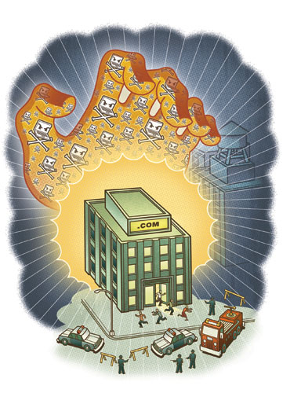
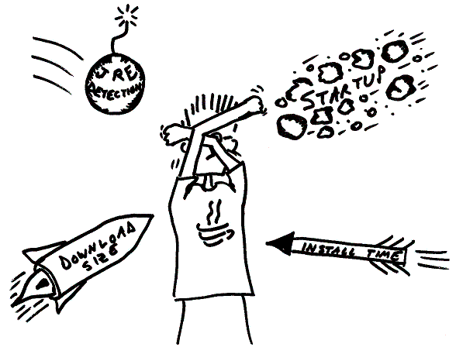
Attacks and threats

Slide 56
Frequent attacks on network systems
PURPOSE? They are designed to harm or bypass computer and network functions.
WHY? Finantial benefits, harmness, misappropriation, economic benefits.
HOW? Threats to confidentiality, integrity and availability of network systems
  attacks by changing the information (modification attack)
  denial of communication (repudiation attack)
  System failure (denial-of-service attack)
  unauthorized access(access attack)

Slide 57
Frequent attacks on network systems

Slide 58
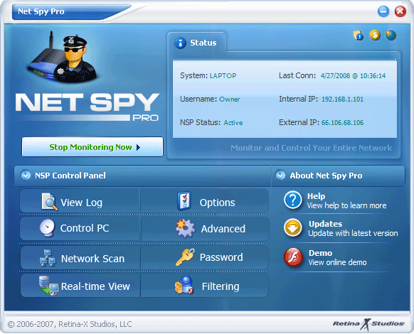
Common attacks
Reconnaissance: the attacker try with a variety of techniques to identify the system architecture, services, etc.
  It helps to prepare the attack on the system
  example (war-dialing): attacker by calling random phone numbers try to identify the number the modem uses to connect to the network

Slide 59

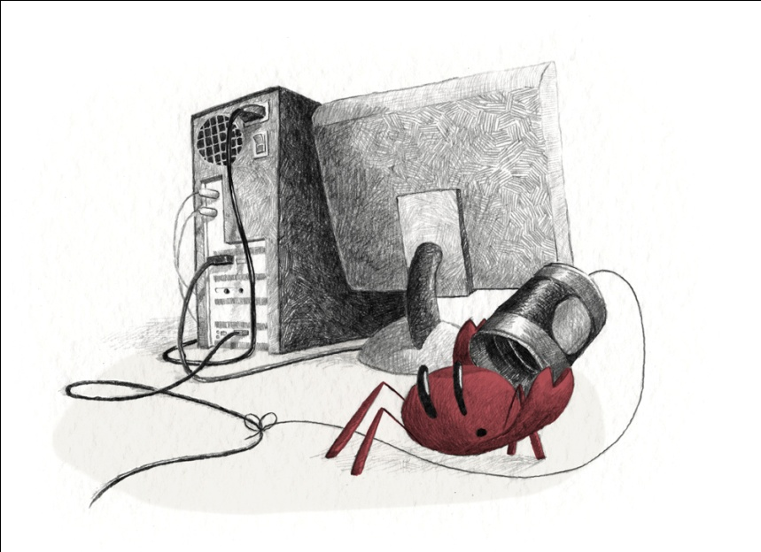
Common attacks
Eavesdropping: intercept network traffic, present especially in wireless networks (attacker obtains passwords, credit card numbers, ...)
  Passive attacker
  Activ attacker

Slide 60

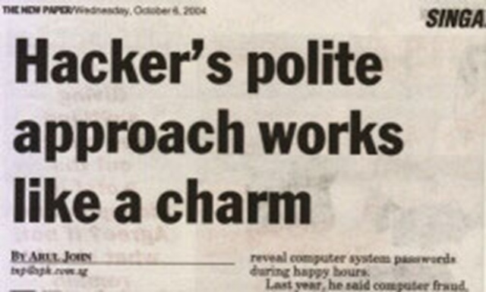
Common attacks
Weak keys
mathematical attacks on cryptographic algorithms and keys
Password guessing (brute force, the dictionary attack)
viruses, worms, tojan horses
exploit weaknesses in the software
Social engineering (over e-maila, telephone, services)
How do you defend on the risks above?

Slide 61
Common attacks
port scan: intruder test, which servers are functioning (e.g. ping) and what services they offer. An attacker can acquire information about the system: DNS, services, operating systems)
Dumpster diving: a method by which attackers can access information about the system (instructions, lists of passwords, phone numbers, work organization)
Mathematical attacks on the cryptographic algorithms and keys (brute force)
Birthday attack: is an attack on hash functions, which require that two messages will not generate the same compressed value. For weaker functions an attacker is looking for a message that will give the same hash value.

Slide 62
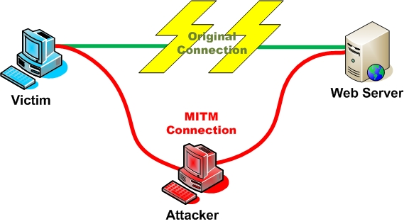
Common attacks
Back door: the attacker bypass security checks and access the system via another way
IP spoofing: the attacker tricks the target system to be someone else (someone known) by changing packets,
Man-in-the-middle: the attacker intercepts communication and behaves as if he is the target system (when using certificates the victim may use the public key of the attacker)

Slide 63
Common attacks
Replay: the attacker intercepts and saves old messages and send them back after some time, posing as one of the participants
  How do we prevent replay attacks?
TCP hijacking: the attacker interrupts communication between the users and insert himself in place of one of them, the other believes that he is still communicating with the first
  What can the attacker gain with this?
Fragmentation attack: packets are divided into fragments. The header is divided into different fragments in a way that the firewall can not filter
  tiny fragment attack: divide the header of the first packet
  overlapping fragment attack: a wrong offset overwrites previous packets

Slide 64
Common attacks - DoS (1/5)
Denial-of-Service
  The aim of the attacker: overload network resources so they stop responding to the requirements of regular users (e.g.. setting up a large number of connections, consume storage capacity, ...)
  DDoS (distributed): DoS attack, caused by an attacker using multiple network systems at once
  users of distributed network systems may not know that the equipment that is attacking is installed where they are

Slide 65
Common attacks - DoS (2/5)
Examples:
  Buffer overflow: the attacker sends more data to a process than it can take(Ping of death: ICMP with more than 65K of data has caused a system crash)
  SYN attack: the attacker sends a large number of connection requests and then he ignores the system response so the system connection queue gets overloaded
    solution: limit the number of open connections, timeout
  Teardrop attack: the attacker changes the number and length of the fragments in the IP packet. In that way the recipient gets confused
  Smurf attack(on the following slide): using indirect broadcast to overload the system

Slide 66

Common attacks - DoS Smurf attack(3/5)
Internet
attacker
Network in which the broadcast works
victim

Slide 67
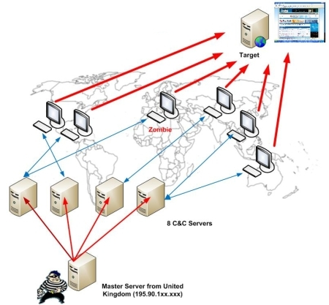
Common attacks - DoS (4/5)
The use of bots(web roBOT) for organizing attacks against the target system
  Bots can be computers, infected with trojan horses
  Their owners may not know that they are attacking the target system

Slide 68
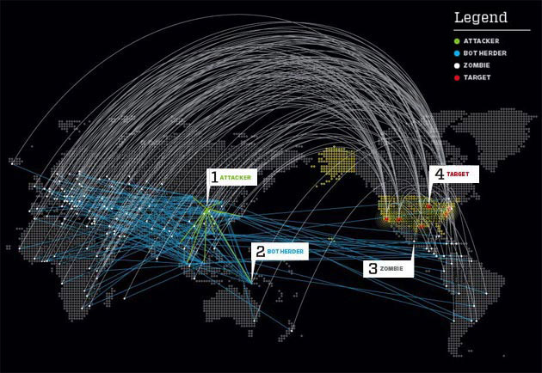
Common attacks - DoS (5/5)
subjects in the attack: the attacker, the central computer to control the bots (Herder), bots (zombie), the goal

Slide 69
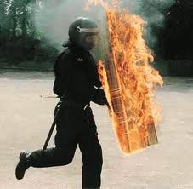
Defense against attacks

Slide 70
Defense techniques
The network needs only one weak link - the weakest user to compromise the network. The administrator must prevent the transfer of harmful programs on the user's workstations and close security holes in the infrastructure (configuration):

Slide 71
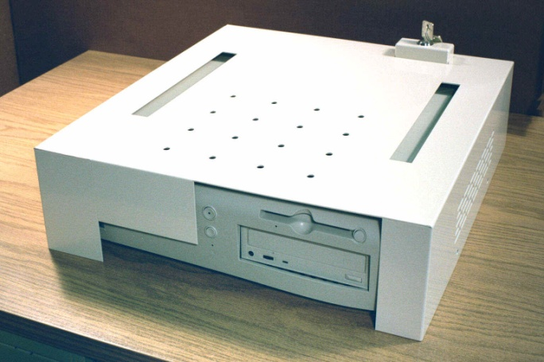
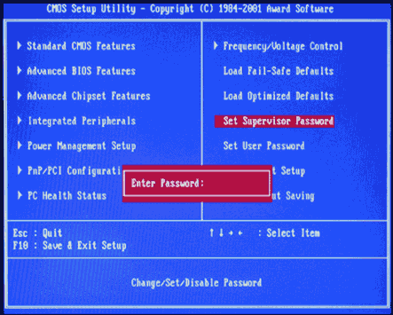
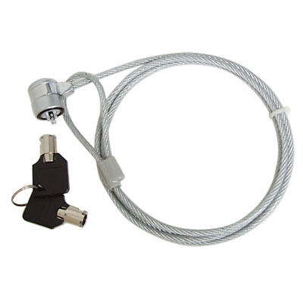
Physical protection of the system
Restrict physical access to servers and computers
  Computer locking
  Boot password(CMOS/BIOS)
  Password for accessing the BIOS(security, boot, etc.)
  Disable boot from floppy or cd

Slide 72
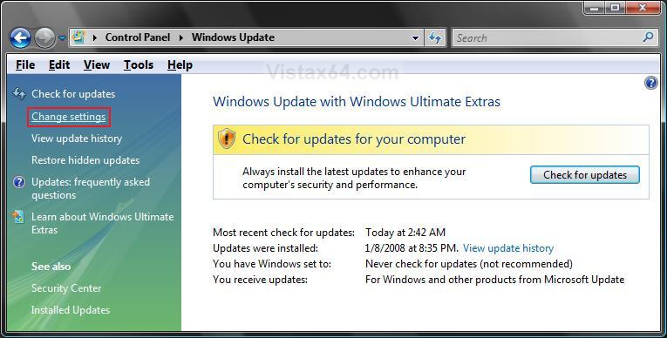
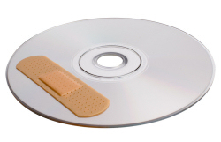
Software update
Updating the software(patching), by which the developer enables us to repair security holes
  The administrator needs a plan for test, introduction and installation of patches

Slide 73
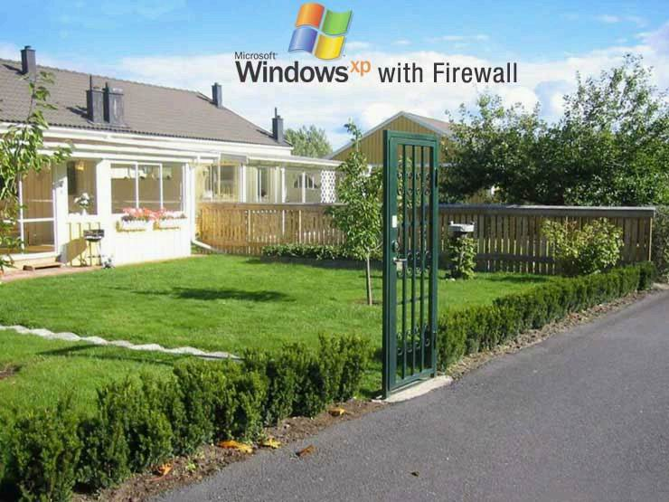

Use of AV / firewall
The use of antivirus software
  Multiple options: installation on the client / server, automatic updates, real-time protection.
    Recommended: install on the client, because malicious software begins to operate there. AV on application gateways tend to look for a subset of protocols on that location
  update
  (individual or centralized)
The use of firewall
  On a network / personal firewalls

Slide 74
User accounts protection
Attackers are looking fo unused, inactive, unprotected accounts to access the system:
  Rename the administrator user name(superuser, root, administrator),
  limit the number of accounts with high privileges (separate admin accounts, frequent changes of passwords),
  disable the use of old accounts,
  use complex passwords

Slide 75
Protection of file/network system
Protect the file system
  Assign the minimum rights required to users to acces the file system
  uninstall unnecessary applications
  Protect areas with boot management. Example - Windows:
c:\autoexec.bat
c:\config.sys
windir\wininit.ini - Usually used by setup programs to have a file run once and then get deleted.
windir\winstart.bat
windir\win.ini - [windows] "load"
windir\win.ini - [windows] "run"
windir\system.ini - [boot] "shell"
windir\system.ini - [boot] "scrnsave.exe"
windir\dosstart.bat - Used in Win95 or 98 when you select the "Restart in MS-DOS mode" in the shutdown menu.
windir\system\autoexec.nt
windir\system\config.nt
HKEY_LOCAL_MACHINE\Software\Microsoft\Windows\CurrentVersion\RunServicesOnce
HKEY_CURRENT_USER\Software\Microsoft\Windows\CurrentVersion\RunServicesOnce
HKEY_LOCAL_MACHINE\Software\Microsoft\Windows\CurrentVersion\RunServices
HKEY_CURRENT_USER\Software\Microsoft\Windows\CurrentVersion\RunServices
HKEY_LOCAL_MACHINE\Software\Microsoft\Windows\CurrentVersion\RunOnce
HKEY_LOCAL_MACHINE\Software\Microsoft\Windows\CurrentVersion\RunOnceEx
HKEY_LOCAL_MACHINE\Software\Microsoft\Windows\CurrentVersion\Run registry key
HKEY_CURRENT_USER\Software\Microsoft\Windows\CurrentVersion\Run registry key
C:\Documents and Settings\All Users\Start Menu\Programs\Startup
C:\wont\Profiles\All Users\Start Menu\Programs\Startup
C:\Documents and Settings\All Users\Start Menu\Programs\Startup
c:\windows\start menu\programs\startup
C:\Documents and Settings\LoginName\Start Menu\Programs\Startup
HKEY_CURRENT_USER\Software\Microsoft\Windows\CurrentVersion\RunOnce
HKEY_LOCAL_MACHINE\Software\Microsoft\Windows\CurrentVersion\Policies\Explorer\Run
HKEY_CURRENT_USER\Software\Microsoft\Windows\CurrentVersion\Policies\Explorer\Run
HKEY_LOCAL_MACHINE\Software\Microsoft\Windows NT\CurrentVersion\Winlogon\Userinit
HKEY_CURRENT_USER\Software\Microsoft\Windows NT\CurrentVersion\Windows\load
HKEY_LOCAL_MACHINE\SOFTWARE\Microsoft\Windows NT\CurrentVersion\Winlogon\Notify
HKEY_LOCAL_MACHINE\Software\Microsoft\Windows NT\CurrentVersion\Windows
HKEY_LOCAL_MACHINE\SOFTWARE\Microsoft\Windows\CurrentVersion\ShellServiceObjectDelayLoad
HKEY_LOCAL_MACHINE\SOFTWARE\Microsoft\Windows\CurrentVersion\Explorer\SharedTaskScheduler

Slide 76
Application protection
correct application settings (default values ​​are not always the safest!)
removing of unnecessary applications
disabling attachments in e-mails
disabling execution of hazardous types of files
installing applications on non-standard ports and non-standard directories
...

Slide 77
Next time we go on!
Security:
  Secure network infrastructute
  information for network operation

