Slide 1
Digital forensics
Andrej Brodnik
Andrej Brodnik: Digital Forensics

Slide 2
Computer
chapter 15
pre-requisite knowledge:
architecture of computers
basics (BIOS)
operating system
secondary memory (disc) and its organization
file systems
Andrej Brodnik: Digital Forensics

Slide 3
Startup
startup steps
at start up, BIOS (Basic Input Output System) runs
Open Firmware (Mac PowerPC), EFI (Mac Intel), Open Boot PROM (Sun), …
it performs a POST (Power On Self Test)
the operating data are stored in xROM
sometimes a password protects the data – password is entered by the user
Andrej Brodnik: Digital Forensics

Slide 4
Startup…
example Moussawi:
The computer has been shut down for a very long time and the battery on the motherboard has been emptied
Access was possible using the data recovered before power was lost.
how the data is encoded
ASCII, ...
Little / big endian
What happens if you take disc to another computer
Andrej Brodnik: Digital Forensics

Slide 5
File format
at the beginning all files have their unique signatures (www.garykessler.net/library/file_sigs.html)
jpg: FF D8 FF E0 or FF D8 FF E3
gif: 47 49 46 38 37 61 or 47 49 46 38 39 61
doc: D0 CF 11 E0 A1 B1 1A E1
Andrej Brodnik: Digital Forensics

Slide 6
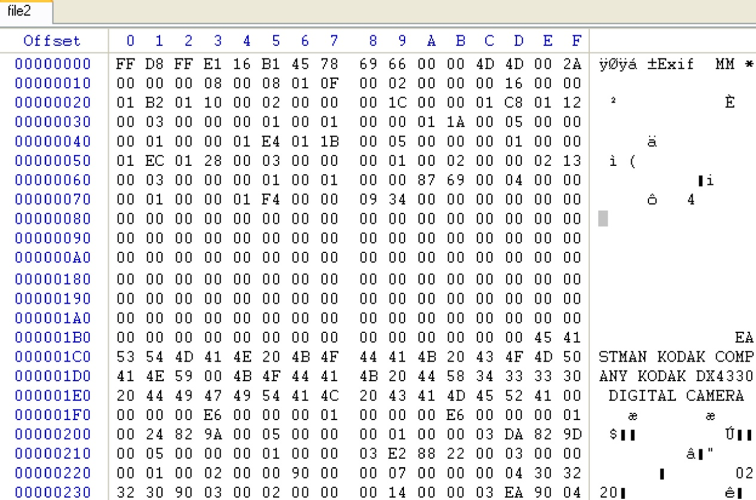
File format - example
jpeg encoded exif (Exchangeable image file format) file
Andrej Brodnik: Digital Forensics

Slide 7
File format
the file can be embedded in another file
find the file
it can be labeled and copied (copy-paste)
or use dd
this procedure is called carving
other tools:
scalpel (http://www.digitalforensicssolutions.com/Scalpel/), DataLifter (http://www.datalifter.com/)
EnCase (http://www.guidancesoftware.com/forensic.htm), FTK (Forensic Toolkit, http://accessdata.com/products/computer-forensics/ftk), X-Ways (http://www.x-ways.net/)
Andrej Brodnik: Digital Forensics
Notes:
X-Ways - video
1

Slide 8
Cutting
in the end, we only get content and not metadata from the directory
The other problem is that the data can be scattered through the disk
Adroit (http://digital-assembly.com/products/adroit-photo-forensics/)
Andrej Brodnik: Digital Forensics

Slide 9
File format - challenge
Challenge: Embed one file in the another file and publish that on the forum. The other colleagues should find the embedded file and extract it using tools like dd or some other tools motioned it the previous slides.
Challenge: Divide the file into more pieces and insert each one into another file and post it all in the forum. Let your colleagues reconsider your distributed pieces.
Andrej Brodnik: Digital Forensics

Slide 10
Data storage and hiding
the I / O units are connected to the computer via:
a bas (IDE, ATA, SATA; SCSI, firewire)
interface (controller)
the interfaces can also be smart
SMART (Self-Monitoring, Analysis, and Reporting Technology)
keep access statistics and other similar data
usually are not relevant for forensic research
Andrej Brodnik: Digital Forensics

Slide 11
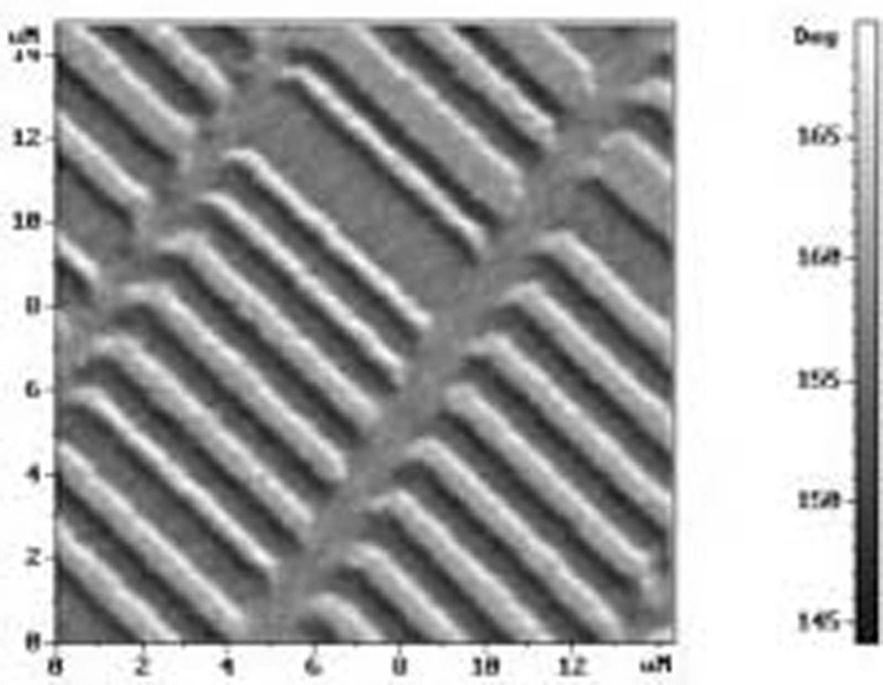
Data storage and hiding
usually we store data permanently on a disk
What does the hard drive look like?
Andrej Brodnik: Digital Forensics

Slide 12
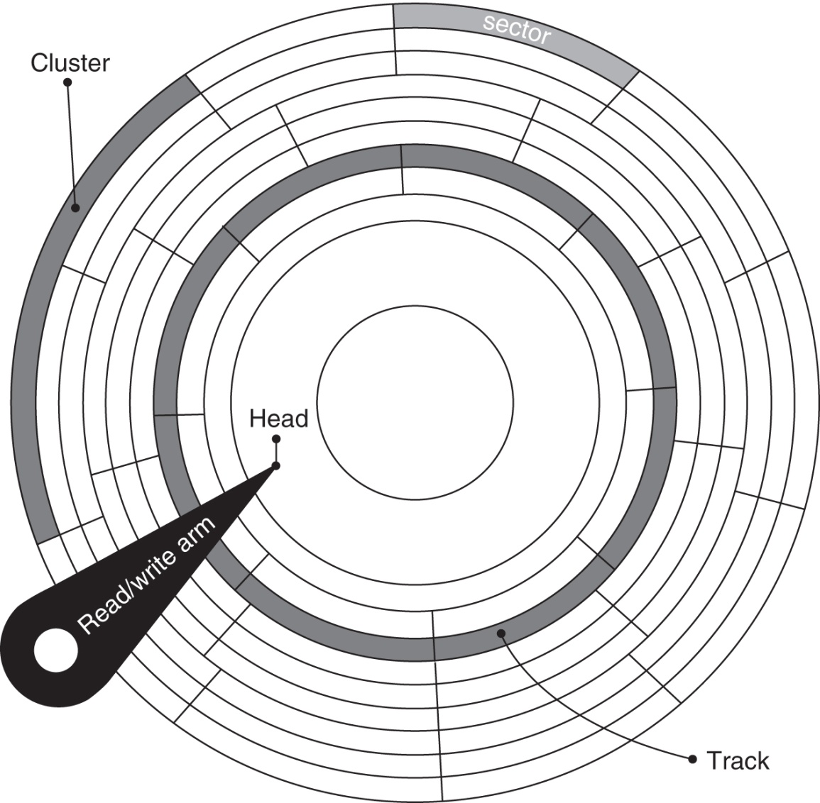
Data storage and hiding
how is the disk organized?
spindle, platter, cylinders, tracks, sectors, cluster
at the first sector are control data (MBR, master boot record)
size (geometry), weak blocks, partitions, ...
what organization in SSD looks like?
Andrej Brodnik: Digital Forensics

Slide 13
Data storage and hiding
Challenge: find anadisk tool and see what it does.
Challenge: what is the MBR structure? Build your MBR and post it in the forum..
Andrej Brodnik: Digital Forensics

Slide 14
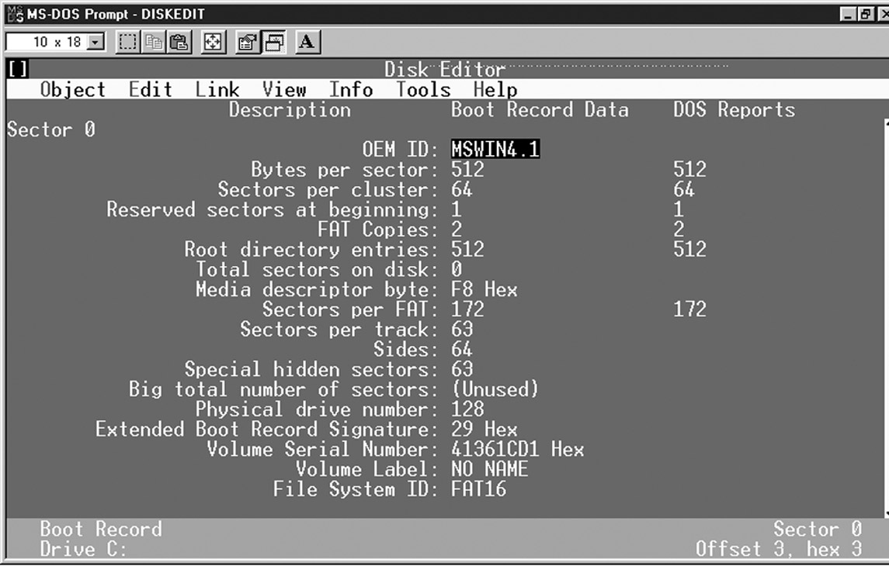
Data storage and hiding
look at the Windows 95 boot sector with the Norton Disk Utils tool
Andrej Brodnik: Digital Forensics

Slide 15
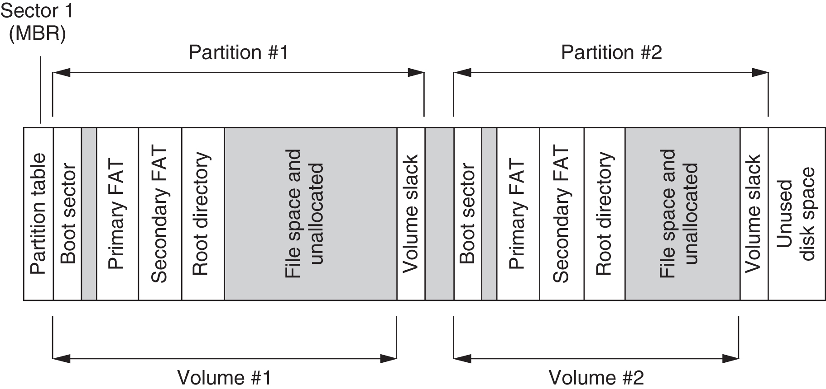
Data storage and hiding
simplified organization of the disk with the FAT file system
Andrej Brodnik: Digital Forensics

Slide 16
Data storage and hiding
partition, volume, bundle/part
inside the file system
can also be without the file system
Andrej Brodnik: Digital Forensics

Slide 17
Data storage and hiding
hiding data due to internal and external fragmentation:
hiding within a cluster
hiding within the partition (partitions usually begin at the beginning of the trace)
hiding partition
partition encryption
service data: DCO (Drive/device configuration overlay) and HPA (Host/hidden protected area) – http://www.forensicswiki.org/wiki/DCO_and_HPA
Andrej Brodnik: Digital Forensics

Slide 18
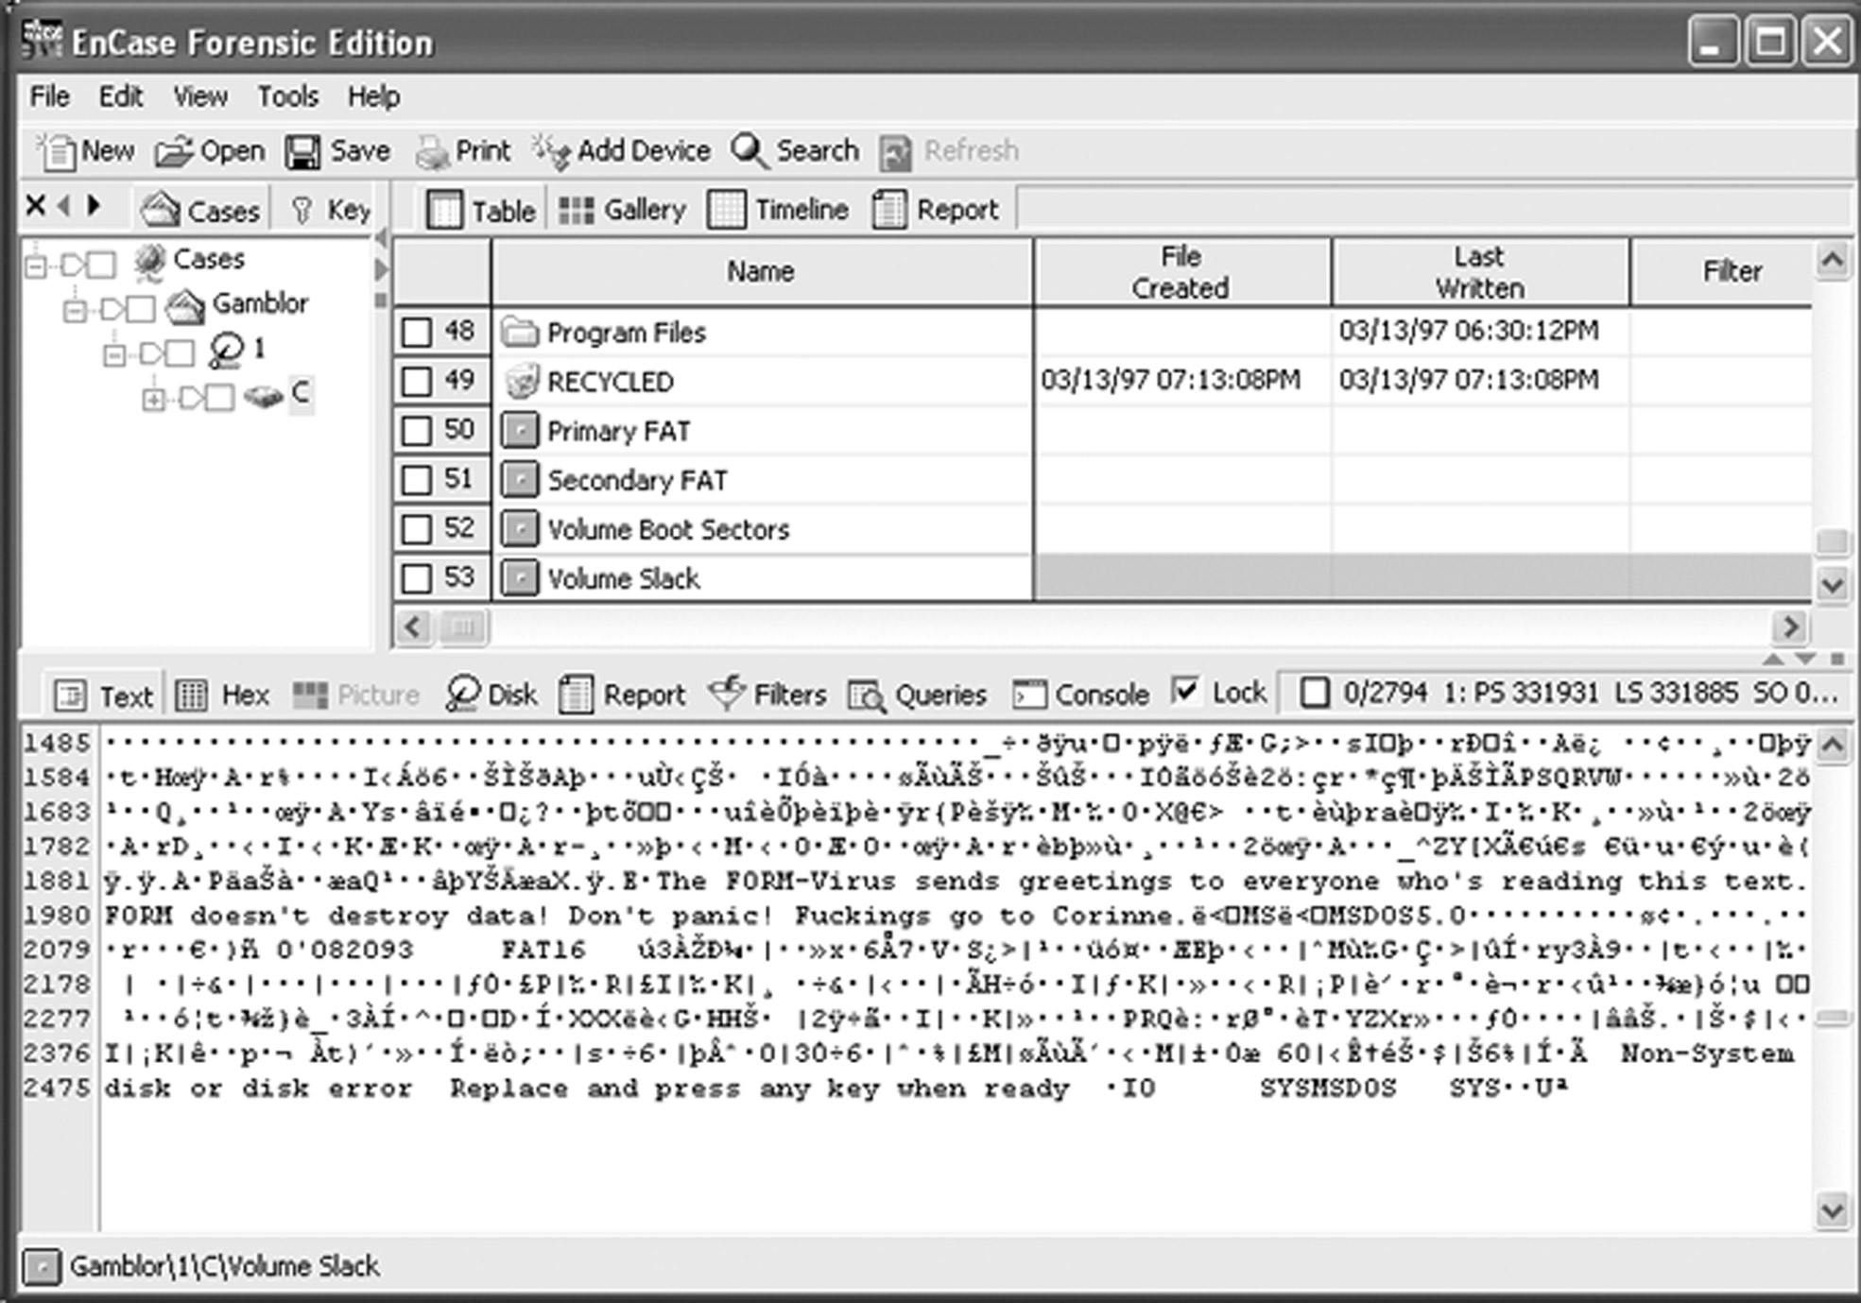
Data storage and hiding
the virus is hidden in the empty partition volume (volume slack)
Andrej Brodnik: Digital Forensics
Notes:
1

Slide 19
Data storage and hiding
when a file is deleted, the data does not disappear
even when we format the disk, the data does not disappear
take a look at the tool fdisk
the result of both operations is a valid file system and a cluster of empty blocks
tools: sleuthkit (http://www.sleuthkit.org/), Norton DiskEdit, …
Andrej Brodnik: Digital Forensics

Slide 20
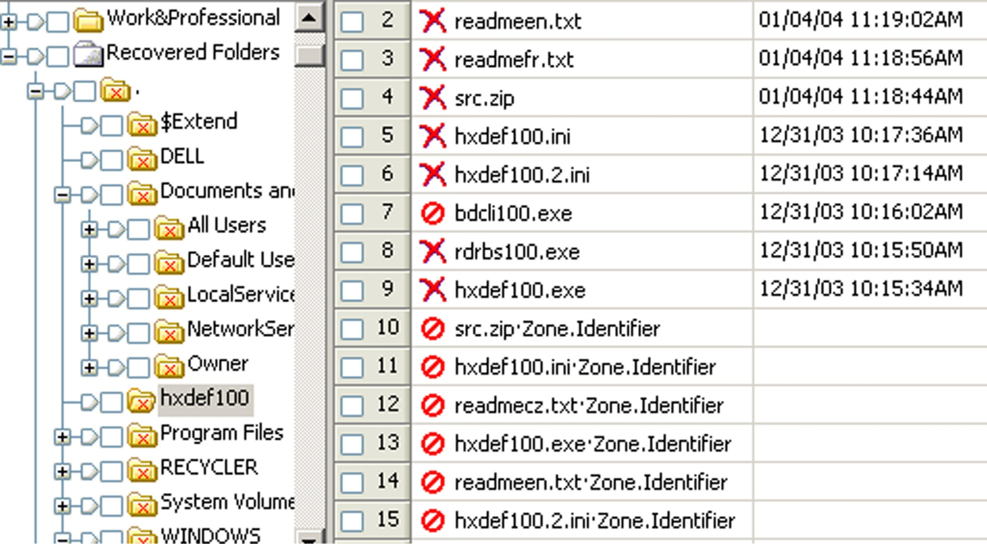
Data storage and hiding
An example of the reconstruction of files on a freshly formatted disk with the EnCase tool
Andrej Brodnik: Digital Forensics

Slide 21
Data storage and hiding
Challenge: See what the MBR and boot sector on your computer looks like with an appropriate tool. Report about this on the forum.
Challenge: Check the configuration of your drive.
Andrej Brodnik: Digital Forensics

Slide 22
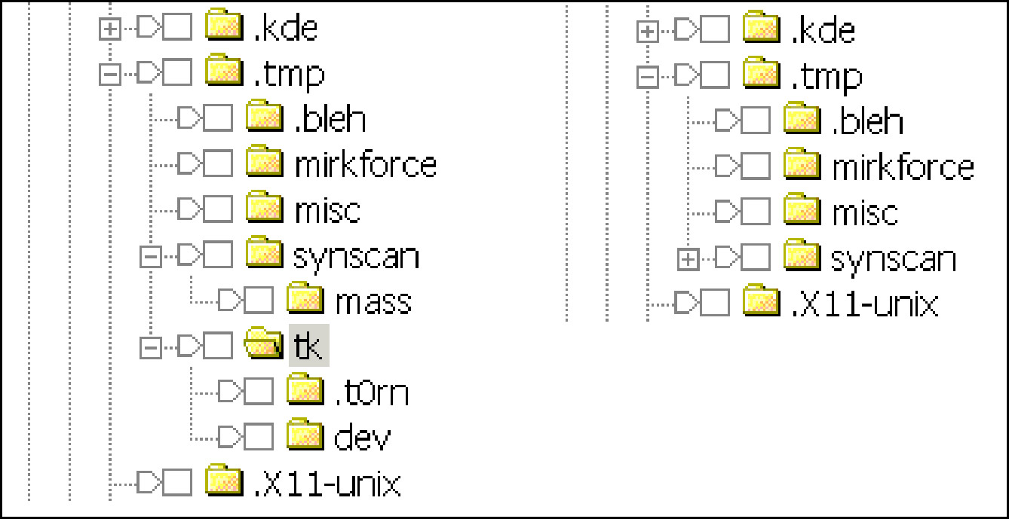
Data storage and hiding
hiding partitions
tool Test Disk (http://www.cgsecurity.org/)
at file level
hiding files: e.g. MS Windows: attrib +H in dir/AH
parlament.jpg -> test.exe
picture in .ppt pres.
the latest tools
Andrej Brodnik: Digital Forensics

Slide 23
Passwords and encryption
tools for breaking and searching passwords
Password Recovery Tool – PRTK in Distributed Network Attack – DNA (http://accessdata.com/products/computer-forensics/decryption)
John the Ripper (www.openwall.com/john/)
Cain and Abel (www.oxid.it/cain.html)
Advanced Archive Password Recovery (www.elcomsoft.com/azpr.html)
Andrej Brodnik: Digital Forensics

Slide 24
Passwords and encryption
more about encryption and cryptography later
some examples
tools caesar, rot13
support for the PGP
tool crypt
Andrej Brodnik: Digital Forensics

Slide 25
OS Windows
chapter 17
file systems
data recovery
log files
registry
communication trails
Andrej Brodnik: Digital Forensics

Slide 26
OS Windows –file system
two basic file systems FAT (File Allocation Table) in NTFS (New Technology File System)
FAT
developed first for hard disks (floppy disks)
FAT12, FAT16, FAT32
Andrej Brodnik: Digital Forensics

Slide 27
File system FAT
FATxx is a list of index clusters in which each file is stored
xx means the number of bits used for the index
12 = 2¹² = 4096, 16 = 2¹⁶ = 65.536, 32 = 2²⁸ = 268.435.456
Andrej Brodnik: Digital Forensics

Slide 28
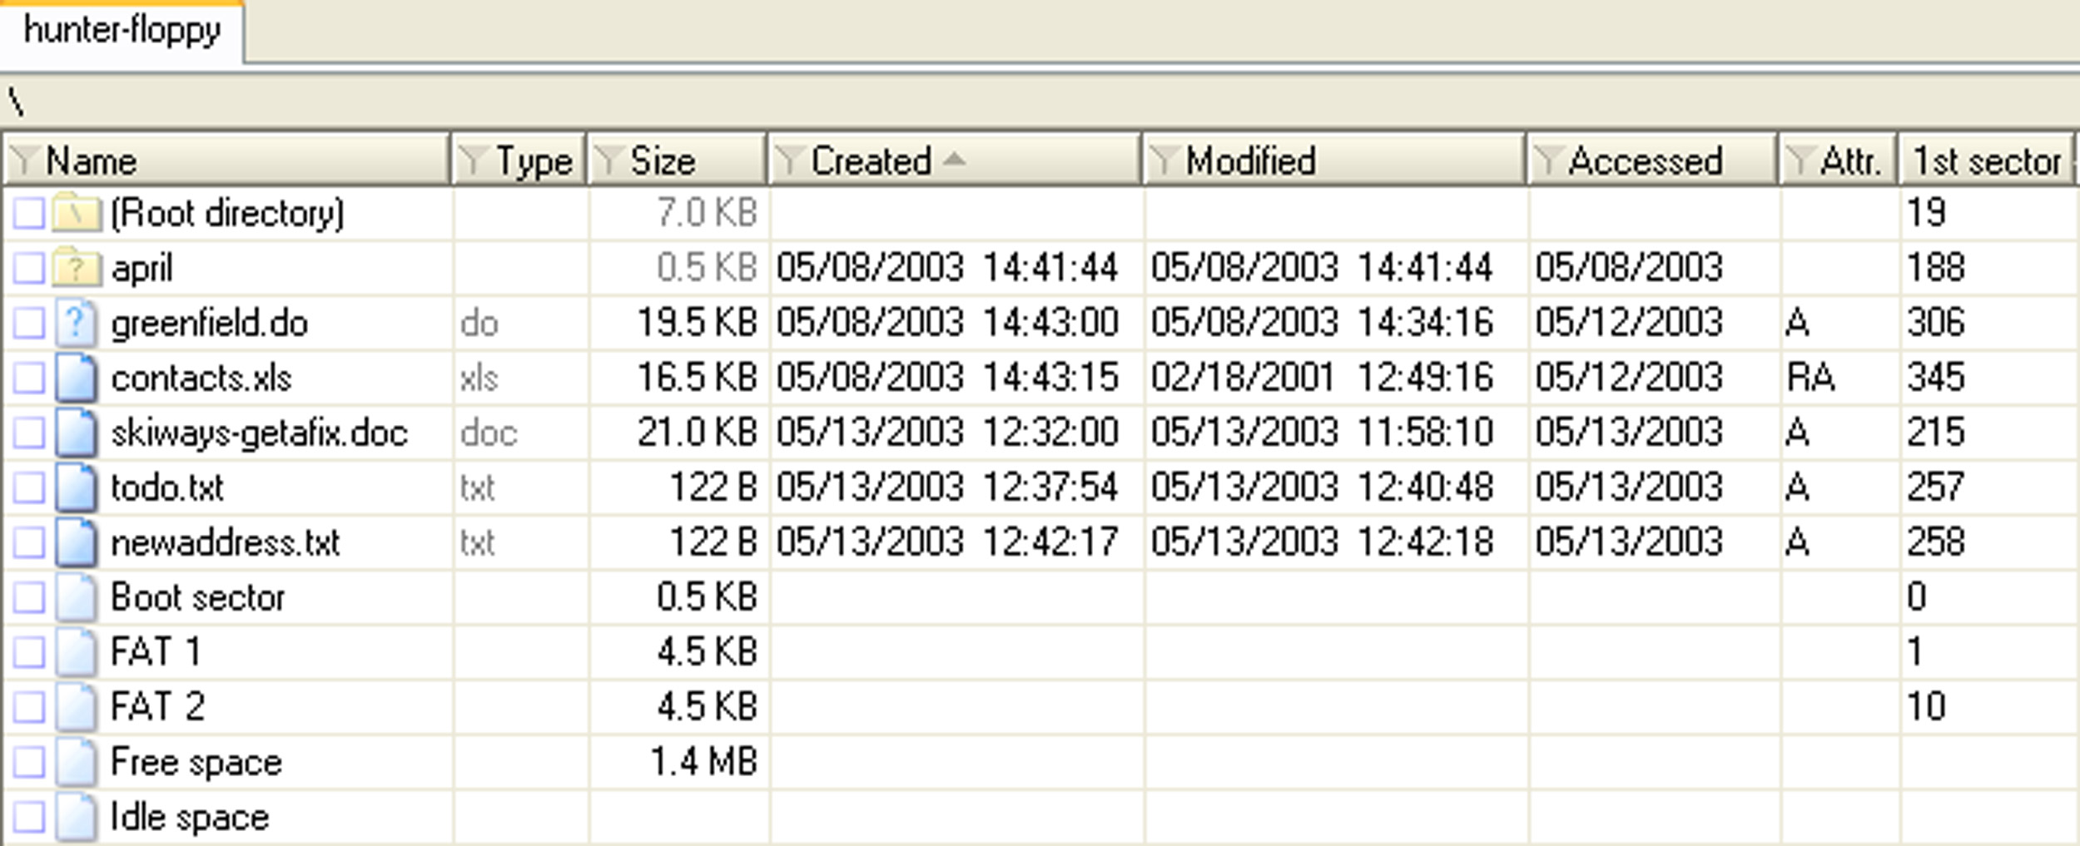
File system FAT
view the root of the file system on the hard disk using the X-Ways program
keeps the creation time and last changes but only the last access date
Andrej Brodnik: Digital Forensics
Notes:
Spodaj je našteto kako izgleda razporeditev podatkov na disku: boot, FAT, korenski imenik
1

Slide 29
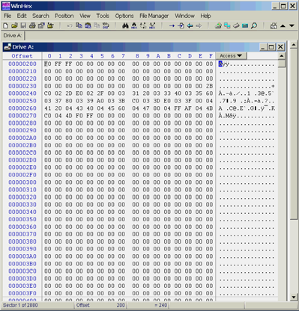
FAT
Andrej Brodnik: Digital Forensics

Slide 30
File system FAT
Challenge: See for yourself what the FAT looks like on your disk. Look in particular for those clusters that are empty - they are not part of any file system.
Andrej Brodnik: Digital Forensics

Slide 31
File system NTFS
a more modern file system
everything is in a file
the file information is stored in the system file $MFT
directory is only a file (B tree structure)
It is a journaling file system and stores transactions in the system file $LogFile
supports multiple data streams
ACL (Access Control List)
better protected, since it stores copies of file system data in multiple locations ($MFTMirr)
Andrej Brodnik: Digital Forensics

Slide 32
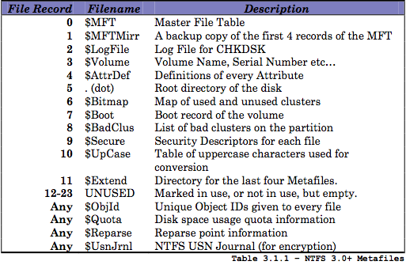
File system NTFS
Andrej Brodnik: Digital Forensics

Slide 33
File system NTFS
Challenge: look for clusters in your NTFS cluster that are empty (unused) and then look at their content.
Andrej Brodnik: Digital Forensics

Slide 34
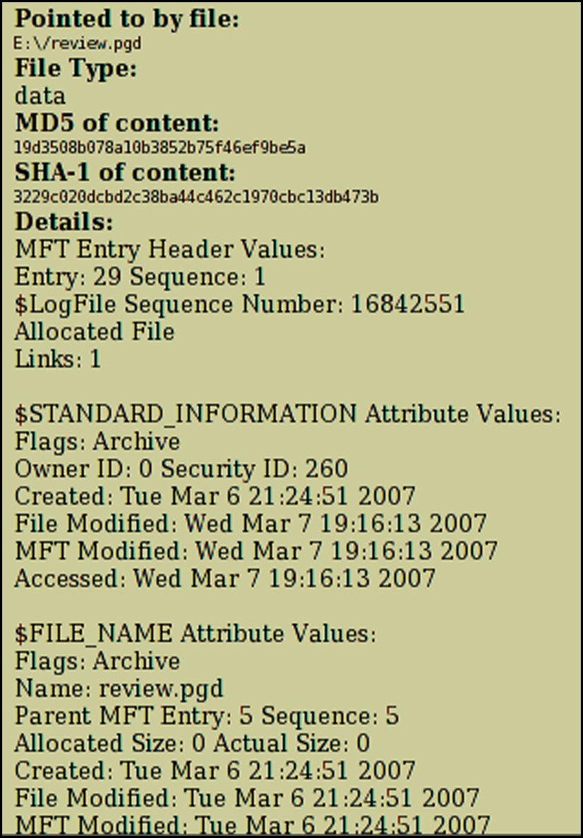
NTFS – $MFT
example of one record in $MFT
the record consists of attributes, the record is the size of the 1kB
if the file is small, it is stored in the record
when a “deleted” flag is set the record can be reused
Andrej Brodnik: Digital Forensics

Slide 35
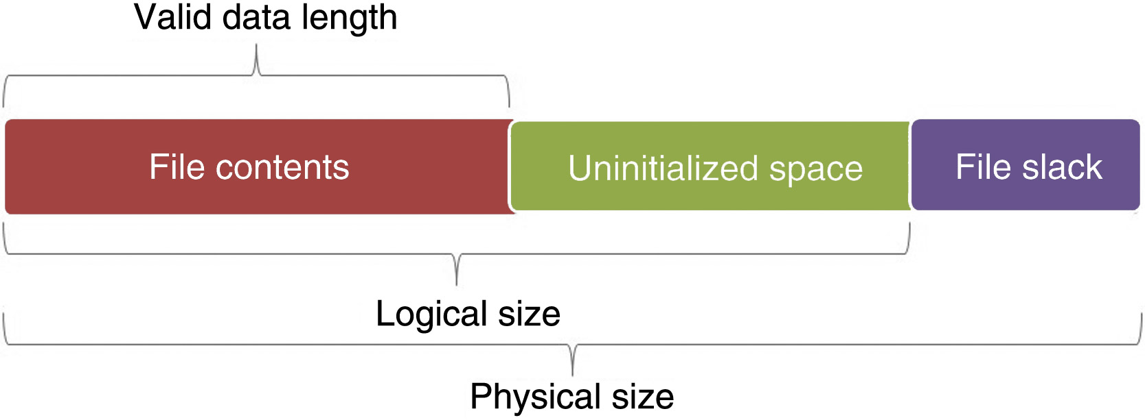
NTFS - search for data
there is a physical file size (cluster), logical size (directory entry) and the end of the file (EOF)
Andrej Brodnik: Digital Forensics

Slide 36
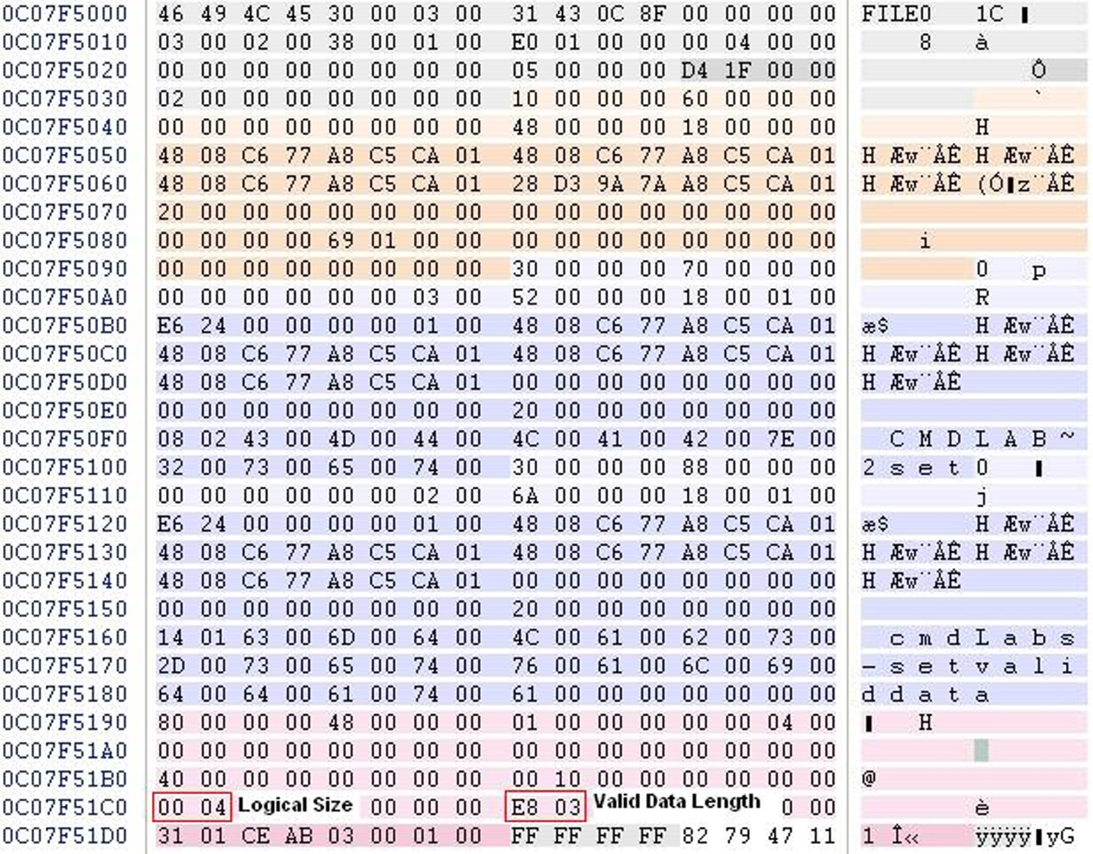
NTFS – MFT record
MFT record and the difference between sizes
Andrej Brodnik: Digital Forensics

Slide 37
NTFS - search for data
Multiple files in a directory can have the same name
Andrej Brodnik: Digital Forensics

Slide 38
File system NTFS
Challenge: Which clusters is your file composed of?
Challenge: Find a busy but unused part of your file (on which clusters) and what's in it.
Challenge: What happens if we make 1000 files, then we delete 1000 and analyze the data?
Andrej Brodnik: Digital Forensics

Slide 39
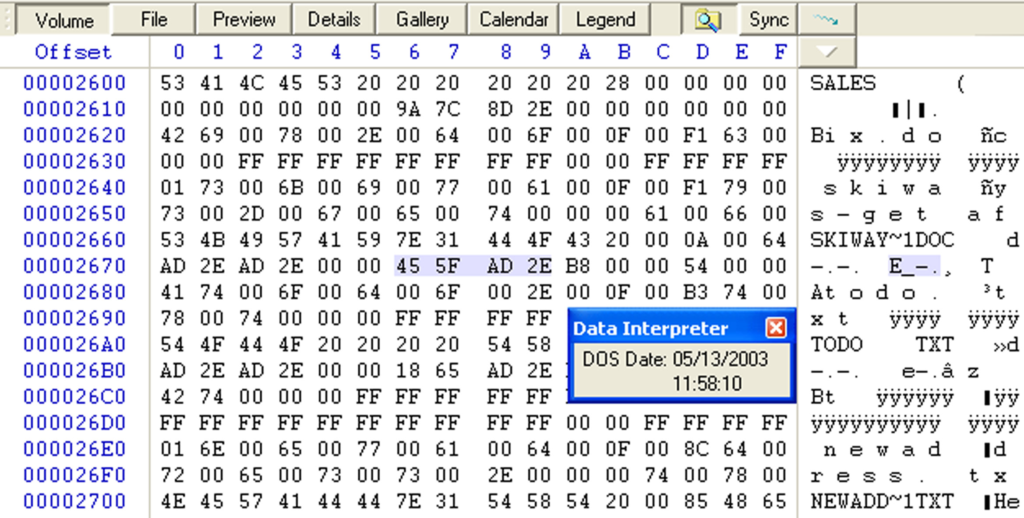
Time coding for files
FAT: 1.1.1980 + LLLLLLLM MMMDDDDD hhhhhmmm mmmsssss
Andrej Brodnik: Digital Forensics

Slide 40
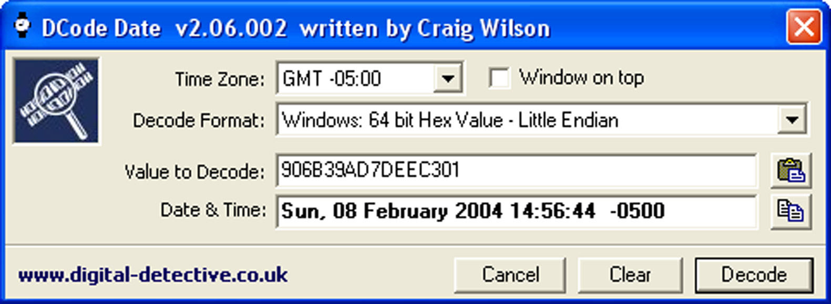
Time coding for files
FILETIME
64 bit record
value = 1.1.1600 + number * 100ns
Andrej Brodnik: Digital Forensics

Slide 41
NTFS - tracks files
various operations have a different impact on the recorded times in the directory (creation - CR, last access - LA, last change - LC, record changed (NTFS) - RC):
moving the file into a folder: it does not affect anything
moving the file to another folder: CR, LA, RC
copy file (target file): CR, LA, RC
copy/paste: LA(*)
drag&drop: LA(*)
delete: LA, RC
special cases:
file on a stick, can be via scp/...: CR > LC
when deleting a directory, file information does not change
Andrej Brodnik: Digital Forensics
Notes:
odreži&prilepi pri novejših se ne popravlja
1

Slide 42
NTFS - tracks files ...
the content of office files contains metadata from the directory
Save as: if an existing file is picked, the data in the file is overwritten and no new file is created in the directory
printing first copies the file to a special directory and then prints it
C:\Windows\Spool\Printers, C:\WinNT\System32\Spool\Printers
even when we print online content, etc.
Andrej Brodnik: Digital Forensics
Notes:
odreži&prilepi pri novejših se ne popravlja
1

Slide 43
NTFS - tracks files ...
Challenge: Find a file that has a creation time greater than the time of the last change.
Challenge: What can you say, is there such a file on the system that has the last access time same at he time of the creation?
Challenge: What is the EMF printing method ? What is stored in the print file (spooler)?
Andrej Brodnik: Digital Forensics
Notes:
odreži&prilepi pri novejših se ne popravlja
<number>

Slide 44
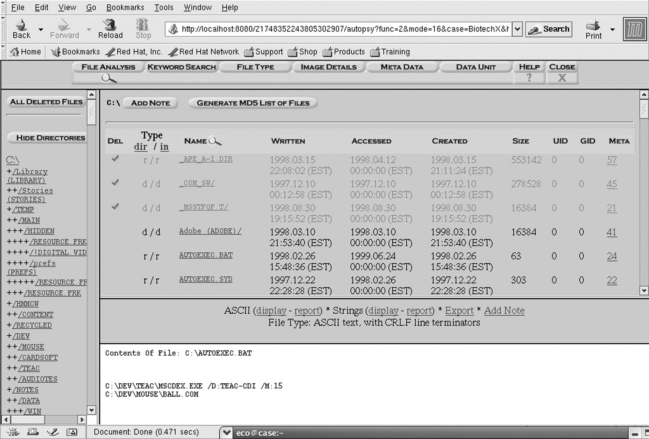
Data recovery
recover deleted files
various tools that can run on WinOS
tool like SleuthKit combined with Autopsy Browser can even browse through the browser (http://www.sleuthkit.org/autopsy/)
Andrej Brodnik: Digital Forensics

Slide 45
Data recovery …
Challenge: install sleuthkit and Autopsy Browser and find the lost files.
Andrej Brodnik: Digital Forensics

Slide 46
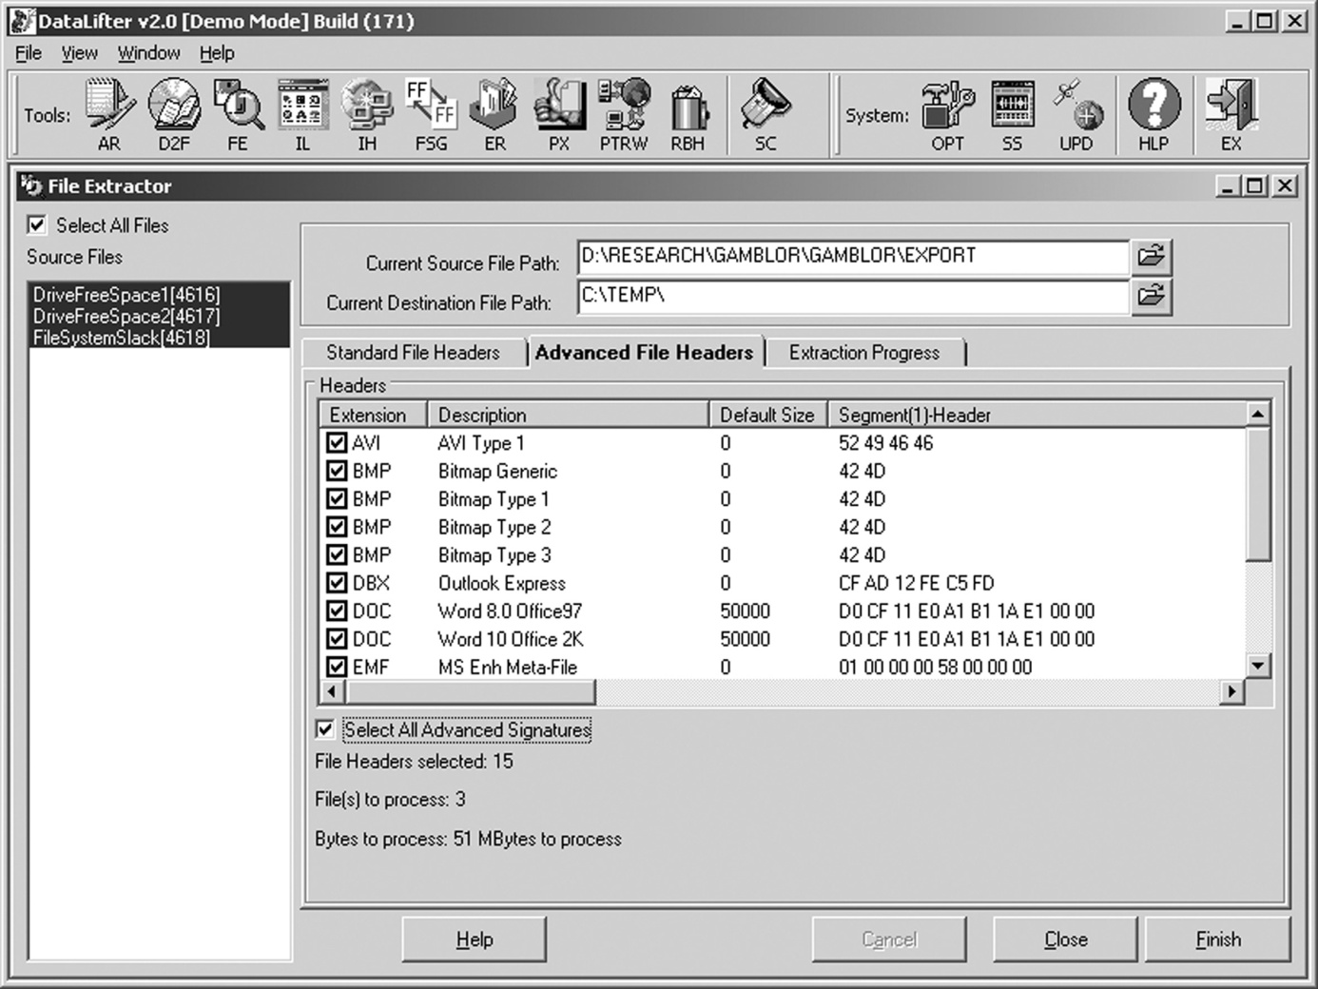
Data recovery …
searching for lost files from a large unformed mound
same as carving files
tool DataLifter: is looking for a lost file from two empty spaces and one of the rest of the file system
Andrej Brodnik: Digital Forensics

Slide 47
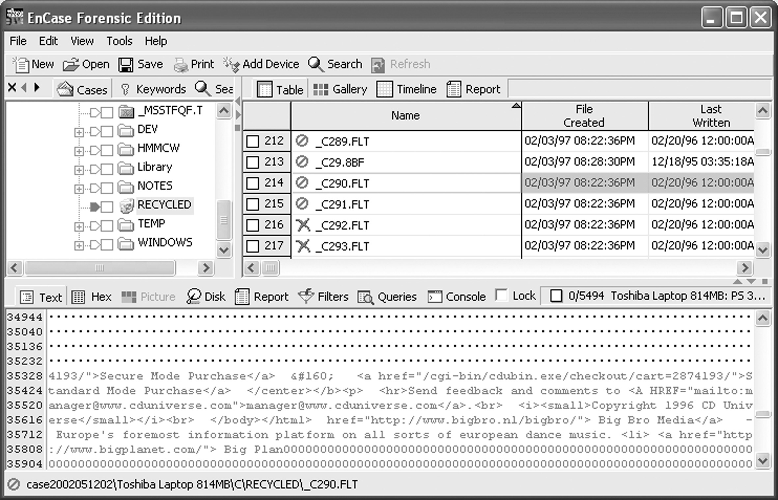
Data recovery …
if a small file overwrites larger one, we can reconstruct most of the larger files
enCase: an example of a shopping cart in the CD Universe, found in the rest of the file space
Andrej Brodnik: Digital Forensics

Slide 48
Log files
the operating system (depending on the settings) records many
access to resources
appearance and deletion of resources,
errors, etc.
saved on %systemroot%\system32\config (c:\winnt\...)
different log entries in different files: Appevent.evt, Secevent.evt, Sysevent.evt
Andrej Brodnik: Digital Forensics

Slide 49
Log files
Challenge: check the format of the .evt file and check what is in them and when you last logged in to the system.
Andrej Brodnik: Digital Forensics

Slide 50
Register
In Windows OS, the process environment variables are defined in the registers
actually, the data is stored in the files (hives) in the system directory %systemroot%\system32\config
ntuser.dat - each user has their own file
files can be viewed with the Windows tool regedit32 (EnCase, FTK, ...)
Andrej Brodnik: Digital Forensics

Slide 51
Register
Challenge: examine the forensic value of the data in the registry.
Andrej Brodnik: Digital Forensics

Slide 52
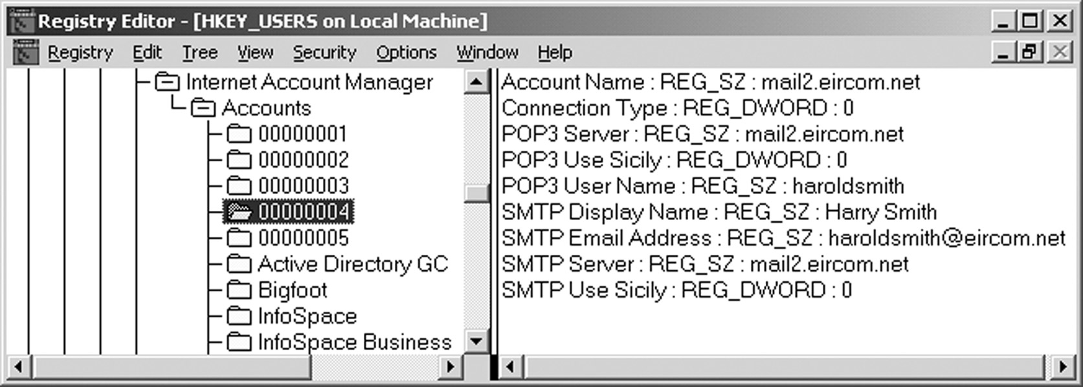
Network tracking
sometimes from the system environment
when connecting, ...
mostly comes directly from application
browsers, mail agents, ...
Andrej Brodnik: Digital Forensics

Slide 53
Network Tracking - Browsers
history:
firefox-3 has been storing history in the sqlite databases Places.sqlite
Internet Explorer is storing history in the file index.dat
tools that are available to search through these databases: Oddesa (www.odessa.sourceforge.net)
local cache
cookies
Andrej Brodnik: Digital Forensics

Slide 54
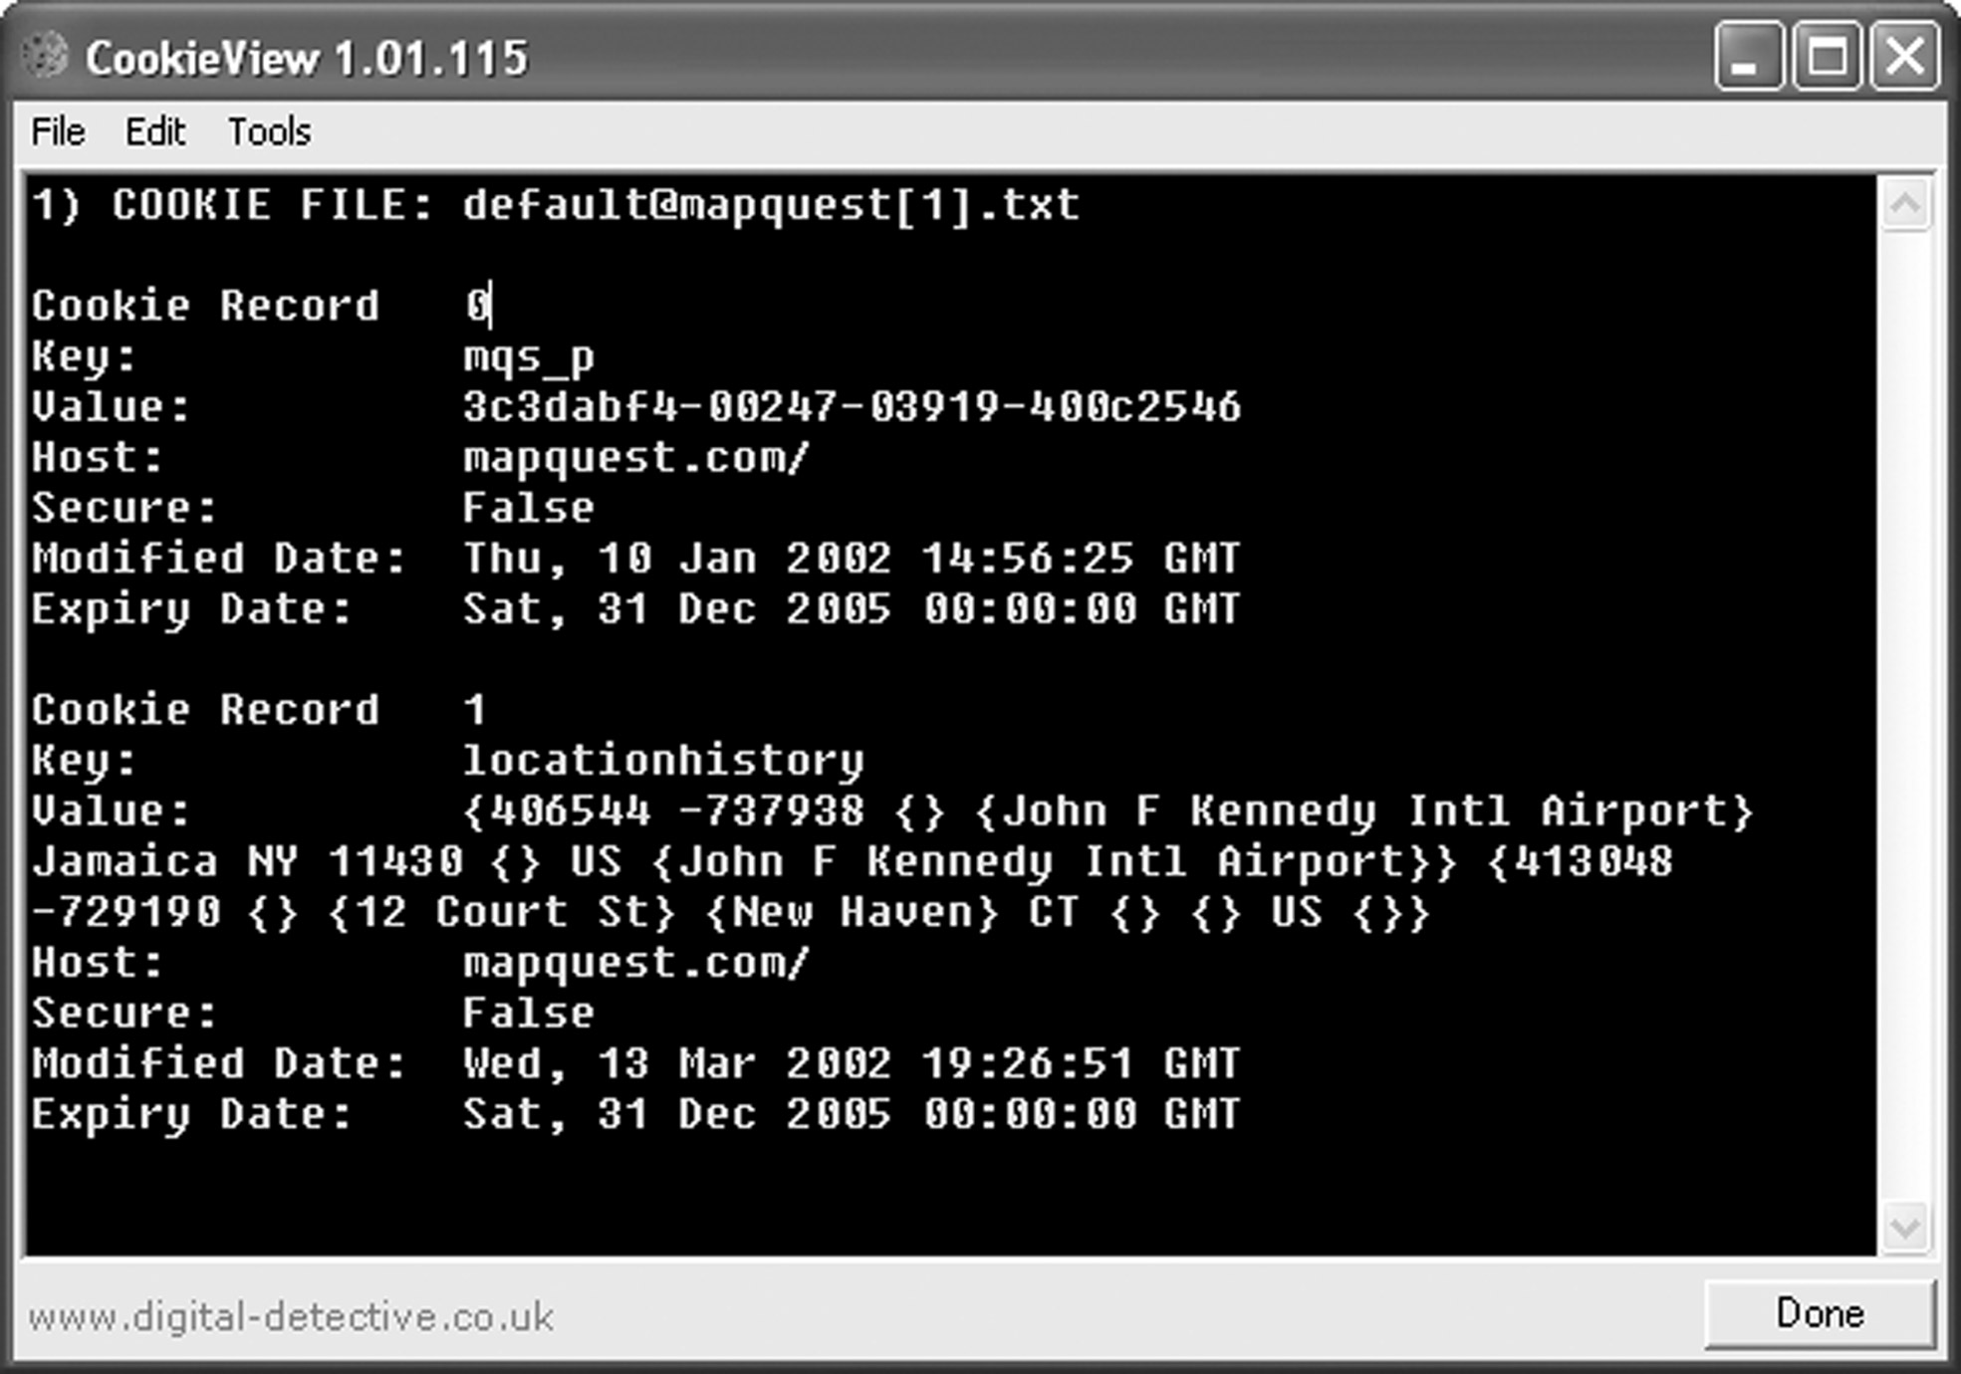
Browsers - Cookies
example of cookies inspection in CookieView (www.digitaldetective.co.uk)
Andrej Brodnik: Digital Forensics

Slide 55
Browsers
Challenge: Find out what leftovers you do have in your cache and check with your browsing history.
Challenge: Get a file from your friend's browser history and disassemble it.
Challenge: Check out what kind of traces are left behind by the IE browser, what kind by the Mozilla and what kind by the Opera.
Andrej Brodnik: Digital Forensics

Slide 56
E-mail
Traces depend on the mail agent we use
sent and received mails
summary of IMAP mailbox
content that is interesting
text mails only
attachments (!) – MIME format
Andrej Brodnik: Digital Forensics

Slide 57
Other programs
different programs leave different traces
network software
access to other systems
allow other systems to access in our system
system programs leave traces in the registry
Andrej Brodnik: Digital Forensics

Slide 58
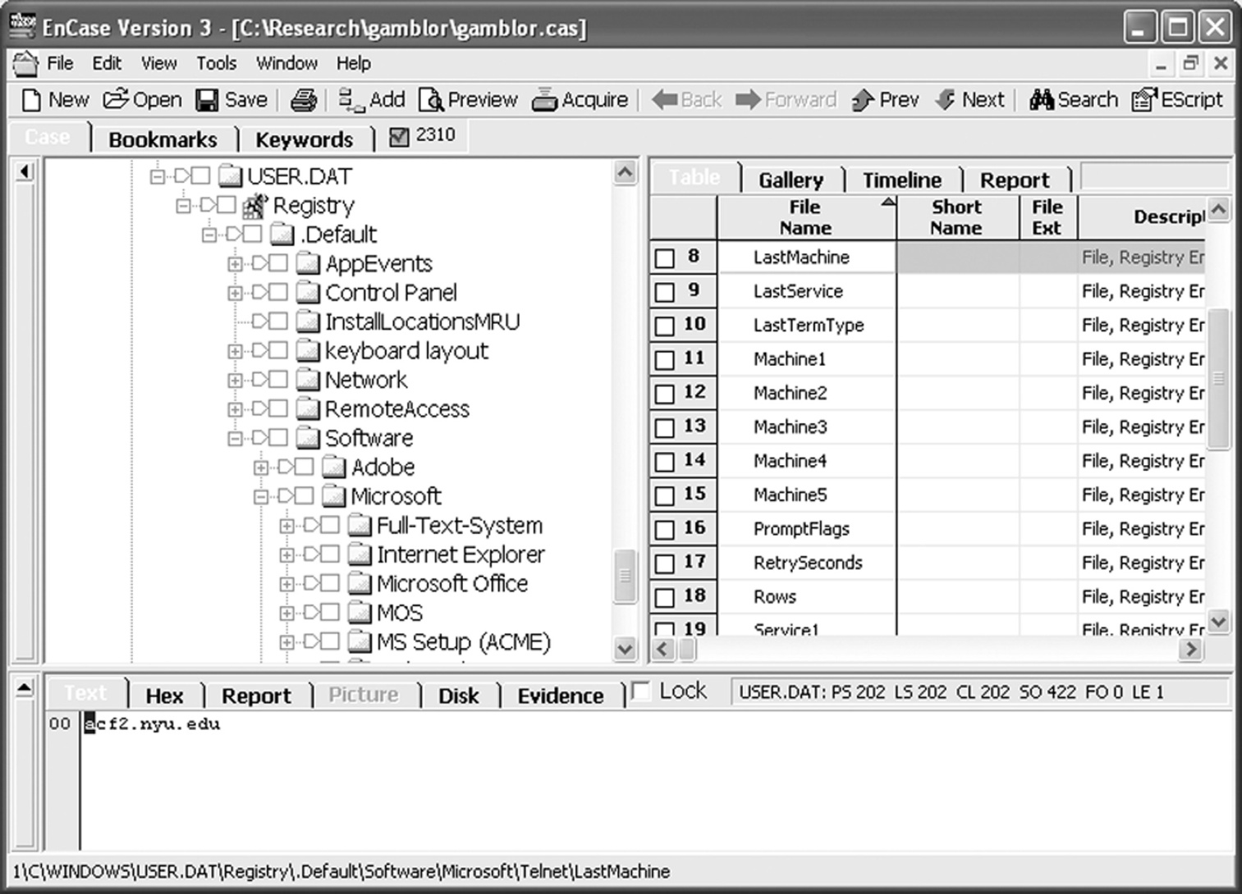
Network access tracking
telnet access to acf2.nyu.edu
Andrej Brodnik: Digital Forensics

