Slide 1
Digital forensics
Andrej Brodnik

Slide 2
Unix Operating system
poglavje 18
Development through history: System V, HP-UX, BSD, ...
Open source versions that appeared later:
Linux: RedHat, SUSE, Ubuntu, ...
BSD: FreeBSD, OpenBSD, NetBSD
Andrej Brodnik: Digitalna forenzika
1

Slide 3
File system Hierarchy Standard
File system Hierarchy Standard – FHS (http://www.pathname.com/fhs/pub/fhs-2.3.html)
Linux Foundation took over the work (http://www.linuxfoundation.org/collaborate/workgroups/lsb/fhs)
Mostly formalization of the BSD file system
Andrej Brodnik: Digitalna forenzika
1

Slide 4
Root directory
/boot : Static files of the boot loader
/dev : Device files
/etc : Host-specific system configuration
/etc/opt : Configuration files for /opt
/etc/X11 : Configuration for the X Window System (optional)
/etc/sgml : Configuration files for SGML (optional)
/etc/xml : Configuration files for XML (optional)
/bin : Essential user command binaries (for use by all users)
/sbin : System binaries
/lib : Essential shared libraries and kernel modules
/lib<qual> : Alternate format essential shared libraries (optional)
Andrej Brodnik: Digitalna forenzika
1

Slide 5
Root directory
/home : User home directories (optional)
/root : Home directory for the root user (optional)
/media : Mount point for removable media
/mnt : Mount point for a temporarily mounted filesystem
/opt : Add-on application software packages
/srv : Data for services provided by this system
/tmp : Temporary files
/usr, /var : Separate hierarchies
Andrej Brodnik: Digitalna forenzika
1

Slide 6
/usr directory
Contains read-only files
Used simultaneously by different systems
Doesn’t contain files that are specific to a particular system
Exception: /usr/local, which is the local directory of a particular system
Andrej Brodnik: Digitalna forenzika
1

Slide 7
/var directory
Contains files that change over time
mail and print queues
logs
data (databases etc)
temporary files
Andrej Brodnik: Digitalna forenzika
1

Slide 8
System files
Operating system is designed so that system files are user-friendly ➔ regular text files
Configuration files: hosts, syslog.conf, ...
Usually in the directory etc (/etc, /usr/local/etc, /opt/etc, ...)
Logging : mail, cups, ...
Usually in the directory log (/var/log, /usr/local/var/log, /opt/var/log)
Andrej Brodnik: Digitalna forenzika
1

Slide 9
Configuration files
# $FreeBSD: release/9.0.0/etc/snmpd.config 216595 2010-12-20 17:28:15Z syrinx $
#
# Example configuration file for bsnmpd(1).
#
#
# Set some common variables
#
location := "Room 200"
contact := "sysmeister@example.com"
system := 1 # FreeBSD
traphost := localhost
trapport := 162
#
# Set the SNMP engine ID.
#
# The snmpEngineID object required from the SNMPv3 Framework. If not explicitly set via
# this configuration file, an ID is assigned based on the value of the
# kern.hostid variable
# engine := 0x80:0x10:0x08:0x10:0x80:0x25
# snmpEngineID = $(engine)
Andrej Brodnik: Digitalna forenzika
1

Slide 10
Logging
Mar 8 00:00:00 svarun newsyslog[85254]: logfile turned over
Mar 8 00:00:12 svarun postfix/smtpd[85247]: connect from S0106c0c1c0ddffcf.vf.shawcable.net[70.69.32.154]
Mar 8 00:00:12 svarun postfix/smtpd[85247]: NOQUEUE: reject: RCPT from S0106c0c1c0ddffcf.vf.shawcable.net[70.69.32.154]: 554 5.7.1 Service unavailable; Client host [70.69.32.154] blocked using bl.spamcop.net; Blocked - see http://www.spamcop.net/bl.shtml?70.69.32.154; from=<unscrupulousnessiw2@deltamar.net> to=<xxxx@brodnik.org> proto=ESMTP helo=<deltamar.net>
Mar 8 00:00:12 svarun postfix/smtpd[85247]: lost connection after DATA from S0106c0c1c0ddffcf.vf.shawcable.net[70.69.32.154]
Andrej Brodnik: Digitalna forenzika
1

Slide 11
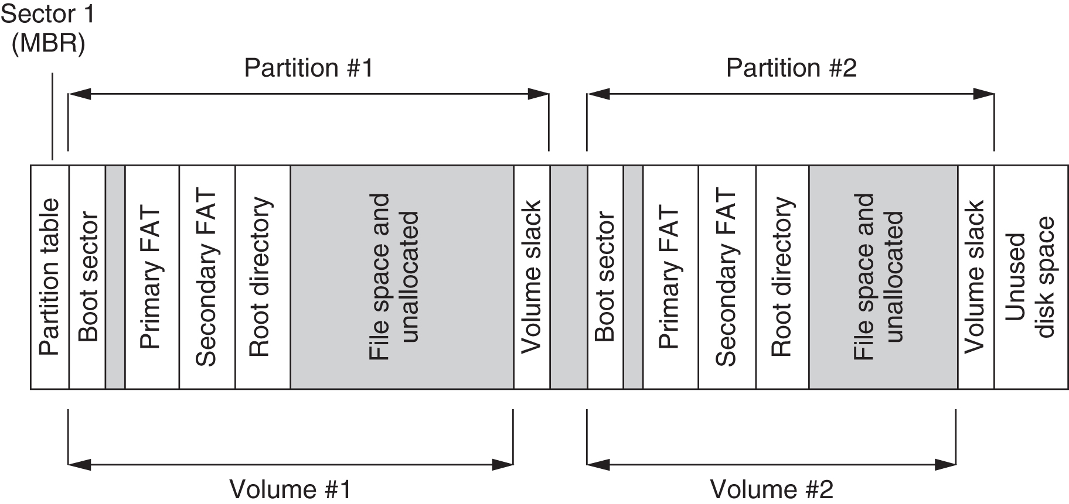
Data storage and hiding
Simplified organization of the disk with FAT file system
Andrej Brodnik: Digitalna forenzika
1
Notes:
GPT, or GUID Partition Table, is a newer standard with many advantages including support for larger drives and is required by most modern PCs. Only choose MBR for compatibility if you need it.
<number>

Slide 12
File systems
We have directories and index nodes(inode)
Inode has a similar function to FAT and MFT at the same time
Directory is just a special file type
We have more special files: links, pipe, socket ...
Andrej Brodnik: Digitalna forenzika
1

Slide 13
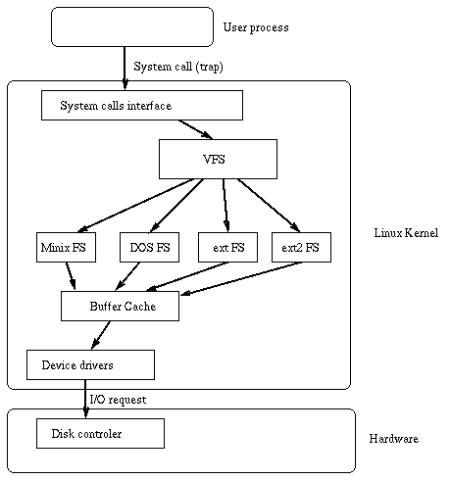
File systems
The oldest: Unix File System – UFS
More recent and used in Linux: ext2 in ext3
There are also ext and ext4
There are a number of other file systems
Andrej Brodnik: Digitalna forenzika
1

Slide 14
Time in the Unix operating system
Time is measured in seconds
Stored as a number, which begins on 1st of December 1970
If time is stored as a 32-bit number, there will be an overflow on Tuesday, December 19th 2038 at 03:14:07 UTC – Y2K38 problem
UTC – Coordinate Universal Time: a harmonized definition of time that takes into account leap years, leap seconds, ...
The last leap second occurred on 31st January 2016
harmonized time between several atomic hours
one of the successors of GMT
Andrej Brodnik: Digitalna forenzika
1

Slide 15
UFS file systems
Defined when VFS was introduced in BSD4.2
Used in *BSD systems
Later used in Solaris OS
vir: Solaris Internals, The UFS File System, Updated by Frank Batschulat, Shawn Debnath, Sarah Jelinek, Dworkin Muller, and Karen Rochford
Andrej Brodnik: Digitalna forenzika
1

Slide 16
UFS – index node
struct dinode {
u_int16_t di_mode; /* 0: IFMT, permissions; see below. */
int16_t di_nlink; /* 2: File link count. */
union {
u_int16_t oldids[2]; /* 4: Ffs: old user and group ids. */
int32_t inumber; /* 4: Lfs: inode number. */
} di_u;
u_int64_t di_size; /* 8: File byte count. */
int32_t di_atime; /* 16: Last access time. */
int32_t di_atimensec; /* 20: Last access time. */
int32_t di_mtime; /* 24: Last modified time. */
int32_t di_mtimensec; /* 28: Last modified time. */
int32_t di_ctime; /* 32: Last inode change time. */
int32_t di_ctimensec; /* 36: Last inode change time. */
ufs_daddr_t di_db[NDADDR]; /* 40: Direct disk blocks. */
ufs_daddr_t di_ib[NIADDR]; /* 88: Indirect disk blocks. */
u_int32_t di_flags; /* 100: Status flags (chflags). */
int32_t di_blocks; /* 104: Blocks actually held. */
int32_t di_gen; /* 108: Generation number. */
u_int32_t di_uid; /* 112: File owner. */
u_int32_t di_gid; /* 116: File group. */
int32_t di_spare[2]; /* 120: Reserved; currently unused */
}
ufs/dinode.h
Andrej Brodnik: Digitalna forenzika
1

Slide 17
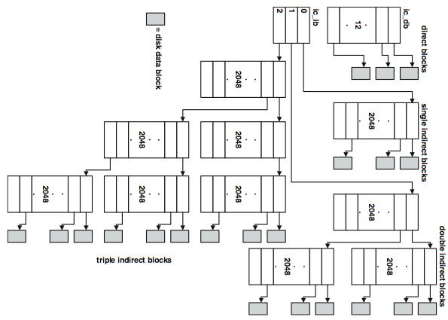
UFS – file systems
Andrej Brodnik: Digitalna forenzika
1

Slide 18
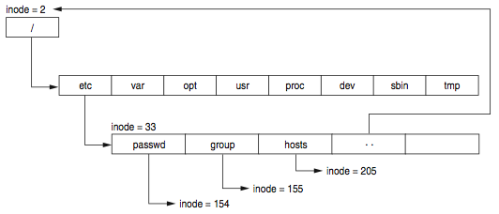
UFS – directory file
a special file that consists of parts of the directory
System V had a predefined file size
The root directory is described in inode 2
Each directory has a special entry pointing to its parent
Andrej Brodnik: Digitalna forenzika
1

Slide 19
UFS – directory entry
#define MAXNAMLEN 255
struct direct {
u_int32_t d_ino; /* inode number of entry */
u_int16_t d_reclen; /* length of this record */
u_int8_t d_type; /* file type, see below */
u_int8_t d_namlen; /* length of string in d_name */
char d_name[MAXNAMLEN + 1];
/* name with length <= MAXNAMLEN */
};
ufs/dir.h
Challenge: what is the record reclen intended for? Can this be used to hide data?
Challenge: what is ACL? How is it implemented in UFS?
Andrej Brodnik: Digitalna forenzika
1

Slide 20
UFS – superblock
Superblock stores the description of the cylinder group configuration
Scattered around the disc - at the beginning of each group of cylinders
To save the configuration – if one record is lost
tool dumpfs
Challenge: find the structure of superblock. How do we know that we are dealing with the UFS file system? Where is it written? Read the superblock from your unix file system and find out for which file system it is.
Andrej Brodnik: Digitalna forenzika
1

Slide 21
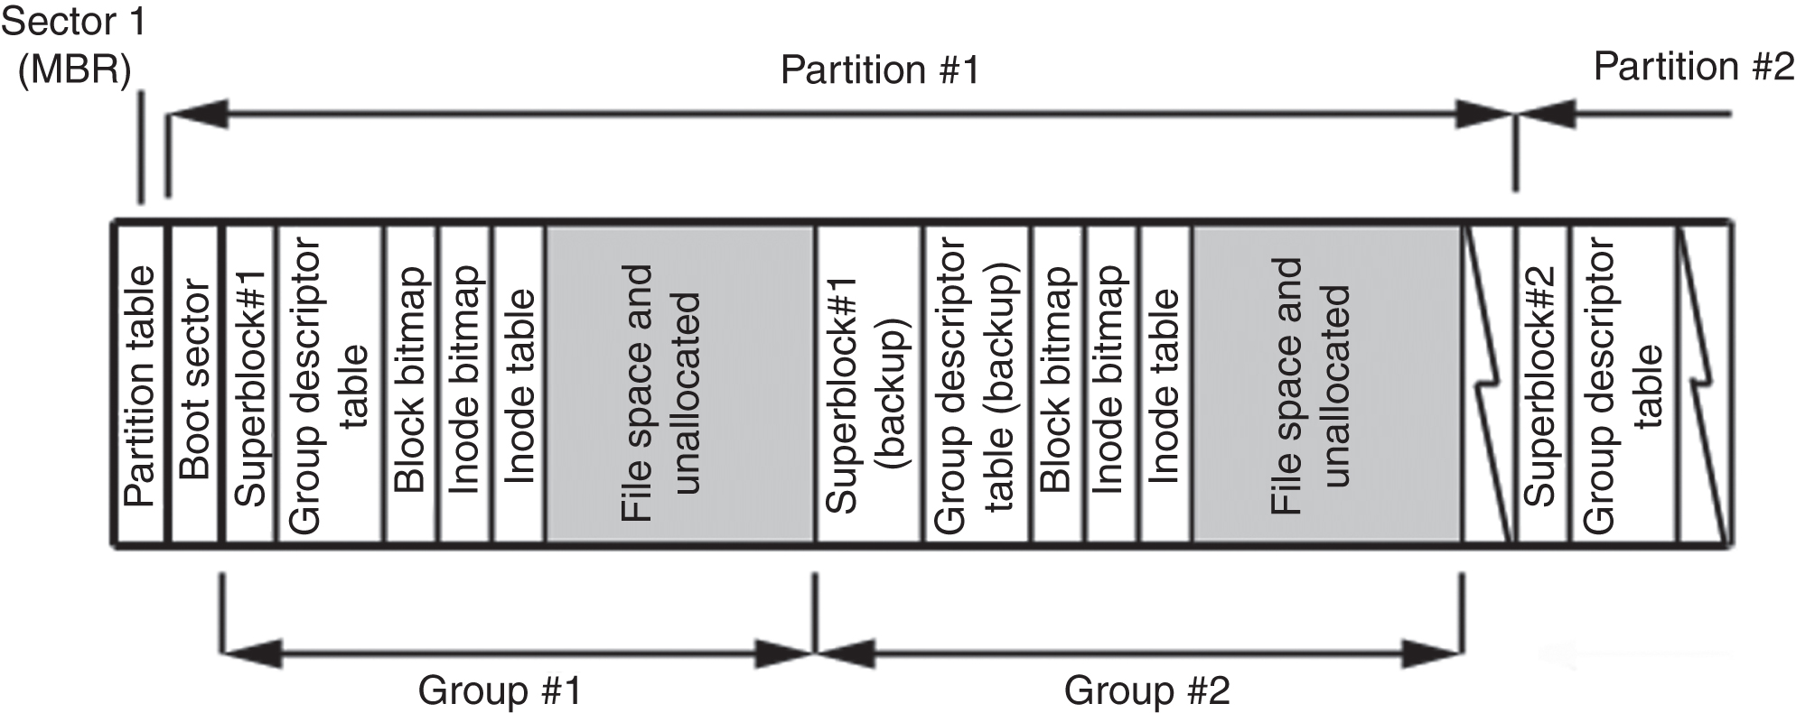
File system ext2
The basic structure is similar to that of UFS
Instead of groups of cylinders, we are talking about block groups
Directories and index nodes - like in UFS
Andrej Brodnik: Digitalna forenzika
1

Slide 22
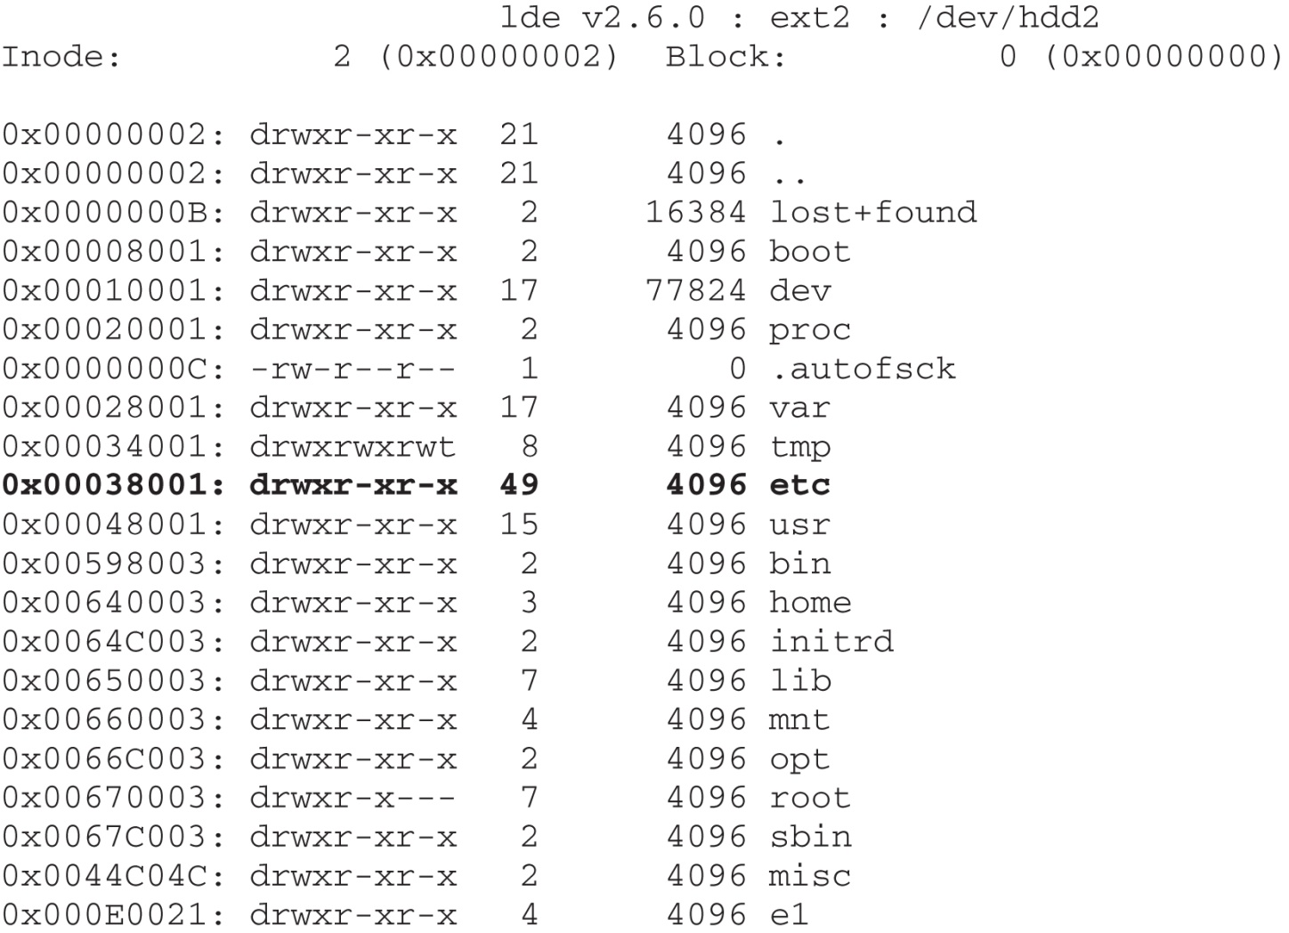
File system ext2
Tool for viewing disks: Linux Disk Editor (LDE) (http://lde.sourceforge.net/)
Andrej Brodnik: Digitalna forenzika
1

Slide 23
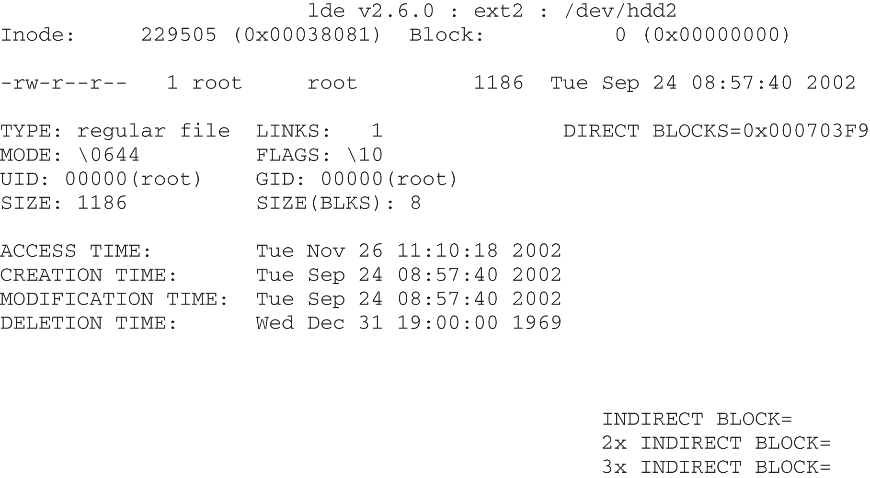
File system ext2
Andrej Brodnik: Digitalna forenzika
1

Slide 24
ext2 – index nodes
struct ext2_inode {
__u16 i_mode; /* 0: File mode */
__u16 i_uid; /* 2: Owner Uid */
__u32 i_size; /* 4: Size in bytes */
__u32 i_atime; /* 8: Access time */
__u32 i_ctime; /* 12: Creation time */
__u32 i_mtime; /* 16: Modification time */
__u32 i_dtime; /* 20: Deletion Time */
__u16 i_gid; /* 24: Group Id */
__u16 i_links_count; /* 26: Links count */
__u32 i_blocks; /* 28: Blocks count */
__u32 i_flags; /* 32: File flags */
__u32 l_i_reserved1; /* 36: OS dependent 1 */
__u32 i_block[EXT2_N_BLOCKS];/* 40: Pointers to blocks */
__u32 i_generation; /* 100: File version (for NFS) */
__u32 i_file_acl; /* 104: File ACL */
__u32 i_dir_acl; /* 108: Directory ACL */
__u32 i_faddr; /* 112: Fragment address */
__u8 l_i_frag; /* 116: Fragment number */
__u8 l_i_fsize; /* 117: Fragment size */
__u16 i_pad1; /* 118: */
__u32 l_i_reserved2[2]; /* 120: OS dependent 2 */
};
ext2fs/ext2_fs.h
Andrej Brodnik: Digitalna forenzika
1

Slide 25
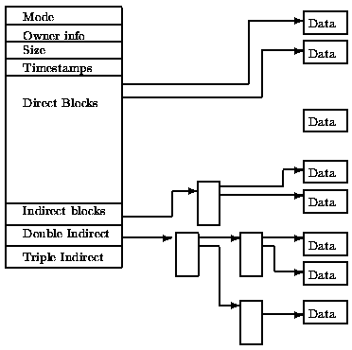
ext2 – index nodes
Andrej Brodnik: Digitalna forenzika
1

Slide 26
Directory file
A special file that consists of parts of the directory
System V had a predefined file size
The root directory is described in inode 2
Each directory has a special entry .. pointing to its parent directory
Andrej Brodnik: Digitalna forenzika
1

Slide 27
ext2 – Directory entry
#define EXT2FS_MAXNAMLEN 255
struct ext2fs_direct {
u_int32_t e2d_ino; /* inode number of entry */
u_int16_t e2d_reclen; /* length of this record */
u_int8_t e2d_namlen; /* length of string in d_name */
u_int8_t e2d_type; /* file type */
char e2d_name[EXT2FS_MAXNAMLEN];
/* name with length <= EXT2FS_MAXNAMLEN */
};
ext2fs/ext2fs_dir.h
Andrej Brodnik: Digitalna forenzika
1

Slide 28
ext2 – superblock
The superblock stores the description of the block group configuration
Scattered across the disk - at the beginning of each block of blocks
to save the configuration if one record is lost
Tool dumpfs
Izziv: poiščite strukturo nadbloka ext2. Primerjajte jo s strukturo UFS superbloka.
Andrej Brodnik: Digitalna forenzika
1

Slide 29
File system ext3
Author Stephen Tweedie 1999 / 2000 / 2001
The basic structure is the same as for the ext2 file system
Split into blocks of blocks including a superblock
Directories and index nodes
Keeping track of the disk
The option of saving the log structure is added
The basic OS Linux file system
Andrej Brodnik: Digitalna forenzika
1

Slide 30
Journaling ext3
Logs contain records of all changes to the file system
Journal structure allows three types of journaling:
comprehensive journal: saves everything; both metadata and content - the most secure
ordered: only metadata is stored but only after a successful operation - medium safe
writeback: similar to sequential, journal records at the same time as actual records - least secure
Andrej Brodnik: Digitalna forenzika
1

Slide 31
Journaling ext3
The log is a sequential file
Records are stored in front of the first group of blocks
The log group is similar to the block group:
Log superblock
Transaction descriptions
Andrej Brodnik: Digitalna forenzika
1

Slide 32
Journaling ext3
The transaction description contains three types of blocks:
Descriptor block: start of a transaction
Metadata blocks: transaction descriptions
Commit block: completion of the transaction
Revoke block: if an error occurs and contains a list of blocks in the file system that need to be reinstalled (restored)
All (including superblock) start with a magical number:
JFS_DESCRIPTOR_BLOCK 1
JFS_COMMIT_BLOCK 2
JFS_SUPERBLOCK_V1 3
JFS_SUPERBLOCK_V2 4
JFS_REVOKE_BLOCK 5
Andrej Brodnik: Digitalna forenzika
1

Slide 33
Journaling ext3
Challenge: Consider the structure of a superblock (e.g. http://linuxsoftware.co.nz/wiki/ext3) . Get a block from your file system and comment on its contents.
Challenge: How do we restored a deleted file in ext2 and in ext3? What about in UFS?
Andrej Brodnik: Digitalna forenzika
1

Slide 34
File systems
There are other file systems:
reiserFS, XFS, gfs, afs, ext4, HSM, ...
Challenge: Make a similar analysis for the mentioned systems as we did for UFS and ext.
Challenge: Compare the described file systems – in which can we hide data?
Challenge: Prepare a file system for your colleague and he must figure out which one it is.
Andrej Brodnik: Digitalna forenzika
1

Slide 35
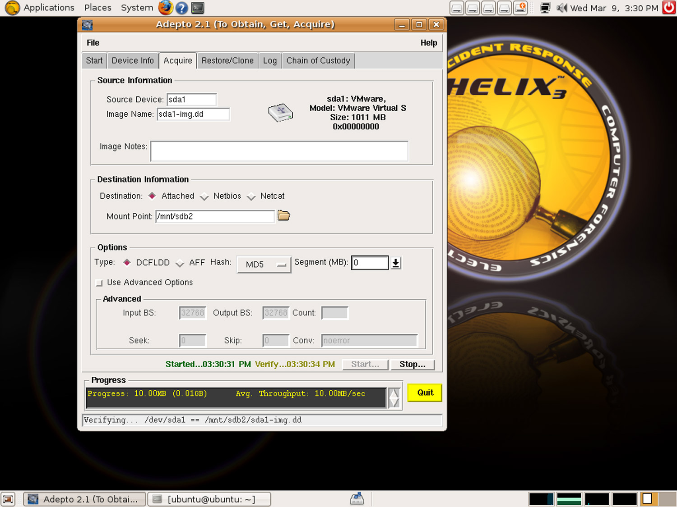
Forensic sources
We use stand-alone operating systems to analyse the disc image
Example: Helix (Ubuntu)
Challenge: Prepare the Helix CD and check what tools are already on it.
Challenge: Find some other similar systems.
Andrej Brodnik: Digitalna forenzika
1

Slide 36
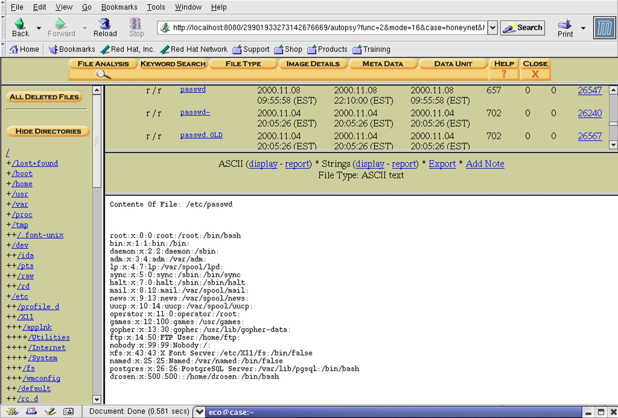
Forensic sources
Tool SleuthKit with Autopsy Forensic Browser
Andrej Brodnik: Digitalna forenzika
1

Slide 37
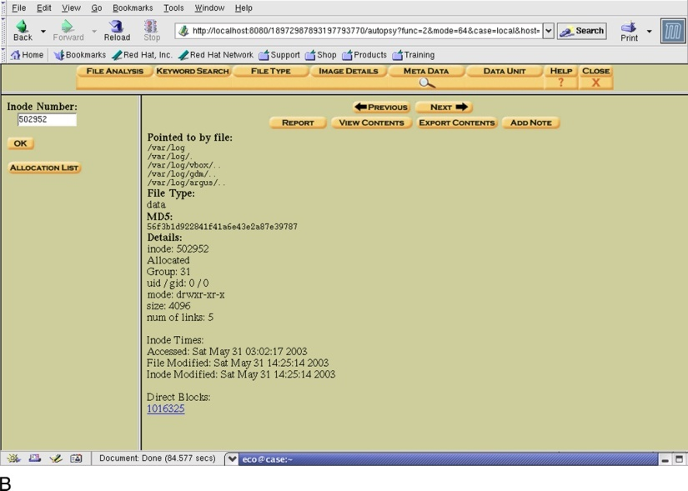
Forensic sources – research with SleuthKit
Andrej Brodnik: Digitalna forenzika
1

Slide 38
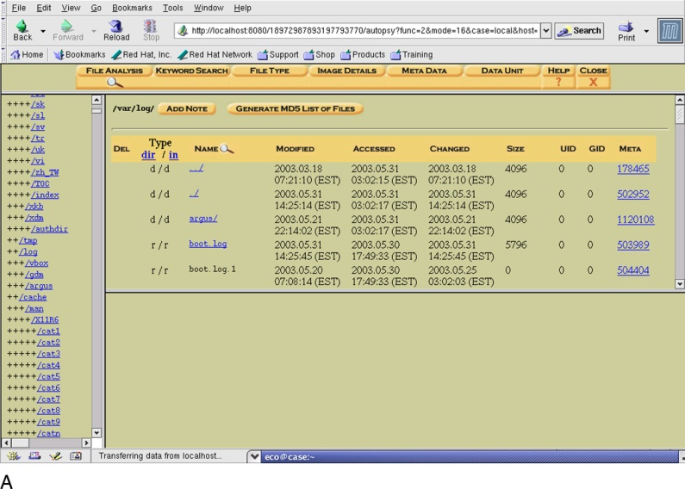
Forensic sources – research with SleuthKit
Andrej Brodnik: Digitalna forenzika
1

Slide 39
Forensic sources
Video File System Forensic Analysis (www.youtube.com/watch?v=rmG8yt1WpuA)
Different organizations
SANS Institute (Sysadmin, Audit, Networking, and Security): courses, literature…
The Honeynet Project (http://www.honeynet.org/)
Challenge: Check out challenges on http://www.honeynet.org/challenges and try them.
Andrej Brodnik: Digitalna forenzika
1

Slide 40
Forensic sources
Some interesting and rich references:
B. Carter, File system forensic analysis. Addison-Wesley, 2005.
Gregorio Narváez, Taking advantage of Ext3 journaling file system in a forensic investigation. SANS Institute, 2007.
Andrej Brodnik: Digitalna forenzika
1

