Slide 1
Digital forensics
Andrej Brodnik

Slide 2
Digital forensics
lectures: dr. Andrej Brodnik
lab sessions: dr. Gašper Fele-Žorž
e-sources: učilnica

Slide 3
Course description
Literature:
Eoghan Casey: Digital Evidence and Computer Crime (third edition)
DFRWS (Digital Forensics Research Conference): http://www.dfrws.org/
Digital Investigation – Elsevier: http://www.journals.elsevier.com/digital-investigation/
SSDDFJ (Small Scale Digital Device Forensics Journal): http://www.ssddfj.org/
IFIP Working Group 11.9 Digital Forensics: http://www.ifip119.org/
IJDCF (International Journal of Digital Crime and Forensics): http://www.igi-global.com/Bookstore/TitleDetails.aspx?TitleId=1112

Slide 4
Course description – cont.
lectures: including at least two invited lectures
homework (HW):
four homework assignments from lectures (!), exercises and books
for a positive grade: each homework is at least 20% and an average of at least 40%
lab work (LW):
two practical laboratory tasks
tasks placed in učilnica, where the results are also submitted
for a positive grade: each task at least 20% and an average of at least 50%

Slide 5
Course description – cont.
seminar (SN):
a group will have to read: a scientific article from a magazine or conference, books, tools, or alike
presentation (20 minutes) and a written product, which is reviewed by colleagues and ultimately a final product
timetable:
by 4.3. group selection; by 11.3. each group issues a proposal for the topic of its seminar paper, which is confirmed or rejected, but no later than 18. 3. confirmed;
by 27.5. submitted presentation; by 13.5. submitted seminar; by 27.5. review; by 10.6. final text;
presentation of seminar papers in May and June
for a positive grade: all assignments submitted and at least 40% from the presentation and 40% from the final written product and at least 50% from the overall grade of the seminar paper

Slide 6
Course description – cont.
written exam (WE):
only one written exam mid-year (scheduled for week 7. 5.)
for a positive grade: at least 50%
final grade:
1/3 * WE + 1/3 * SN + 1/3 * (½ * LW + ½ * HW)

Slide 7
Course content
Introduction and basics
Investigation of an electronic device with an introduction to criminal proceedings
Computers – hardware
Operating Systems (MS Windows, Unix/Linux)
Computer networks
Mobile devices
Performing a digital investigation
Digital forensics of images
images in slides are from the book © 2011: Eoghan Casey: Digital Evidence and Computer Crime (third edition)

Slide 8
Course content – cont.
invited lectures:
Digital forensics at the Police
Protection of personal data (Information Commissioner)
Digital forensics of networks (SI-CERT)

Slide 9
Introduction and basics
chapters 1 – 5

Slide 10
The basics of digital forensics
chapter 1
What is digital evidence?
Digital evidence is any digital information that is stored or transferred which enables confirmation or denial of a [criminal] act.
What is a computer system?
open computer systems
communication systems
embedded systems

Slide 11
The basics of digital forensics
to carry out a forensic investigation, knowledge is not enough, as it requires certification of personnel, organization, laboratory, ...

Slide 12
Principles of digital forensics
use of science for the needs of law
the importance of distinguishing between certainty and probability :
The lack of evidence is not evidence of non-existence!
preparation and storage of material for potential litigation

Slide 13
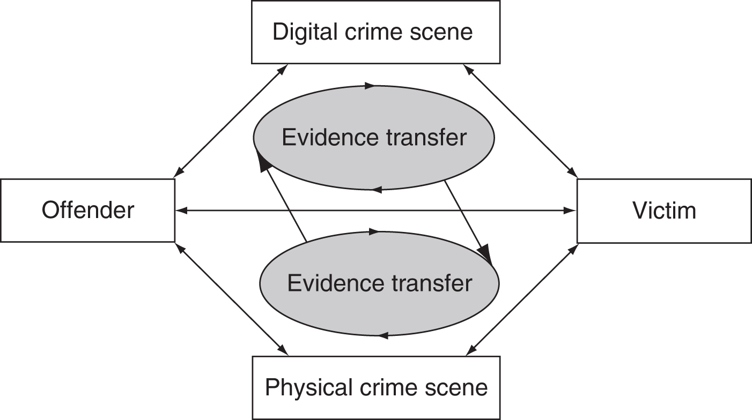
Exchanging evidence
fingerprints (on the keyboard)
e-mail and notes
notes about visited sites
communication trails
...
Exchanging evidence between the victim and the perpetrator (or scene)
Locard's principle of exchange

Slide 14
Evidence
evidence has common properties (all programs of this type) and special properties (concrete settings)
digital evidence acceptable in court:
must be properly processed (captured) and
must be stored in a forensically correct manner
that‘s why all actions on the scene must be recorded

Slide 15
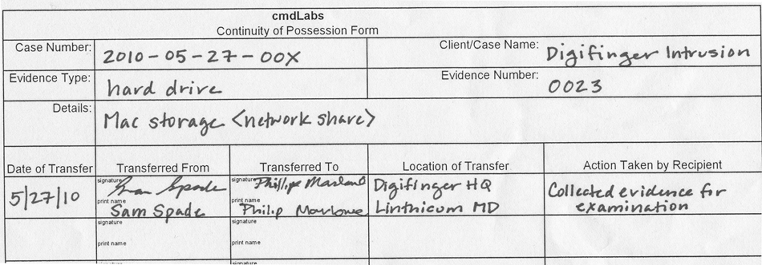
Evidence
ensuring authenticity:
the content must be unchanged
content must originate from the scene (recording the order of possession of evidence - the evidence chain)
additional information on the handling of evidence

Slide 16
The integrity of the evidence
the accepted form of ensuring the integrity of evidence is signing it with a spray function
MD5, SHA-1, ...

Slide 17
Handling evidence
objectivity of evidence
contains interpretation and presentation of evidence
repeatability of evidence analysis

Slide 18
The challenges of handling digital evidence
residue or reconstruction is not the same as the whole material:
the reconstructed file that was deleted is not the same as the partitions of it
the remnants of the sent e-mail are not the same as the entire e-mail
the connection between (digital) evidence and the perpetrator is not always obvious
data is not eternal
traffic information on the network

Slide 19
The challenges of handling digital evidence
evidence is not necessarily error-free
the administrator has already tried to save the deleted file
the system administrator changed the content to secure the system
there was an error during data capture (non-standard procedure)
during the data capture, an infected medium was used
the media with the stored data has been damaged
...

Slide 20
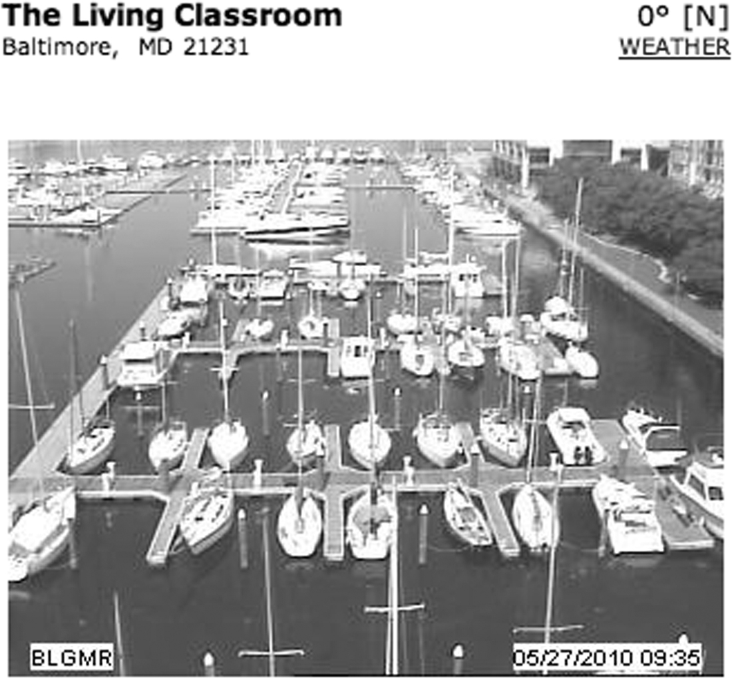
The digital world is not separate from the real one
example: a buyer bought a good through eBay
case example: Auction Fraud, 2000; str. 29
data can come from unexpected places

Slide 21
Developing the language of computer crime research
chapter 2
there were no computers at the beginning, and the law only protected material evidence
digital evidence includes:
computer (file) forensics
network forensics
mobile forensics
malware forensics
important difference between research and data analysis
the investigation includes capture, organization, ...
the analysis represents the actual processing of evidence

Slide 22
The role of computer
According to Parker:
as the object of a crime
when a computer is stolen or destroyed
as the subject of a crime - a computer is the environment in which the crime is committed
when a computer is infected by a virus or impaired in some other way to inconvenience the individuals who use it
as the tool for conducting or planning a crime
when a computer is used to forge documents or break into other computers
the symbol of the computer itself to intimidate or deceive
offering services or the capabilities of computer services: gains on the stock exchange, ...
data source(!!) - remains of files, e-mails, ...

Slide 23
The role of computer
USDOJ (US Department of Justice):
hardware as Contraband or Fruits of Crime
hardware as an Instrumentality
hardware as Evidence
information as Contraband or Fruits of Crime
information as an Instrumentality
information as Evidence

Slide 24
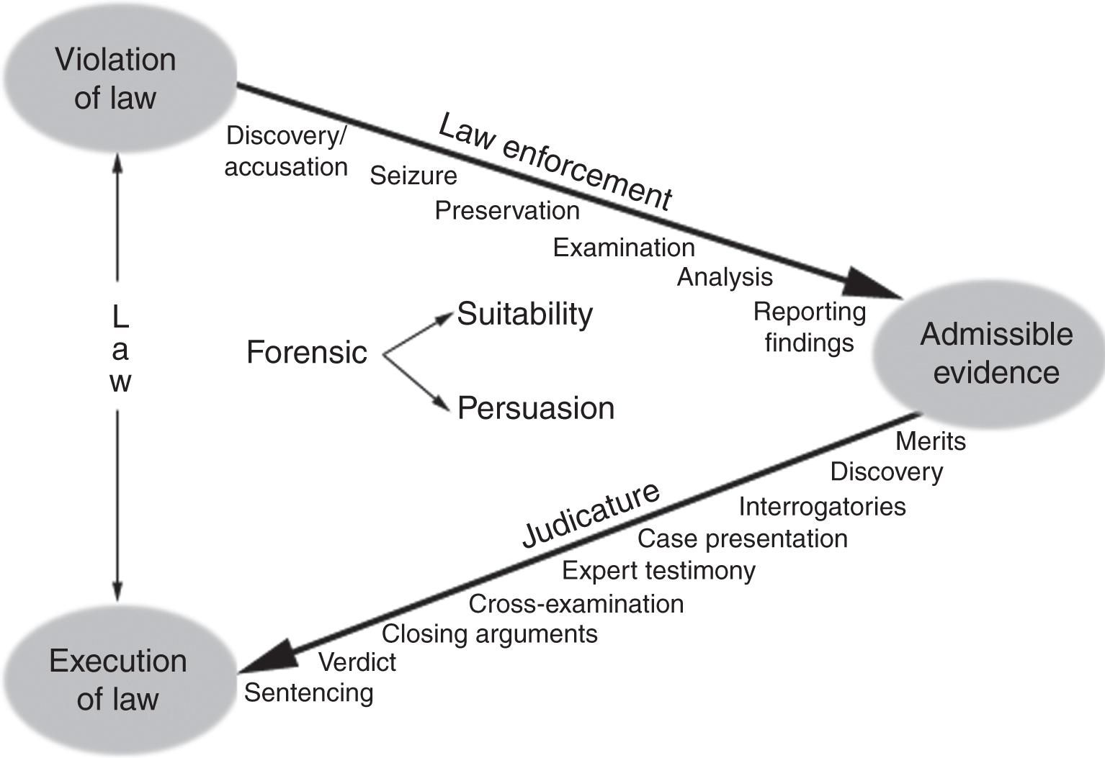
Digital evidence in court
chapter 3
Digital evidence in court

Slide 25
Tasks of an expert
presentation of evidence material:
do not succumb to influences
to reject prematurely set theories
use of scientific truth for the needs of the legal process
ACM Code of ethics
IEEE Code of ethics

Slide 26
Admissibility
five basic rules:
relevance of the material for the case
authenticity of the material (capture, traceability, ...)
not hearsay or admissible hearsay (the evidence is not hearsay unless the speaker is present)
the best possible evidence (original and copy)
not unduly prejudicial
search warrant

Slide 27
Levels of Certainty
we have a record in the notes:
2009-04-03 02:28:10 W3SVC1 10.10.10.50 GET /images/snakeoil13.jpg-80-192.168.1.1 Mozilla/4.0+(compatible;+MSIE+6.0;Windows+NT+5.1) 200 0 0
what do we conclude from it?
levels of Certainty:
(1) almost definitely; (2) most probably; (3) probably; (4) very possibly; (5) possibly
statistical probability

Slide 28
Computer Legislation
chapter 4
legislation USA
50 legislations
Washington DC legislation
federal legislation

Slide 29
Computer Legislation
chapter 5
legislation ES (EU)
Ireland and Great Britain separate system – common law
the rest of the countries – civil law
common legislation:
parliament EU
Convention on Cybercrime, 1. July 2004
has not been ratified by Ireland and the United Kingdom
Protocol on acts of racism and xenophobia, 1. March 2006

Slide 30
Crimes over the integrity of the computer
Access to a computer is not allowed unless authorized by the owner
Examples – read 5.4.*:
hackers
stealing data
intercepting data
Influencing data and/or systems (DOS, viruses)
››incorrect‹‹ or unintentional use of the unit/device

Slide 31
Crimes with the help of computers
forgery
fraud
abuse

Slide 32
Crimes related to data content
Crimes that affect the content of the data – read 5.6.*
child pornography
web seduction - what is this???
racism and xenophobia

Slide 33
Other crimes
copyright infringement
computer blackmail
...

