Slide 1
Computer Forensics
Andrej Brodnik
Andrej Brodnik: Computer Forensics

Slide 2
Computer network basics
chapters 21, 23, 24 and 25
from history
Andrej Brodnik: Computer Forensics

Slide 3
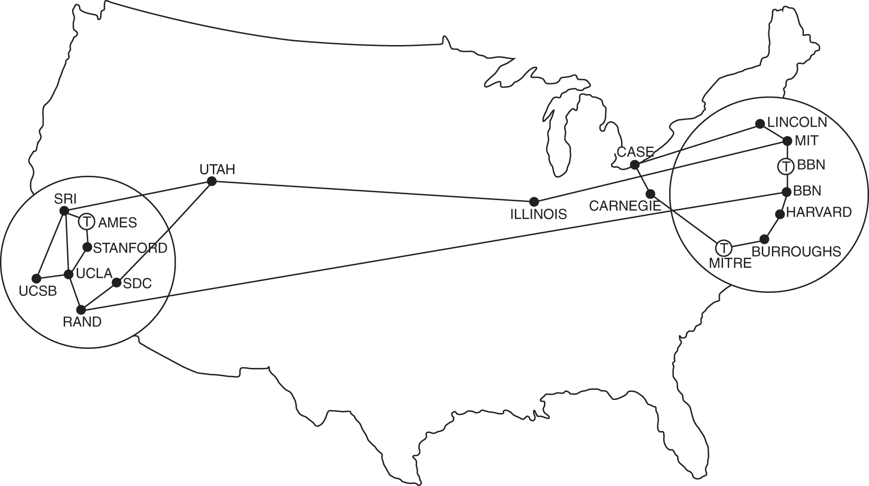
Computer network basics
from history: ARPANET
TCP/IP: 1973/74
Andrej Brodnik: Computer Forensics

Slide 4
Computer network basics
network, internet
Andrej Brodnik: Computer Forensics

Slide 5
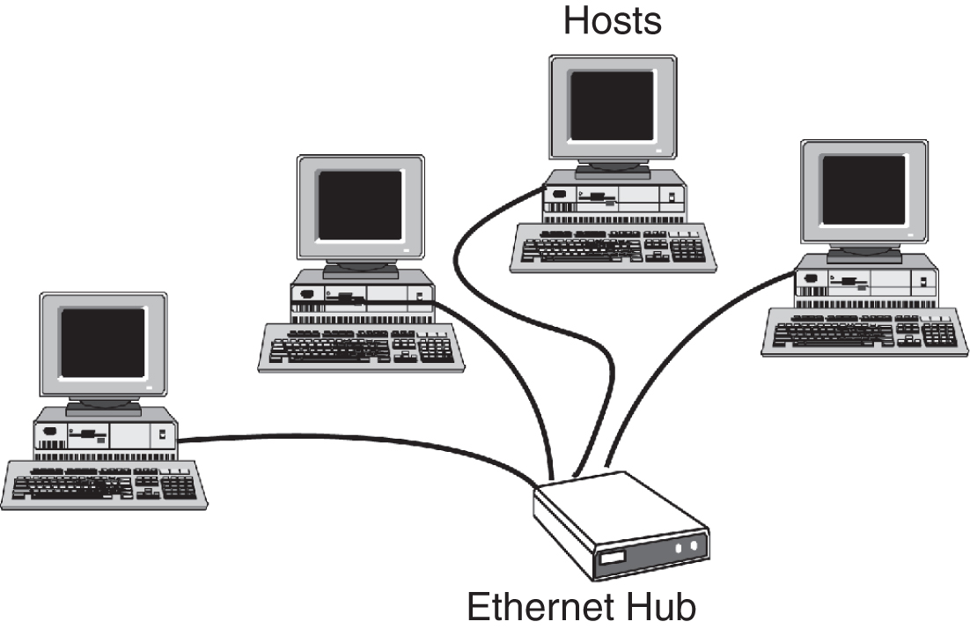
Network
IEEE 802.3 Ethernet
Andrej Brodnik: Computer Forensics

Slide 6
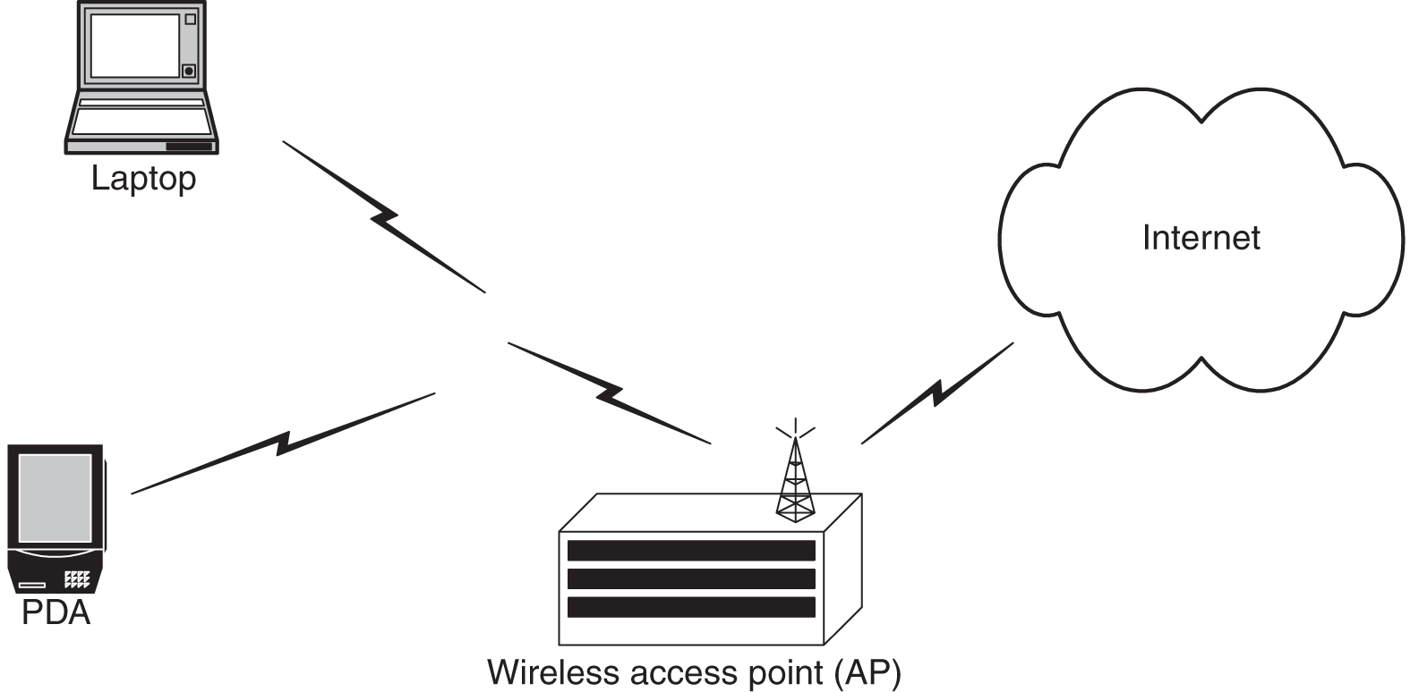
Network
IEEE 802.11 Ethernet
Andrej Brodnik: Computer Forensics

Slide 7
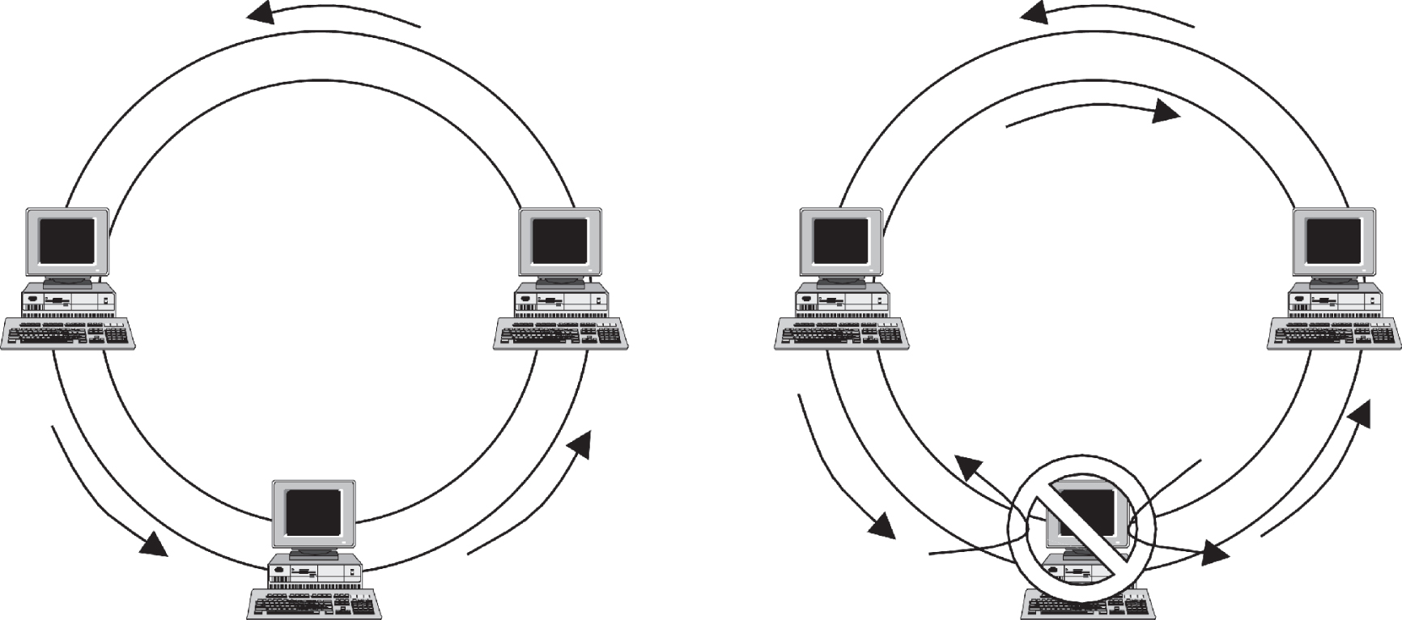
Network
FDDI
Andrej Brodnik: Computer Forensics

Slide 8
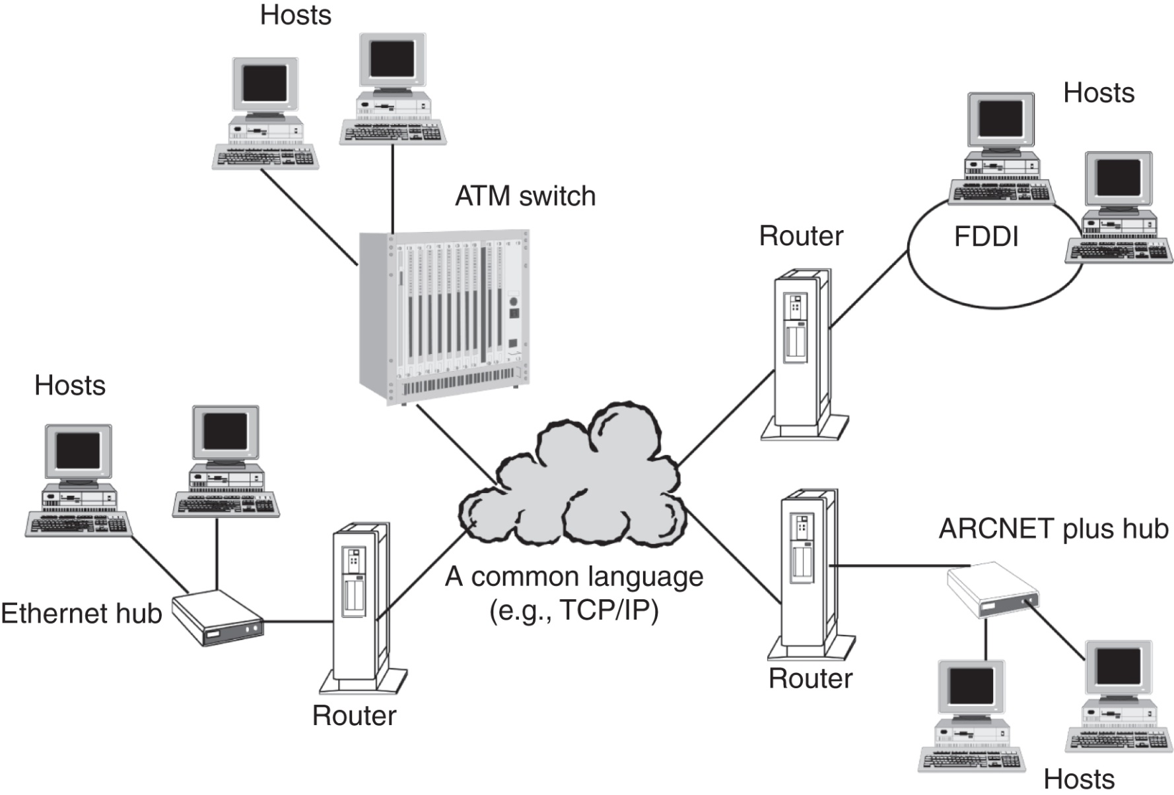
Network
network of dissimilar networks and common language
Andrej Brodnik: Computer Forensics

Slide 9
Layer model
each layer is independant from others
It serves the layers above and is served by layers below
VPE??
layer n+1
PCI
SDU
SDT??
PCI
layer n
head
SDU
PCI = Protocol Control Information
SDU = Service Data Unit
PDU = Protocol Data Unit
n-PDU
Andrej Brodnik: Computer Forensics

Slide 10
Reference models
layers of OSI reference model: physical, data link, network, transport, session, presentation, application.
application
application
interface
protocol
presentation
presentation
session
session
computer A
transport
transport
computer B
network
network
network
network
data link
data link
data link
data link
physical
physical
physical
physical
Andrej Brodnik: Computer Forensics

Slide 11
Reference model – TCP/IP
TCP/IP reference model
is the foundation of the internet and de facto standard
no presentation or session layers
physical and data link layers are combined in so called “Host-to-network” layer
data link layer is composed of MAC and LLC (IEEE 802)
TELNET
FTP
SMNP
SMTP
HTTP
application layer
TCP
UDP
ICMP
transport layer
IP
network layer
ARPANET
Packet radio
LAN
physical and
data link layer
Andrej Brodnik: Digitalna forenzika

Slide 12
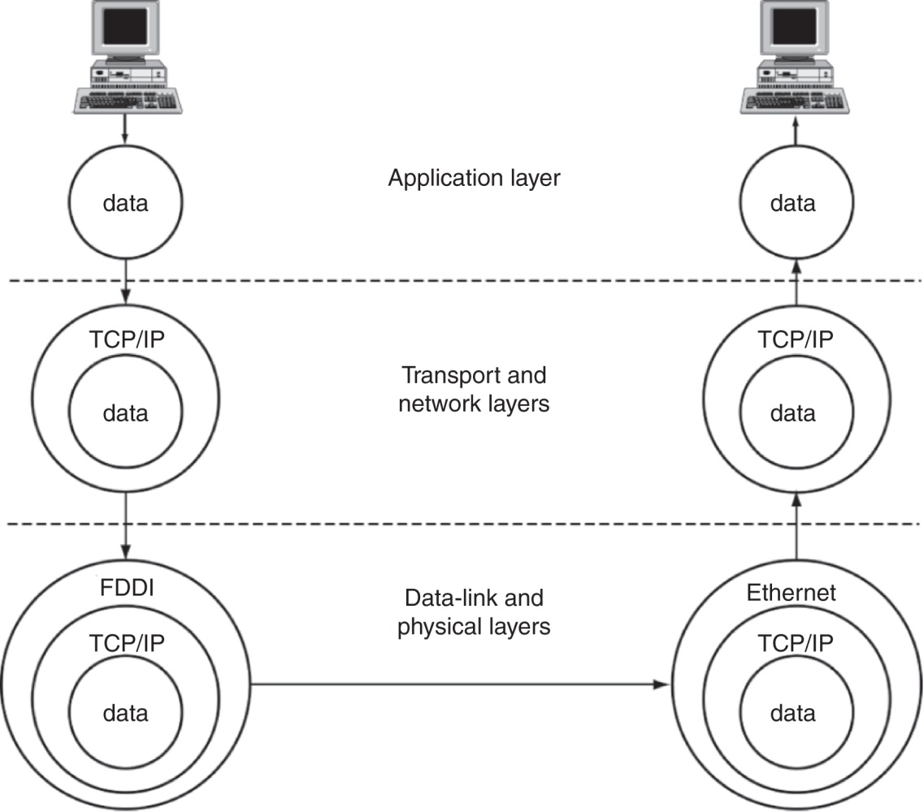
Containers
TCP/IP example
Andrej Brodnik: Computer Forensics

Slide 13
Physical and data link layers
physical: transmission of physical signals
data link:
IEEE 802.11 is the most common
encompases different technologies
among the most well known are IEEE 802.3, 11, 15, 16, ...
composed of MAC and LLC sublayers
MAC – media access control: unique for a particular technology
LLC – link layer control: equal for all technologies
Andrej Brodnik: Computer Forensics

Slide 14
Network layer
IP (internet protocol) is used for transparently relaying packets across networks
best-effort and out-of-order delivery
shared address space (IPv4, IPv6)
connected to the data link layer through ARP (arp tool)
Challenge: determine which computers are in your network. How would the protocol be used in a forensic investigation? How would the protocol (possibly with additional tools) be used in finding out what is happening in our network?
Andrej Brodnik: Computer Forensics

Slide 15
Transport layer
fundamental protocols TCP and UDP: connection-oriented and connectionless communication
TCP represents a stream of data between two processes on different computers
Andrej Brodnik: Computer Forensics

Slide 16
Application layer
standard applications: mail, web, news, IRC, ...
non-standard applications: defined by the user
Andrej Brodnik: Computer Forensics

Slide 17
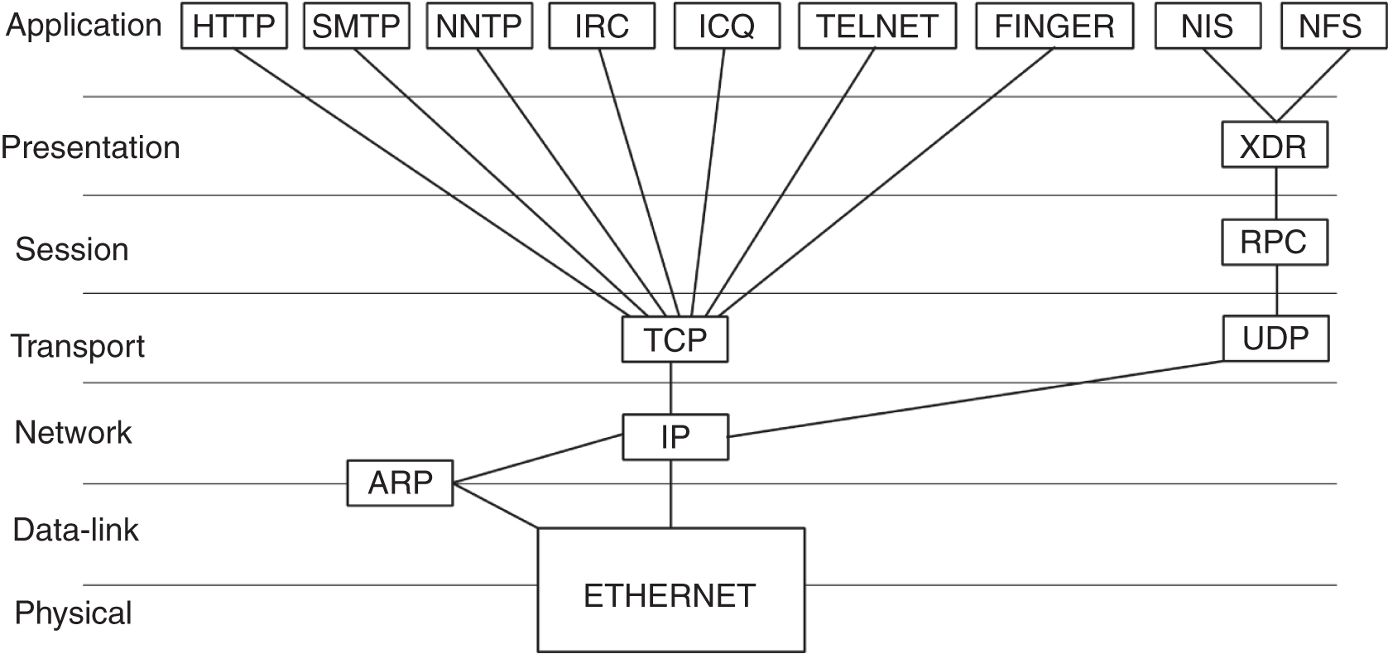
TCP/IP example
example of protocol taxonomy
Andrej Brodnik: Computer Forensics

Slide 18
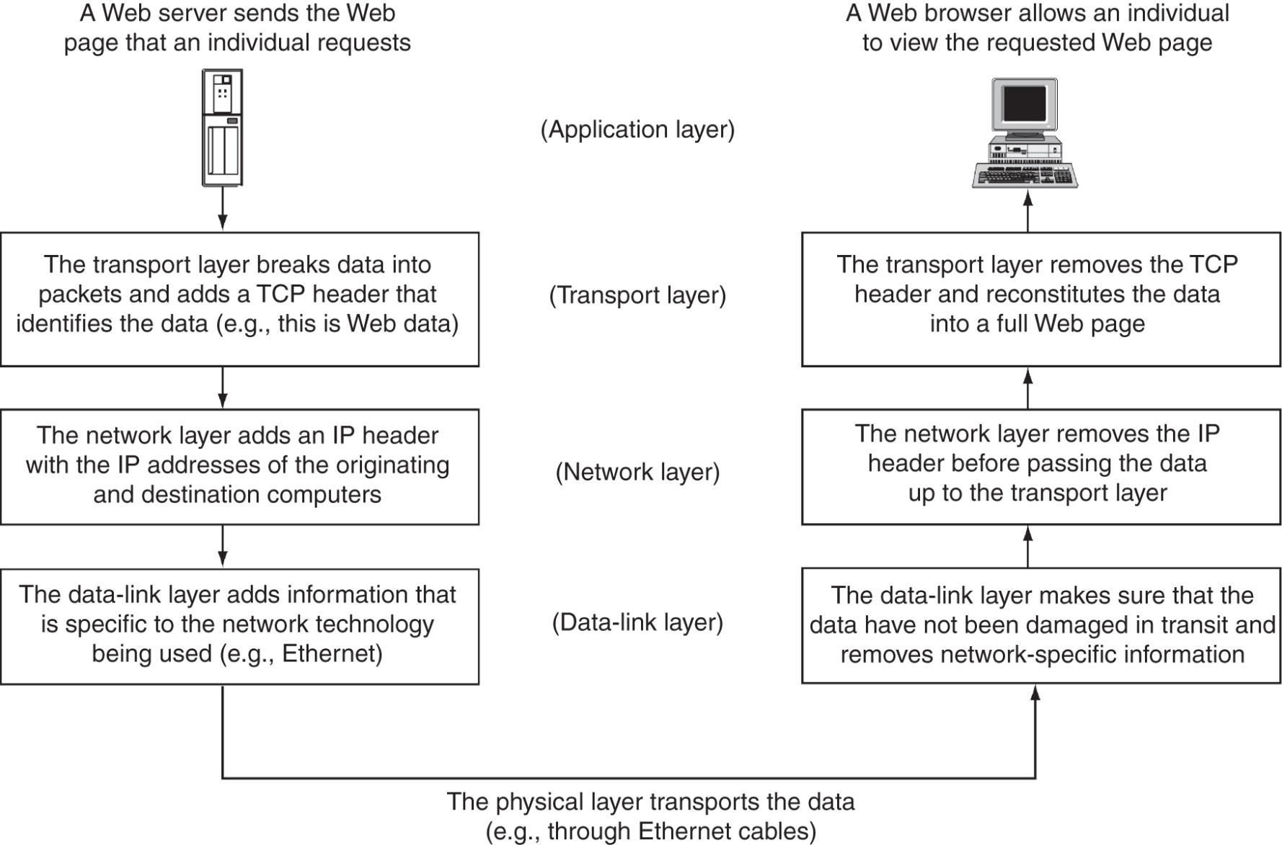
Protocol stack TCP/IP
Andrej Brodnik: Computer Forensics

Slide 19
Some fundamental tools
basic tools made available by the operating system
arp:
Andy@svarun:~[122]%> arp -an
? (192.168.127.7) at 00:1f:5b:f2:e1:da on rl0 expires in 1189 seconds [ethernet]
? (192.168.127.1) at 00:13:f7:39:d8:d1 on rl0 permanent [ethernet]
Andrej Brodnik: Computer Forensics

Slide 20
Some fundamental tools ...
netstat:
Andy@svarun:~[124]%> netstat -rn
Routing tables
Internet:
Destination Gateway Flags Refs Use Netif Expire
default 213.250.19.90 UGS 0 15915184 tun0
10.0.0.1 link#11 UHS 0 0 lo0
10.0.0.2 link#11 UHS 0 0 tun0
127.0.0.1 link#10 UH 0 168729 lo0
192.168.127.0/24 link#7 U 0 3843148 rl0
192.168.127.1 link#7 UHS 0 134062 lo0
193.77.156.167 link#11 UHS 0 0 lo0
213.250.19.90 link#11 UHS 0 0 tun0
Internet6:
Destination Gateway Flags Netif Expire
::/96 ::1 UGRS lo0
::1 ::1 UH lo0
::ffff:0.0.0.0/96 ::1 UGRS lo0
fe80::/10 ::1 UGRS lo0
fe80::%rl0/64 link#7 U rl0
fe80::213:f7ff:fe39:d8d1%rl0 link#7 UHS lo0
fe80::%rl1/64 link#8 U rl1
fe80::213:f7ff:fe39:dac7%rl1 link#8 UHS lo0
fe80::%lo0/64 link#10 U lo0
fe80::1%lo0 link#10 UHS lo0
ff01::%rl0/32 fe80::213:f7ff:fe39:d8d1%rl0 U rl0
ff01::%rl1/32 fe80::213:f7ff:fe39:dac7%rl1 U rl1
ff01::%lo0/32 ::1 U lo0
ff02::/16 ::1 UGRS lo0
ff02::%rl0/32 fe80::213:f7ff:fe39:d8d1%rl0 U rl0
ff02::%rl1/32 fe80::213:f7ff:fe39:dac7%rl1 U rl1
ff02::%lo0/32 ::1 U lo0
Andrej Brodnik: Computer Forensics

Slide 21
Some fundamental tools ...
sockstat:
Andy@svarun:~[128]%> sockstat
USER COMMAND PID FD PROTO LOCAL ADDRESS FOREIGN ADDRESS
.... imap 97205 0 stream -> ??
dovecot imap-login 97204 3 stream -> ??
dovecot imap-login 97204 4 tcp4 *:143 *:*
dovecot imap-login 97204 5 tcp4 *:993 *:*
dovecot imap-login 97204 11 stream -> /var/run/dovecot/login/default
bind named 1750 513 udp4 127.0.0.1:53 *:*
bind named 1750 514 udp4 10.0.0.1:53 *:*
root syslogd 1649 4 dgram /var/run/log
root syslogd 1649 5 dgram /var/run/logpriv
...
Andrej Brodnik: Digitalna forenzika

Slide 22
Some fundamental tools ...
ifconfig:
Andy@svarun:~[131]%> ifconfig
alc0: flags=8802<BROADCAST,SIMPLEX,MULTICAST> metric 0 mtu 1500
options=c3198<VLAN_MTU,VLAN_HWTAGGING,VLAN_HWCSUM,TSO4,WOL_MCAST,WOL_MAGIC,VLAN_HWTSO,LINKSTATE>
ether 54:04:a6:94:54:0b
nd6 options=23<PERFORMNUD,ACCEPT_RTADV,AUTO_LINKLOCAL>
media: Ethernet autoselect
rl0: flags=8843<UP,BROADCAST,RUNNING,SIMPLEX,MULTICAST> metric 0 mtu 1500
options=3808<VLAN_MTU,WOL_UCAST,WOL_MCAST,WOL_MAGIC>
ether 00:13:f7:39:d8:d1
inet6 fe80::213:f7ff:fe39:d8d1%rl0 prefixlen 64 scopeid 0x7
inet 192.168.127.1 netmask 0xffffff00 broadcast 192.168.127.255
nd6 options=23<PERFORMNUD,ACCEPT_RTADV,AUTO_LINKLOCAL>
media: Ethernet autoselect (100baseTX <full-duplex>)
status: active
rl1: flags=8843<UP,BROADCAST,RUNNING,SIMPLEX,MULTICAST> metric 0 mtu 1500
options=3808<VLAN_MTU,WOL_UCAST,WOL_MCAST,WOL_MAGIC>
ether 00:13:f7:39:da:c7
inet6 fe80::213:f7ff:fe39:dac7%rl1 prefixlen 64 scopeid 0x8
nd6 options=23<PERFORMNUD,ACCEPT_RTADV,AUTO_LINKLOCAL>
media: Ethernet autoselect (100baseTX <full-duplex>)
status: active
Andrej Brodnik: Computer Forensics

Slide 23
Some fundamental tools ...
ifconfig:
lo0: flags=8049<UP,LOOPBACK,RUNNING,MULTICAST> metric 0 mtu 16384
options=3<RXCSUM,TXCSUM>
inet6 ::1 prefixlen 128
inet6 fe80::1%lo0 prefixlen 64 scopeid 0xa
inet 127.0.0.1 netmask 0xff000000
nd6 options=23<PERFORMNUD,ACCEPT_RTADV,AUTO_LINKLOCAL>
ipfw0: flags=8801<UP,SIMPLEX,MULTICAST> metric 0 mtu 65536
nd6 options=23<PERFORMNUD,ACCEPT_RTADV,AUTO_LINKLOCAL>
tun0: flags=8051<UP,POINTOPOINT,RUNNING,MULTICAST> metric 0 mtu 1492
options=80000<LINKSTATE>
inet 10.0.0.1 --> 10.0.0.2 netmask 0xffffff00
inet 193.77.156.167 --> 213.250.19.90 netmask 0xffffff00
nd6 options=21<PERFORMNUD,AUTO_LINKLOCAL>
Opened by PID 85187
Andrej Brodnik: Computer Forensics

Slide 24
Some fundamental tools ...
tcpdump / pcap:
Andy@svarun:~[129]%> svarun# tcpdump -i rl0 -n
tcpdump: verbose output suppressed, use -v or -vv for full protocol decode
listening on rl0, link-type EN10MB (Ethernet), capture size 65535 bytes
08:10:33.878428 IP 193.77.156.167.22 > 192.168.127.7.53945: Flags [P.], seq 1108677235:1108677427, ack 2653943873, win 1040, options [nop,nop,TS val 2243985208 ecr 1042431634], length 192
08:10:33.878574 IP 192.168.127.7.53945 > 193.77.156.167.22: Flags [.], ack 192, win 33208, options [nop,nop,TS val 1042431634 ecr 2243985208], length 0
08:10:34.379667 IP 192.168.127.7.47895 > 195.221.158.190.56534: UDP, length 137
08:10:34.429933 IP 192.168.127.7.47895 > 111.221.74.19.40012: UDP, length 32
08:10:34.441387 IP 195.221.158.190 > 192.168.127.7: ICMP 195.221.158.190 udp port 56534 unreachable, length 156
08:10:34.712616 IP 111.221.74.19.40012 > 192.168.127.7.47895: UDP, length 434
08:10:34.878466 IP 193.77.156.167.22 > 192.168.127.7.53945: Flags [P.], seq 192:736, ack 1, win 1040, options [nop,nop,TS val 2243986208 ecr 1042431634], length 544
...
Andrej Brodnik: Computer Forensics
Notes:
packet capture
<number>

Slide 25
Some fundamental tools ...
Challenge: use basic tools to explore your neighborhood.
Challenge: examine your system and determine which services it offers to the devices in the neighborhood?
Challenge: the tcpdump tool allows for storage of captured data for later usage. The analysis of this data can be done using the wireshark tool. Try to perform this procedure.
Challenge: in a forensically sound manner capture the data in your network and post the results on the forum. A colleague should then perform the analysis.
Andrej Brodnik: Computer Forensics

Slide 26
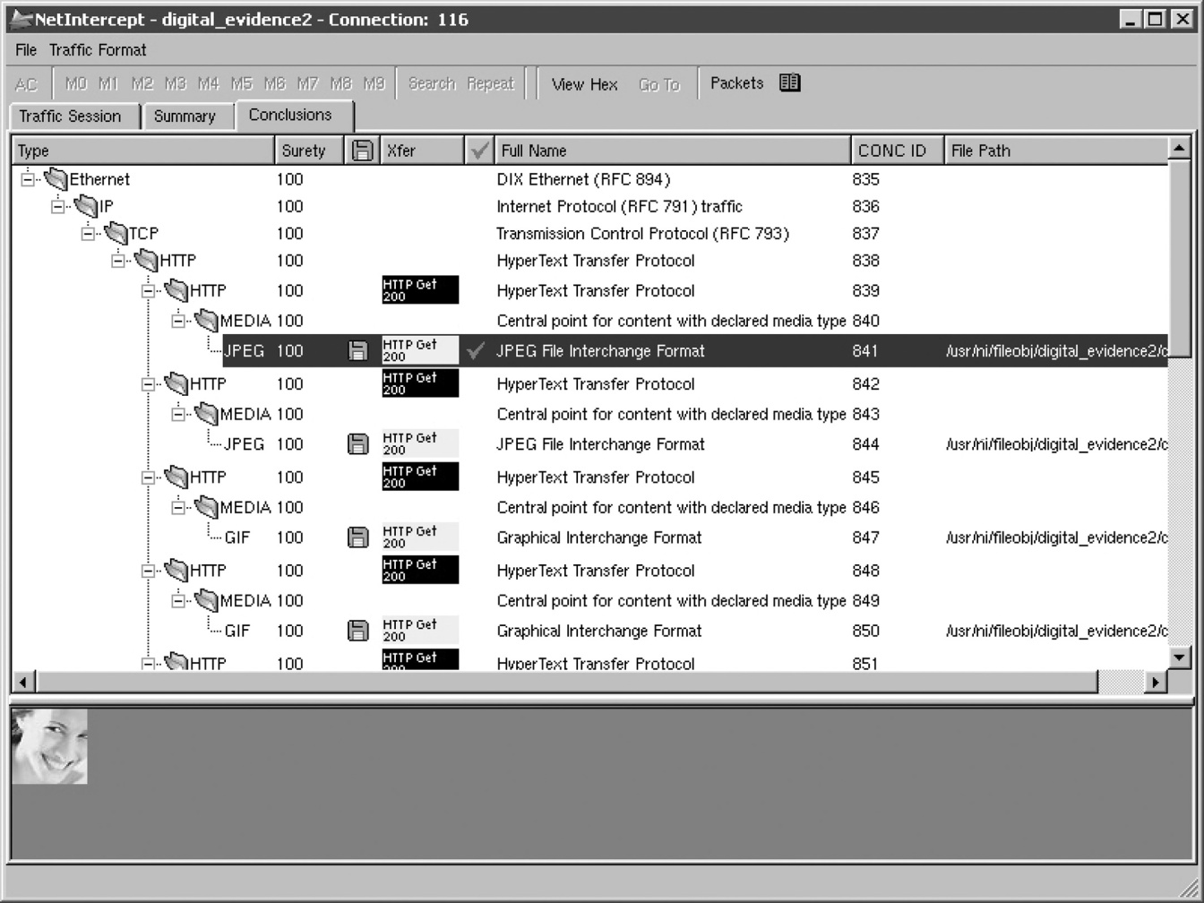
Professional and other tools
Niksun forensics tools http://www.niksun.com/sandstorm.php: netintercept
Andrej Brodnik: Computer Forensics

Slide 27
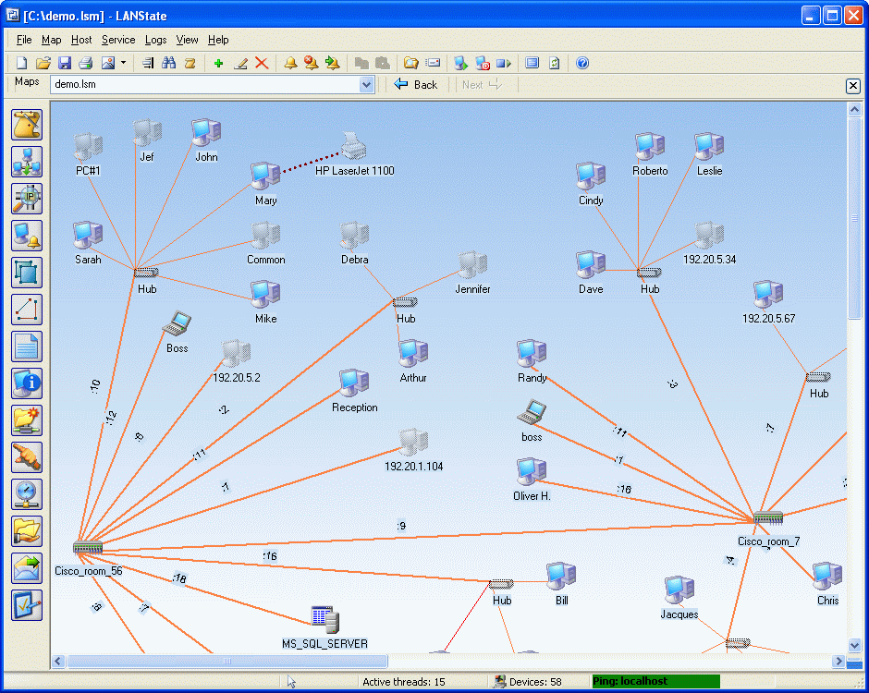
Professional and other tools
network management protocols: snmp, rmon, …
Andrej Brodnik: Digitalna forenzika

Slide 28
Protocol SNMP
snmp v2 and v3
connectionless data transfer: UDP
two types of commands:
on-demand data transfer and
event based data transfer
the status of the network is stored in the MDB and in the log files
Challenge: find tools for network exploration that employ the snmp protocol and explore your neighborhood.
Andrej Brodnik: Computer Forensics

Slide 29
Strength in numbers
www.fri.uni-lj.si = 212.235.188.25
DNS service maps strings to numbers
a mapping table in /etc/hosts can alternatively be used
a DNS server inquires other DNS servers if there is a string it can’t map
file /etc/namedb/named.root
tools dig and nslookup
Andrej Brodnik: Computer Forensics

Slide 30
DNS server
file /etc/namedb/named.root (excerpt):
; formerly NS.INTERNIC.NET
;
. 3600000 IN NS A.ROOT-SERVERS.NET.
A.ROOT-SERVERS.NET. 3600000 A 198.41.0.4
A.ROOT-SERVERS.NET. 3600000 AAAA 2001:503:BA3E::2:30
;
; FORMERLY NS1.ISI.EDU
;
. 3600000 NS B.ROOT-SERVERS.NET.
B.ROOT-SERVERS.NET. 3600000 A 192.228.79.201
;
; FORMERLY C.PSI.NET
;
. 3600000 NS C.ROOT-SERVERS.NET.
C.ROOT-SERVERS.NET. 3600000 A 192.33.4.12
;
; FORMERLY TERP.UMD.EDU
;
. 3600000 NS D.ROOT-SERVERS.NET.
D.ROOT-SERVERS.NET. 3600000 A 128.8.10.90
D.ROOT-SERVERS.NET. 3600000 AAAA 2001:500:2D::D
;
; FORMERLY NS.NASA.GOV
;
. 3600000 NS E.ROOT-SERVERS.NET.
E.ROOT-SERVERS.NET. 3600000 A 192.203.230.10
;
; FORMERLY NS.ISC.ORG
Andrej Brodnik: Computer Forensics

Slide 31
DNS server
Challenge: with an appropriate tool find your DNS server and examine its records.
Challenge: with your colleagues set up an isolated network with its own root name servers.
Challenge: assume that the following packet was captured on the network:
09:13:01.839003 IP (tos 0x10, ttl 64, id 13571, offset 0, flags [DF], proto TCP (6), length 180)
www.brodnik.org.ssh > AndyMac.gotska.brodnik.org.53945: Flags [P.], cksum 0xf181 (correct), seq 1108696419:1108696547, ack 2653946897, win 1040, options [nop,nop,TS val 2247733168 ecr 1042469077], length 128
comment on the contents and determine the sender and the recipient.
Andrej Brodnik: Computer Forensics

Slide 32
Strength in numbers
DNS service uses port 53
there is no service that would map DNS to 53
there is however a mappign table in /etc/services
the system binds the application to the process (program) at startup
Andrej Brodnik: Computer Forensics

Slide 33
Application names
#
# Network services, Internet style
#
# WELL KNOWN PORT NUMBERS
#
rtmp 1/ddp #Routing Table Maintenance Protocol
tcpmux 1/udp # TCP Port Service Multiplexer
tcpmux 1/tcp # TCP Port Service Multiplexer
...
domain 53/tcp #Domain Name Server
domain 53/udp #Domain Name Server
imap 143/tcp imap2 imap4 #Interim Mail Access Protocol v2
imap 143/udp imap2 imap4 #Interim Mail Access Protocol v2
imaps 993/tcp # imap4 protocol over TLS/SSL
imaps 993/udp
...
Andrej Brodnik: Computer Forensics

Slide 34
Application names
sockstat
Andy@svarun:~[128]%> sockstat
USER COMMAND PID FD PROTO LOCAL ADDRESS FOREIGN ADDRESS
.... imap 97205 0 stream -> ??
dovecot imap-login 97204 3 stream -> ??
dovecot imap-login 97204 4 tcp4 *:143 *:*
dovecot imap-login 97204 5 tcp4 *:993 *:*
dovecot imap-login 97204 11 stream -> /var/run/dovecot/login/default
bind named 1750 513 udp4 127.0.0.1:53 *:*
bind named 1750 514 udp4 10.0.0.1:53 *:*
root syslogd 1649 4 dgram /var/run/log
root syslogd 1649 5 dgram /var/run/logpriv
...
Andrej Brodnik: Computer Forensics

Slide 35
Application names
Challenge: what is the actual name of the DNS service in the said table?
Challenge: add/modify an entry in the table. Do you notice any changes when running sockstat, netstat, tcpdump?
Challenge: kako operacijski sistem poveže aplikacijo z vrati za storitev? Kako se to naredi na Windows, na FreeBSD in kako na Linux?
Andrej Brodnik: Computer Forensics

Slide 36
Protocol names
excerpt:
ip 0 IP # internet protocol, pseudo protocol number
icmp 1 ICMP # internet control message protocol
igmp 2 IGMP # internet group management protocol
ggp 3 GGP # gateway-gateway protocol
tcp 6 TCP # transmission control protocol
udp 17 UDP # user datagram protocol
ddp 37 DDP # Datagram Delivery Protocol
ipv6 41 IPV6 # ipv6
mobile 55 MOBILE # IP Mobility
ipv6-icmp 58 IPV6-ICMP icmp6 # ICMP for IPv6
etherip 97 ETHERIP # Ethernet-within-IP Encapsulation
Andrej Brodnik: Computer Forensics

Slide 37
Names ...
Challenge: which protocol is denoted by the number 50 ans what is it used for?
Challenges: what are the formats of all three etc files – hosts, protocols, services?
Challenge: what is cifs/smb? In which folder would you look for its definition?
Andrej Brodnik: Computer Forensics

Slide 38
Where are the numbers from?
global number assignment agreement
numbers stored and allocated by IANA – The Internet Assigned Numbers Authority, www.iana.org
root DNS servers: www.iana.org/domains/root/db/arpa.html
ports: www.iana.org/assignments/port-numbers
protocols: www.iana.org/protocols/
Challenge: write a program which can produce a services file from the available information on the IANA server
Challenge: what information does the following webpage contain: www.iana.org/domains/root/db/si.html?
Andrej Brodnik: Computer Forensics

Slide 39
Going further
so far, we understand the following:
what is an IP address and how is it mapped from a name (FQN – fully qualified name) (hosts, DNS)
what is the name of the protocol we are using (protocols)
what service do we want from a remote computer and what is its name (services)
what application offers a particular service (sockstat, netstat)
Andrej Brodnik: Computer Forensics

Slide 40
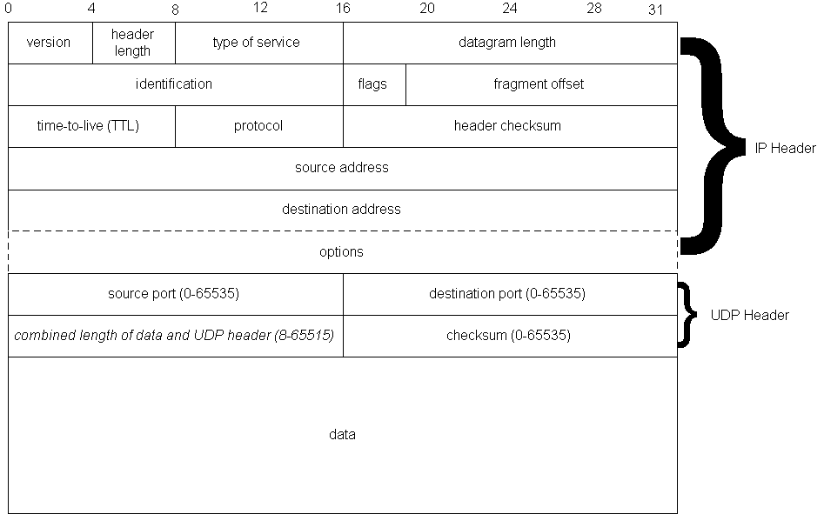
Going further
Andrej Brodnik: Computer Forensics

Slide 41
Going further
who is the service provider?
we can identify the provider by its IP or by the FQN bound to it
Andrej Brodnik: Computer Forensics

Slide 42
WHOIS service
service
nicname 43/tcp whois
nicname 43/udp whois
we need a whois server
whois.iana.org, whois.arnes.si
tools: telnet, whois
Andrej Brodnik: Computer Forensics

Slide 43
WHOIS service
Andy@svarun:~[171]%> whois fri.uni-lj.si
%%%%%%%%%%%%%%%%%%%%%%%%%%%%%%%%%%%%%%%%%%%%%%%%%%%%%%%%%%%%%%%%%%%%%%%%%
% This is ARNES whois database
%%%%%%%%%%%%%%%%%%%%%%%%%%%%%%%%%%%%%%%%%%%%%%%%%%%%%%%%%%%%%%%%%%%%%%%%%
% Rights restricted by copyright.
% See http://www.arnes.si/domene/whois-legal.html
%%%%%%%%%%%%%%%%%%%%%%%%%%%%%%%%%%%%%%%%%%%%%%%%%%%%%%%%%%%%%%%%%%%%%%%%%
% The WHOIS service offered by Arnes, .si Registry, is
% provided for information purposes only. It allows persons
% to check whether a specific domain name is still available
% or not and to obtain information related to the registration
% records of existing domain names.
%
% This WHOIS service accepts and displays only ASCII characters.
%
% Arnes cannot be held liable should the stored information
% prove to be wrong, incomplete or inaccurate in any sense.
%
% By submitting a query you agree not to use the information
% made available to:
% o Allow, enable or otherwise support the transmission
% of unsolicited, commercial advertising or other solicitations
% whether via email or otherwise;
% o Target advertising in any possible way;
% o Cause nuisance in any possible way to the registrants
% by sending (whether by automated, electronic processes
% capable of enabling high volumes or other possible
% means) messages to them;
% o copy, extract and/or publish contents of the WHOIS database.
%%%%%%%%%%%%%%%%%%%%%%%%%%%%%%%%%%%%%%%%%%%%%%%%%%%%%%%%%%%%%%%%%%%%%%%%%
% No entries found for the selected source(s).
Andrej Brodnik: Computer Forensics

Slide 44
WHOIS service
Andy@svarun:~[172]%> whois uni-lj.si
...
domain: uni-lj.si
registrar: Arnes
registrar-url: http://www.arnes.si/storitve/splet-posta-strezniki/registracija-si-domene.html
nameserver: dns1.uni-lj.si (193.2.1.90,2001:1470:8000::90)
nameserver: dns2.uni-lj.si (193.2.1.89,2001:1470:8000::89)
nameserver: dns3.uni-lj.si (193.2.1.94,2001:1470:8000::94)
registrant: G39085
status: ok
created: 1992-11-23
expire: 2015-06-06
source: ARNES
Domain holder:
NOT DISCLOSED
Tech:
NOT DISCLOSED
%%%%%%%%%%%%%%%%%%%%%%%%%%%%%%%%%%%%%%%%%%%%%%%%%%%%%%%%%%%%%%%%%%%%%%%%%
% For more information, please visit http://www.registry.si/whois.html
%%%%%%%%%%%%%%%%%%%%%%%%%%%%%%%%%%%%%%%%%%%%%%%%%%%%%%%%%%%%%%%%%%%%%%%%%
Andrej Brodnik: Computer Forensics

Slide 45
WHOIS service
Andy@svarun:~[173]%> whois ul.si
...
domain: ul.si
registrar: Arnes
registrar-url: http://www.arnes.si/storitve/splet-posta-strezniki/registracija-si-domene.html
nameserver: dns1.uni-lj.si (193.2.1.90,2001:1470:8000::90)
nameserver: dns2.uni-lj.si (193.2.1.89,2001:1470:8000::89)
nameserver: dns3.uni-lj.si (193.2.1.94,2001:1470:8000::94)
registrant: G39085
status: ok
created: 2010-10-20
expire: 2015-10-20
source: ARNES
Domain holder:
NOT DISCLOSED
Tech:
NOT DISCLOSED
%%%%%%%%%%%%%%%%%%%%%%%%%%%%%%%%%%%%%%%%%%%%%%%%%%%%%%%%%%%%%%%%%%%%%%%%%
% For more information, please visit http://www.registry.si/whois.html
%%%%%%%%%%%%%%%%%%%%%%%%%%%%%%%%%%%%%%%%%%%%%%%%%%%%%%%%%%%%%%%%%%%%%%%%%
Andrej Brodnik: Computer Forensics

Slide 46
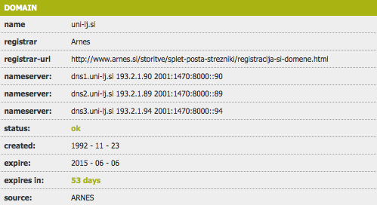
WHOIS service
Andrej Brodnik: Computer Forensics

Slide 47
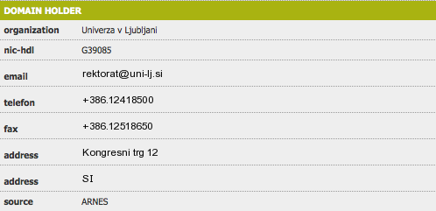
WHOIS service
Andrej Brodnik: Computer Forensics

Slide 48
WHOIS service
Andrej Brodnik: Computer Forensics

Slide 49
WHOIS service
Challenge: looking up information about the gov.si domain should not be difficult. What about other, foreign domains?
Challenge: google.si is no challenge, what about google.com?
Challenge: rkc.si – one would not have tought.
Challenge: keeping in mind the sources of information we have talked about today, examine and comment on the following packets:
14:59:26.608728 IP xx.domain.netbcp.net.52497 > valh4.lell.net.ssh: . ack 540 win 16554
14:59:26.610602 IP resolver.lell.net.domain > valh4.lell.net.24151: 4278 1/0/0 (73)
14:59:26.611262 IP valh4.lell.net.38527 > resolver.lell.net.domain: 26364+ PTR? 244.207.104.10.in-addr.arpa. (45)
Andrej Brodnik: Computer Forensics

