Slide 1
Digital forensics
Andrej Brodnik

Slide 2
Cell (mobile) phones
chapter 20
various technologies of data transfer
sometimes mostly phones, today mostly computers
rich source of personal data
call history (incoming, outgoing and missed)
SMS and MMS history (received and sent)
history of location data
images, journals, calendars, ...
access to the web networks – shortly, all the data which is also found on usual computers

Slide 3
Data on the cell phone
Example (POCKET-DIAL M FOR MURDER):
The perpetrator had a phone in his pocket during the crime, which has pocket-dialed cellphone of his wife, who was the victim of the crime. On the wife’s phone, the call went to voicemail and it was recorded.
Computational power of mobile devices is increasing because they contain much more I/O devices
thermometers
accelerometers
credit card scanners
...
use of these units went beyond the manufacturer’s intentions; e.g. at certain temperature some action is triggered
phones became one type of embedded systems

Slide 4
Mobile device forensics
devices have more capable operation systems
Android
iPhone
Blackberry
Windows Mobile
and older operation systems (SYMBIAN, ...)

Slide 5
Mobile device forensics
devices are by the definition network devices
GPRS, CDMA, UMTS, ...
IEEE 802.11
IEEE 802.15 (Bluetooth)
Infrared communication
...
access to the device may destroy or modify the evidence material

Slide 6
Mobile device forensics
data is usually saved in storage media
it cannot be deleted, but it can be copied
due to the limited number of writes, writing algorithms spread data across storage media
that is why we can get a lot of data that seems to be deleted

Slide 7
Mobile device forensics
data acquiring from device
usually using cable connected to the data port
protocol knowledge needed
sometimes a direct capture from the storage media is required
direct reading from chip

Slide 8
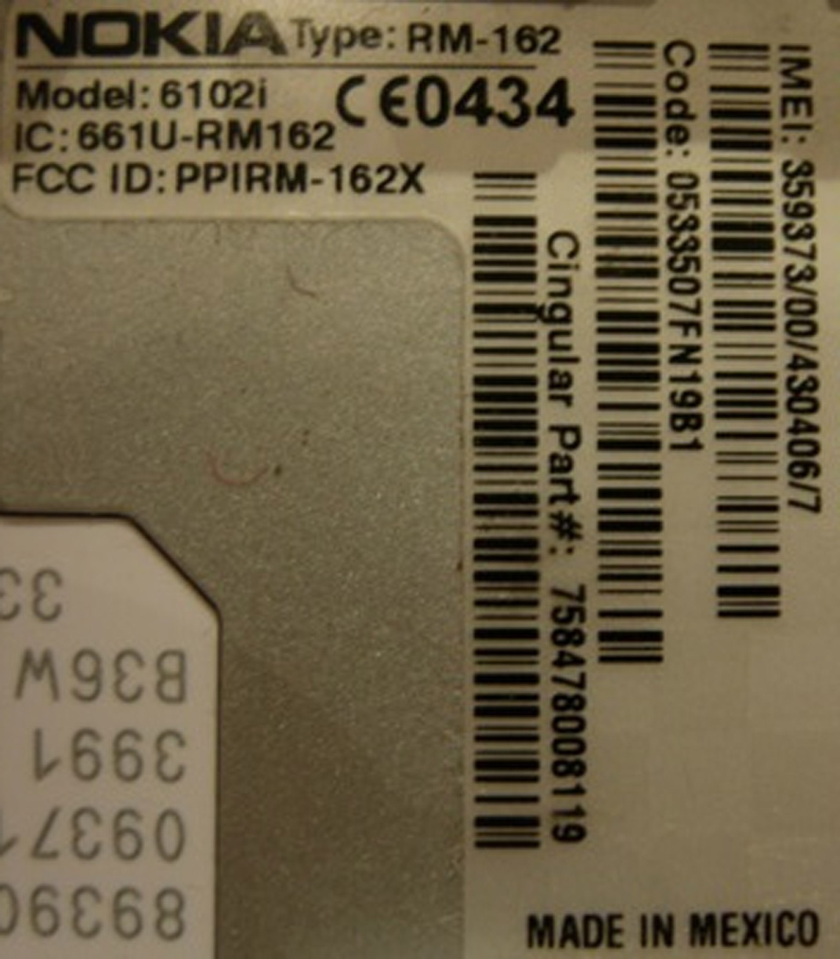
Mobile device forensics
devices are made from two parts
device itself
SIM cards
device has unique identification number IMEI (International Mobile Equipment Identity)

Slide 9
Mobile device forensics
SIM cards are computers
CPU, ROM, RAM
contain ICC-ID (Integrated Circuit Card Identifier):
MCC (mobile country code),
MNC (mobile network code),
serial number of card

Slide 10
SIM cards
Challenge: Which data SIM card also contains?
Challenge: What is LAI and what is IMSI?
Challenge: What your SIM card has? What are the values of this data? What is the identification of your mobile device?

Slide 11
Data about and on the device
on device – depends on the type of the device:
baseline phone
smart phone
where the data is also stored:
user’s computer
operator
SIM card
on device are at least stored:
titles
incoming, outgoing and missed calls
received and sent SMS

Slide 12
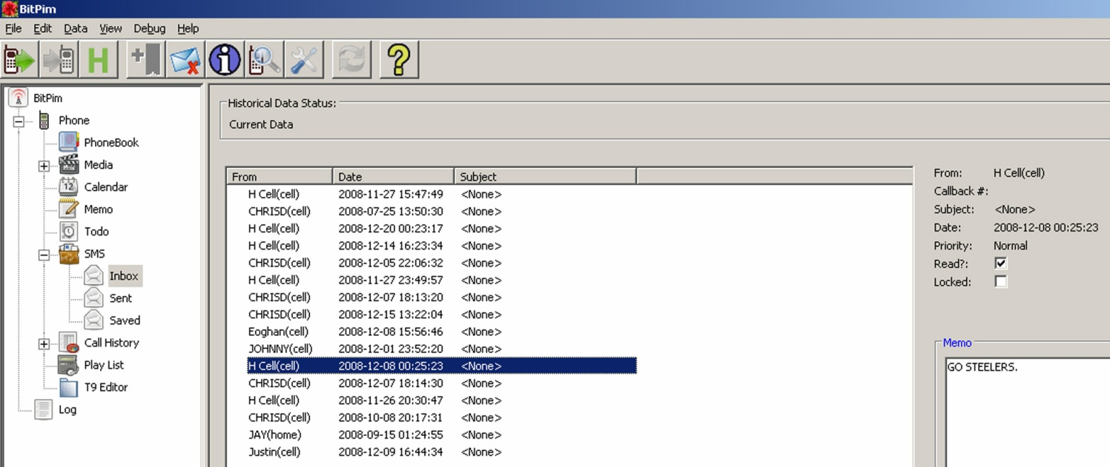
SMS as digital evidence
full information: when is sent/received, from who and content
no record of when messages were first read
example of data acquired using BitPim (http://www.bitpim.org/)

Slide 13
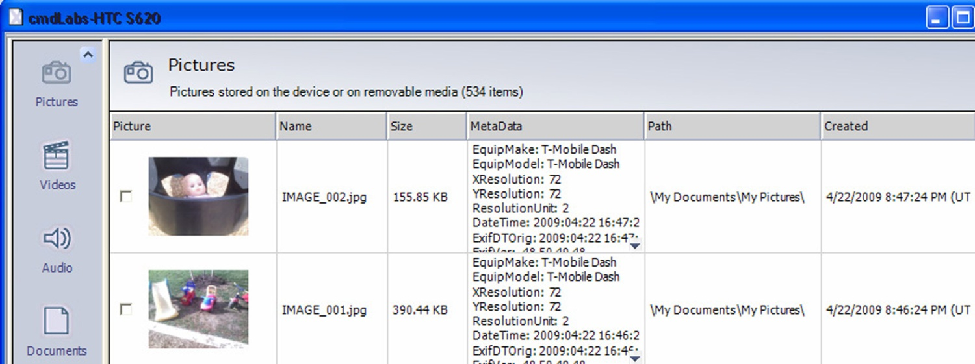
Image data
smart phones have cameras
Image data is in EXIF record (usually)
Example of data acquired from Windows Mobile device using XRY (http://www.msab.com/)

Slide 14
Access to the Internet services
mobile devices enable access to the web
often user saves passwords there
there is history of entries
logs of the last entries
...
mobile devices enable e-mail reading
passwords to access mailboxes
last received / sent mails
...
other applications and their data

Slide 15
Access to the Internet services
example of data on an iPhone
F:\tools>sqlite3.exe “iPhone2\Keychains\keychain-2.db”
SQLite version 3.6.16
Enter “.help” for instructions
Enter SQL statements terminated with a “;”
sqlite> select labl,acct,svce from genp;
|eric.rooster@yahoo.com|Yahoo-token
|erooster@live.com|
|erikroost@hotmail.com|
|therooster@hotmail.com|
|therooster@hotmail.com|com.apple.itunesstored.keychain
erooster|MMODBracketsAccount|
LumosityBrainTrainer|erooster|LumosityBrainTrainer

Slide 16
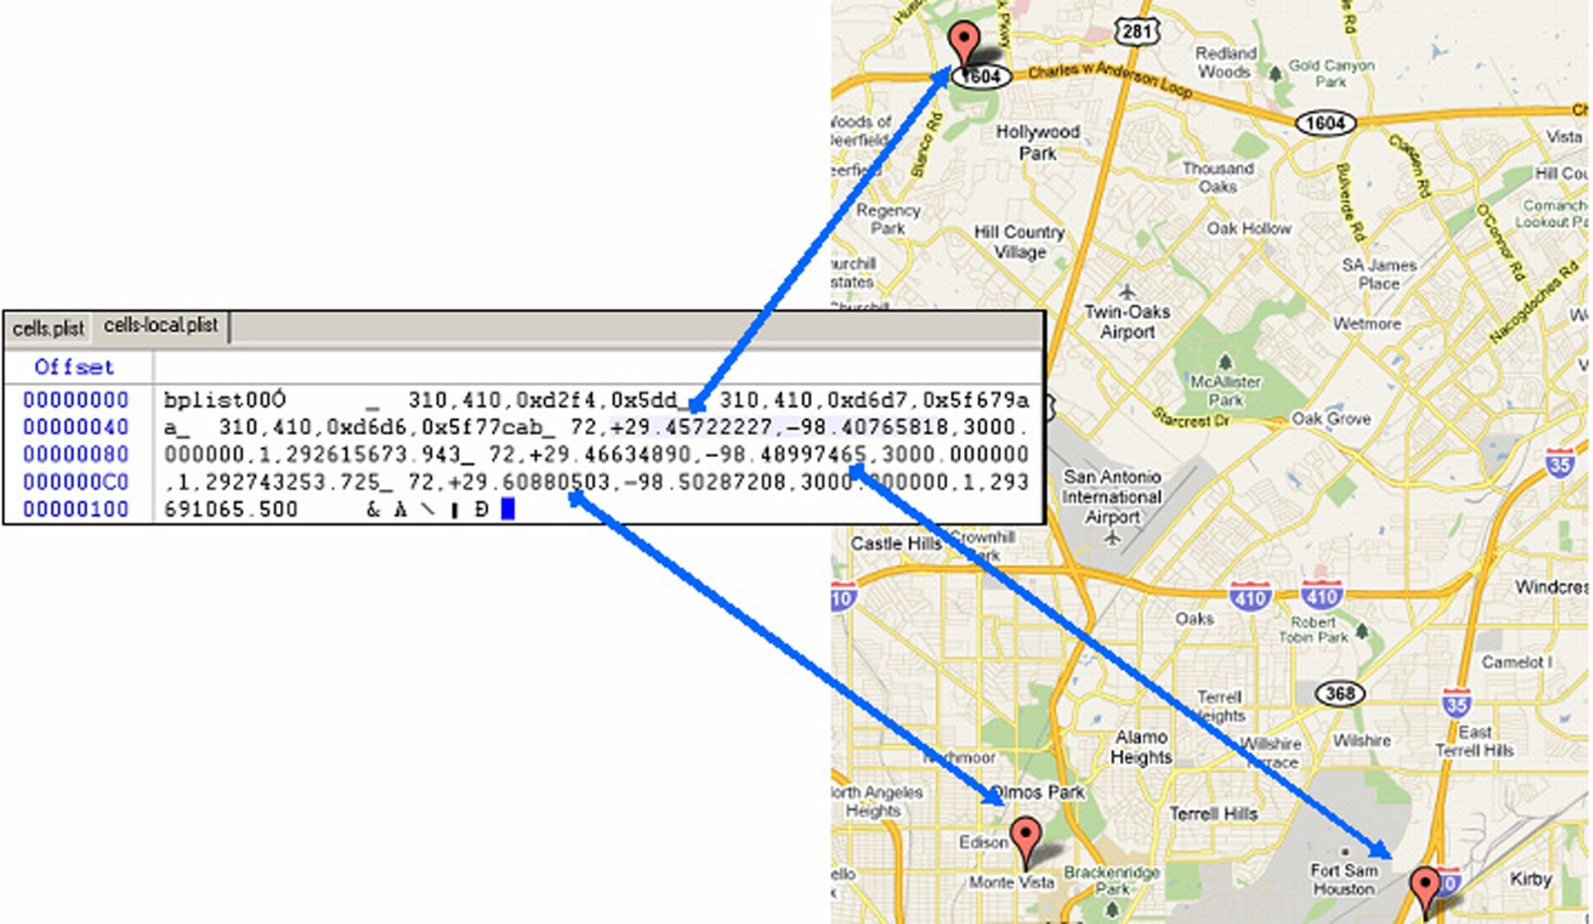
Location Information
history of moving between cellular towers can be saved
GPS devices can save exact coordinates

Slide 17
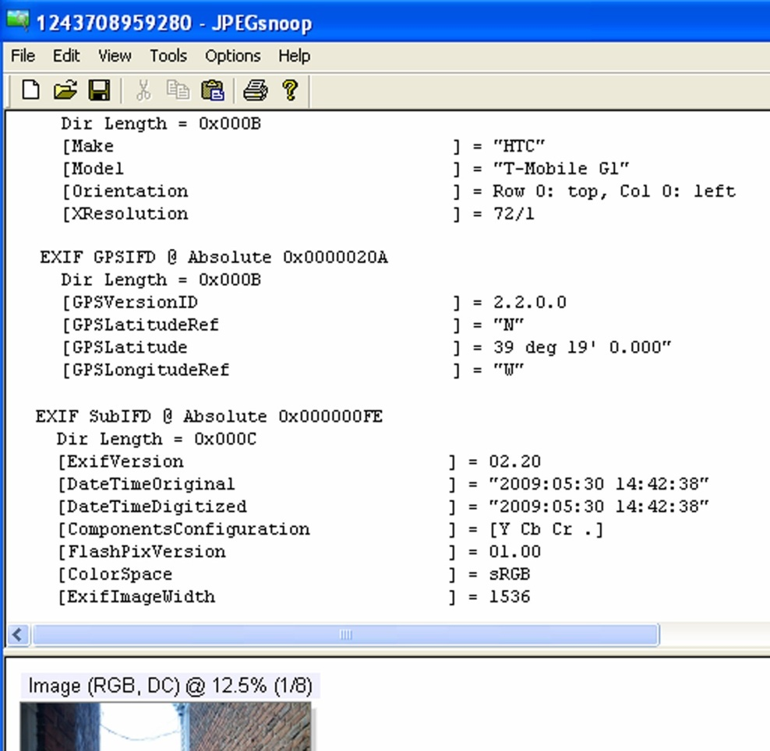
Location Information
images can save information such as when and where they were taken
e.g. EXIF format
Challenge: search for location information in your phone.

Slide 18
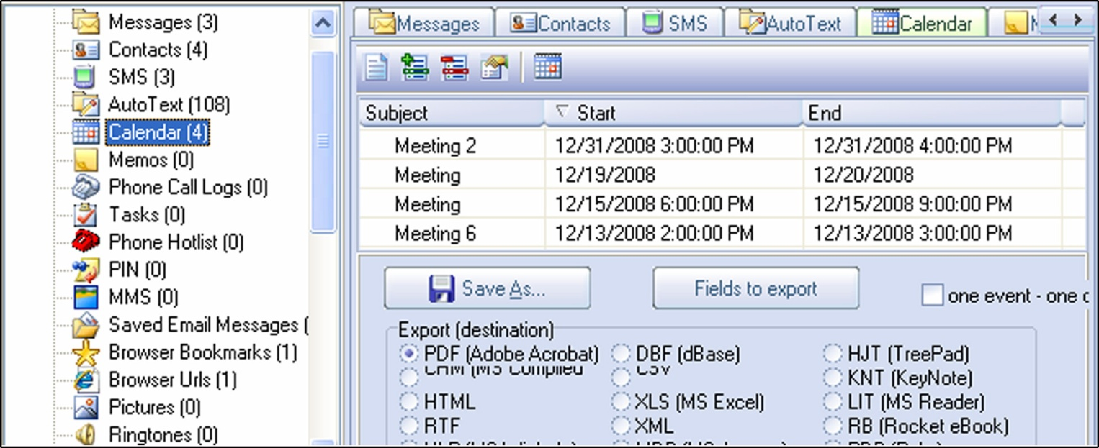
Other data
calendar, notes, ...
Challenge: search for calendar data in your phone.

Slide 19
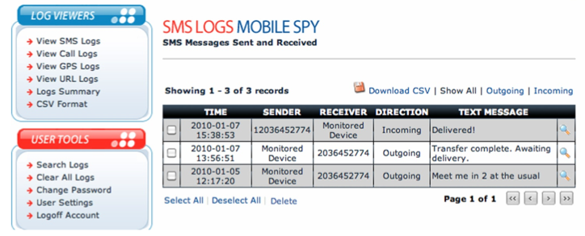
Attacks on mobile devices
the attacker loads his code on the device
through the network
the user uploads an application that seems useful and friendly (http://www.theregister .co.uk/2010/01/11/android_phishing_app/)
the application reads passwords, ...
allows the attacker to access to bank accounts ...
see MobileSpy (http://www.mobile-spy.com/)

Slide 20
Attacks on mobile devices
Challenge: How does the MobileSpy work?
Challenge: Find the software that can harm your Android system?
Challenge: Make your own program that reads data on Android (iPhone) system. Can this also be useful software?

Slide 21
Thinking Outside of the Device
additional data:
user’s computer
operator: call center and base stations
devices, user knows something about (transitivity)

Slide 22
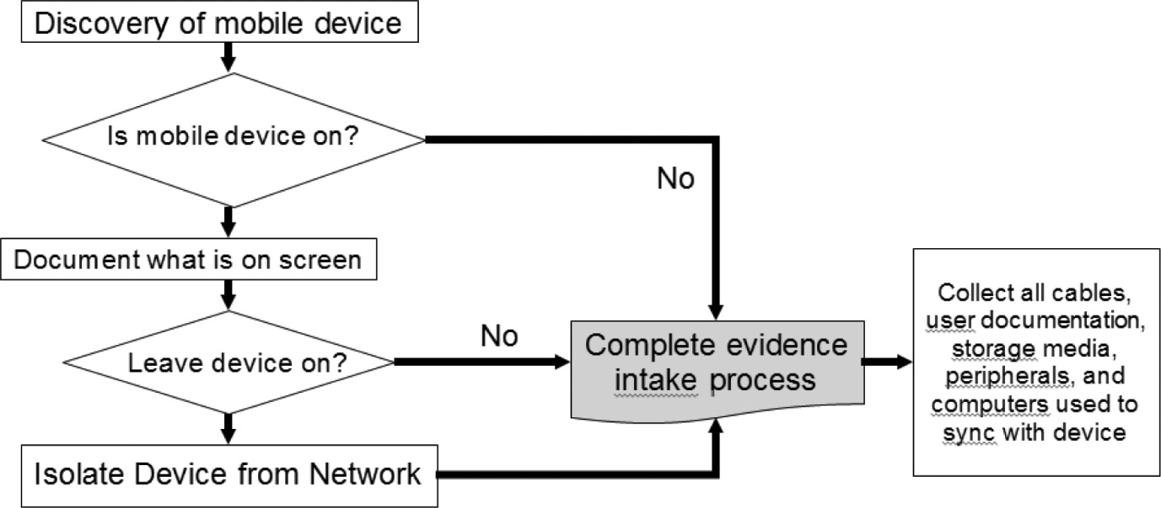
Handling Mobile Devices
the device can wirelessly connect with world
disable
remove power
other ways

Slide 23
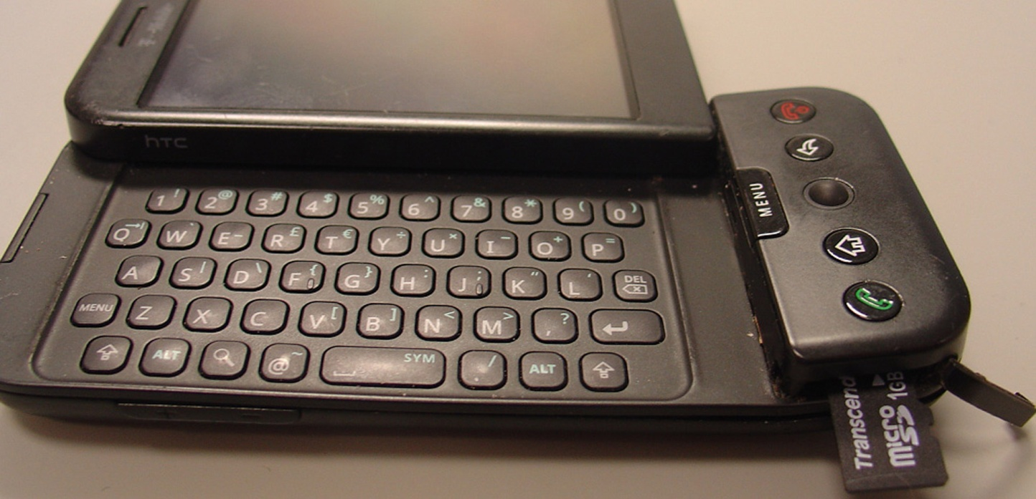
Handling Mobile Devices
remove storage module
storage modules are always smaller
usually FAT file system
iPhone: APFS, Android: Linux design
otherwise usual procedures (signature, journals, ...)

Slide 24
Accessing the data
different methods of accessing with different types
not every device has USB guide
examples:
via user interface
via communication port
property interface (Nokia F-BUS, Flash BUS)
via JTAG (Joint Test Action Group) interface
via direct memory chip access

Slide 25
Accessing the data
some devices provide agent access
when device is on, it runs the agent which takes over control of the device (iPhone)
sometimes we can stop software launching and put our code as further upload
manufacturers offer data archiving software which also provides access to deleted and other data

Slide 26
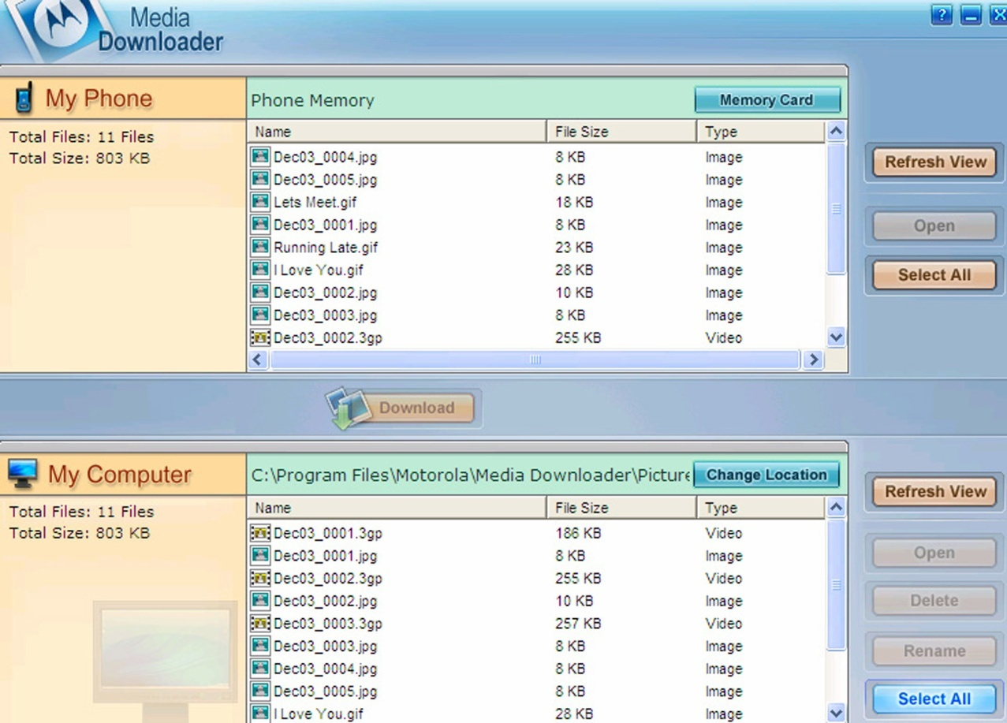
Examples ...
example of stored data with an archive using XACT (Motorola device)

Slide 27
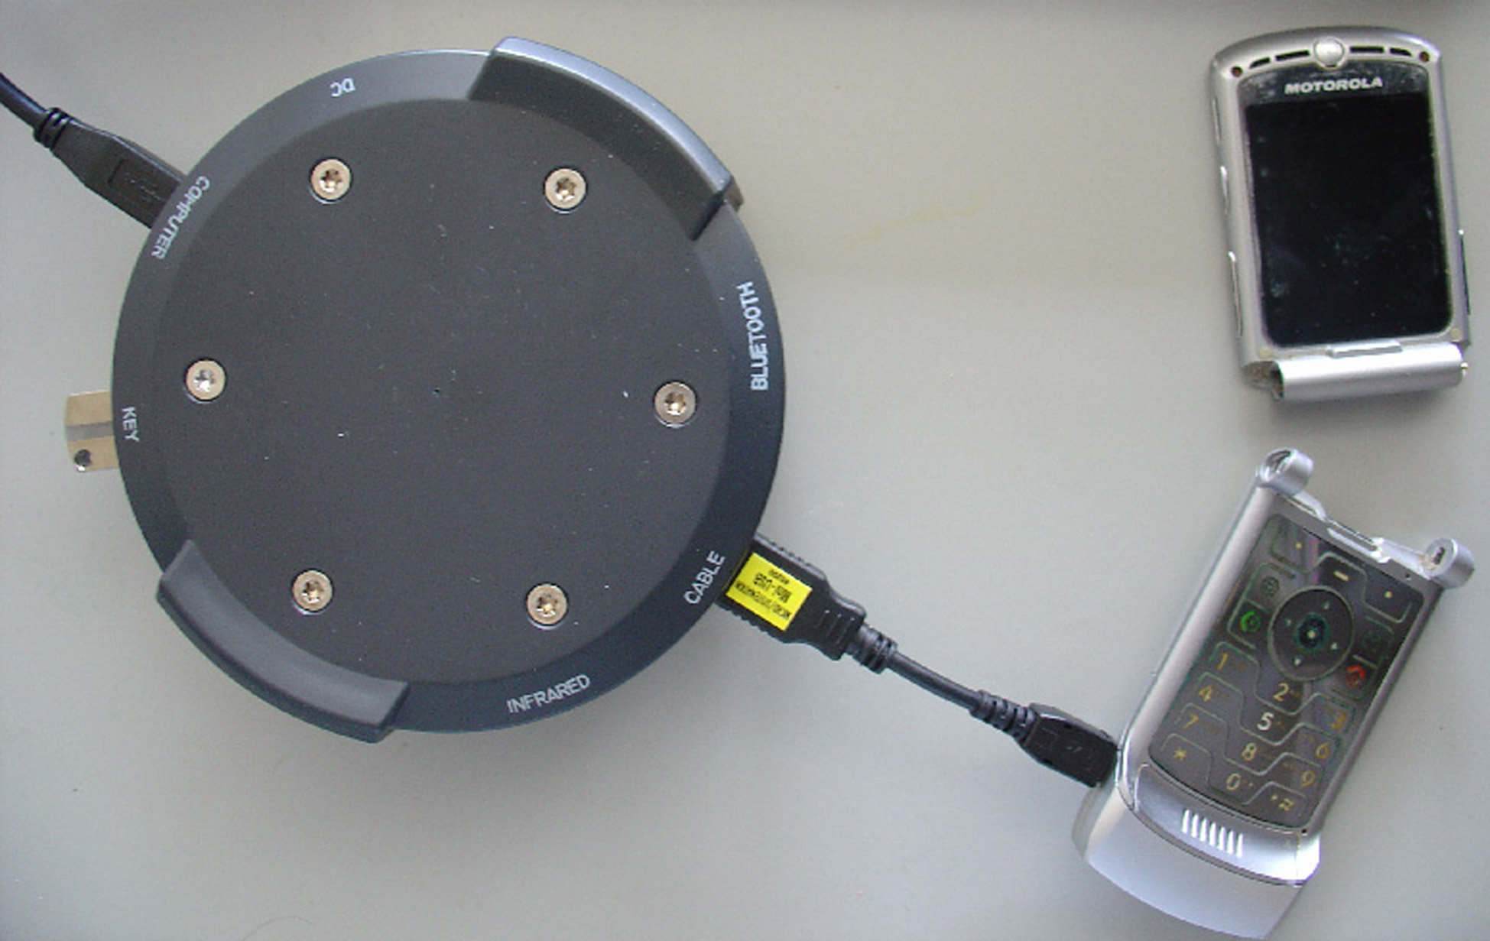
Examples ...
device, which is partly broken, it may still work well enough

Slide 28
Mobile Device Forensics Tools
any tool allows access to the device memory (for example disk)
in the case of a disk, access is relatively safe because it cannot change content by itself
in case of mobile device that is not necessarily true

Slide 29
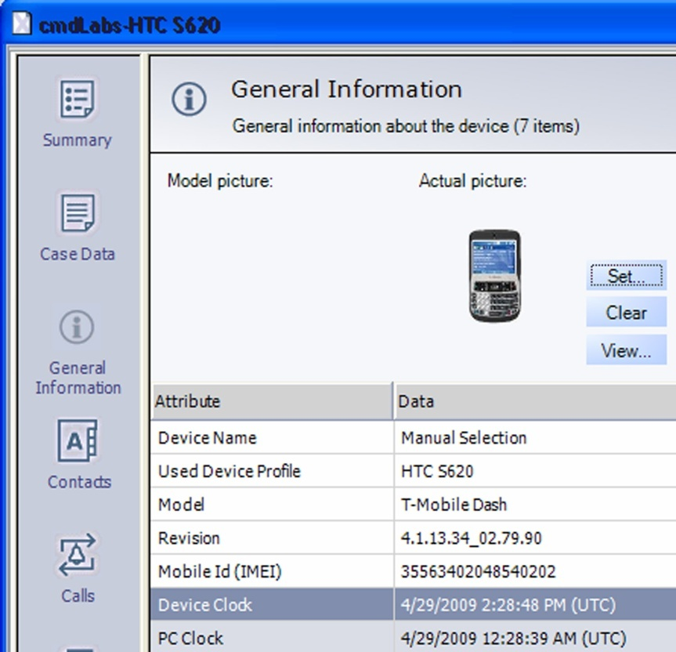
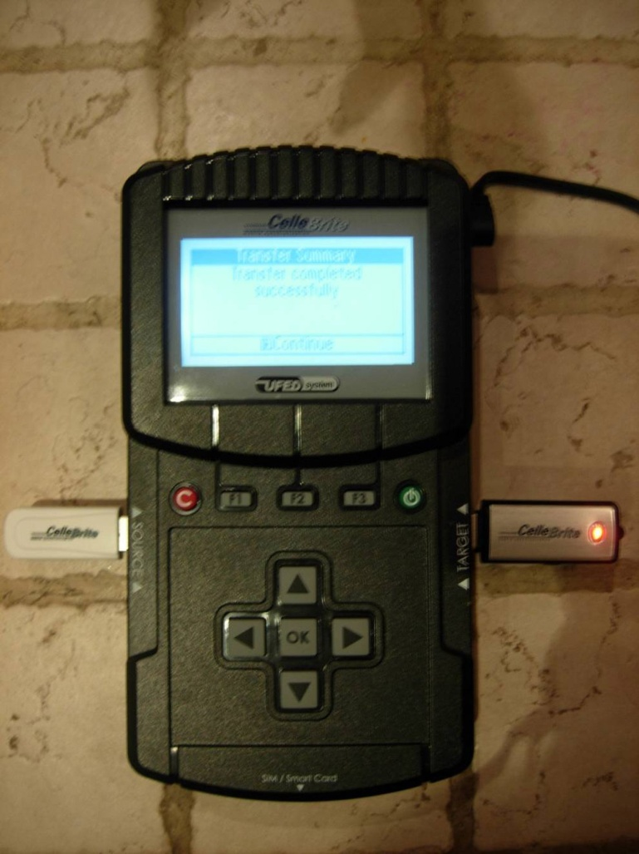
Mobile Device Forensics Tools
XRY (http://www.msab.com/)
Cellebrite UFED (Universal Forensic Extraction Device) - http://www.cellebrite.com/

Slide 30
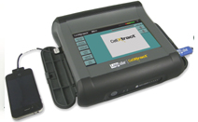
Mobile Device Forensics Tools
Logicube CellDEK (http://www.logicube.com/)
MOBILedit! Forensic (http://mobiledit.com/)
progamming equipment for analysis

Slide 31
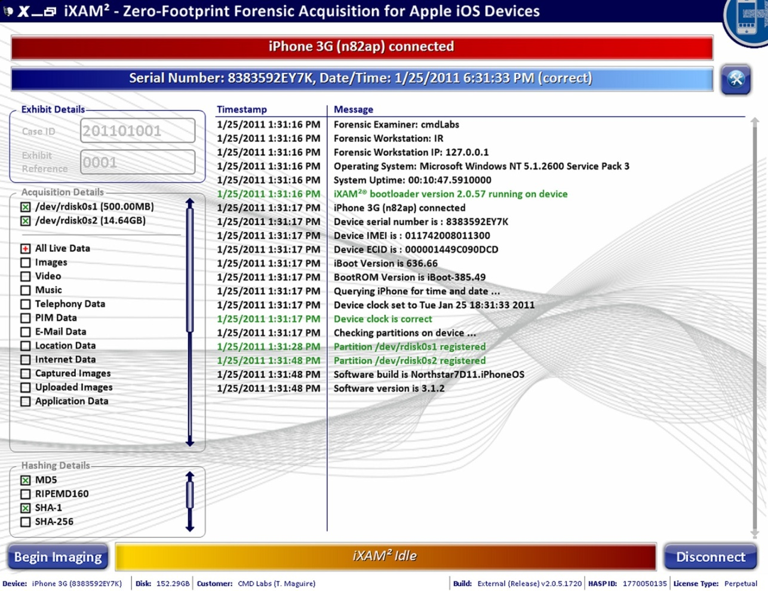
Mobile Device Forensics Tools
iXAM (http://www.ixam-forensics.com/)

Slide 32
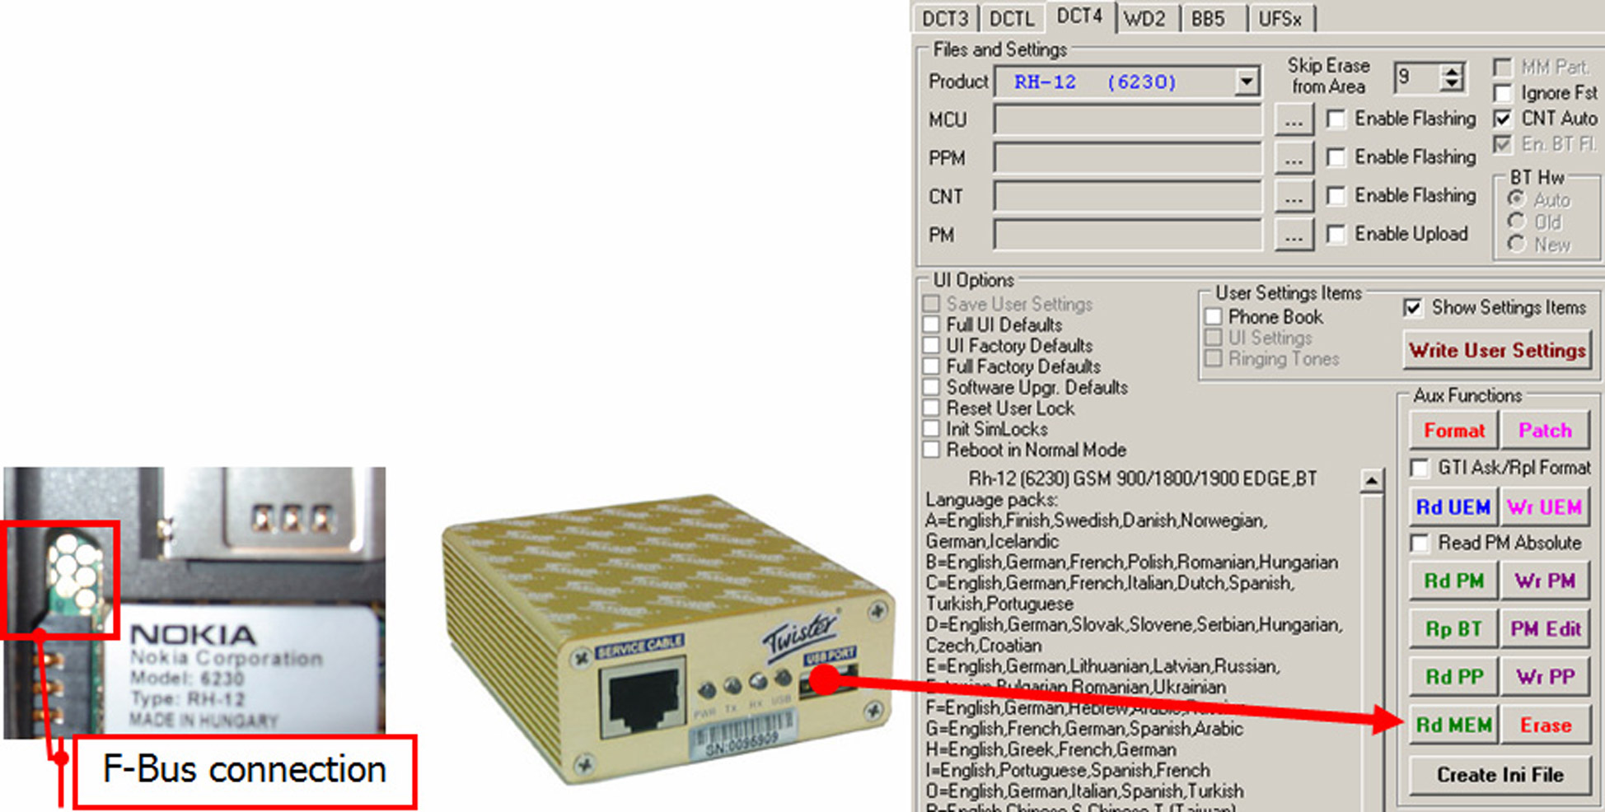
Mobile Device Forensics Tools
Twister Flasher

Slide 33
File System Examination
depends on device
unique
built in systems Qualcomm (BREW, Binary Runtime Environment for Wireless)
FAT, ext2, ext3, HSFX, APFS, …
various tools are available:

Slide 34
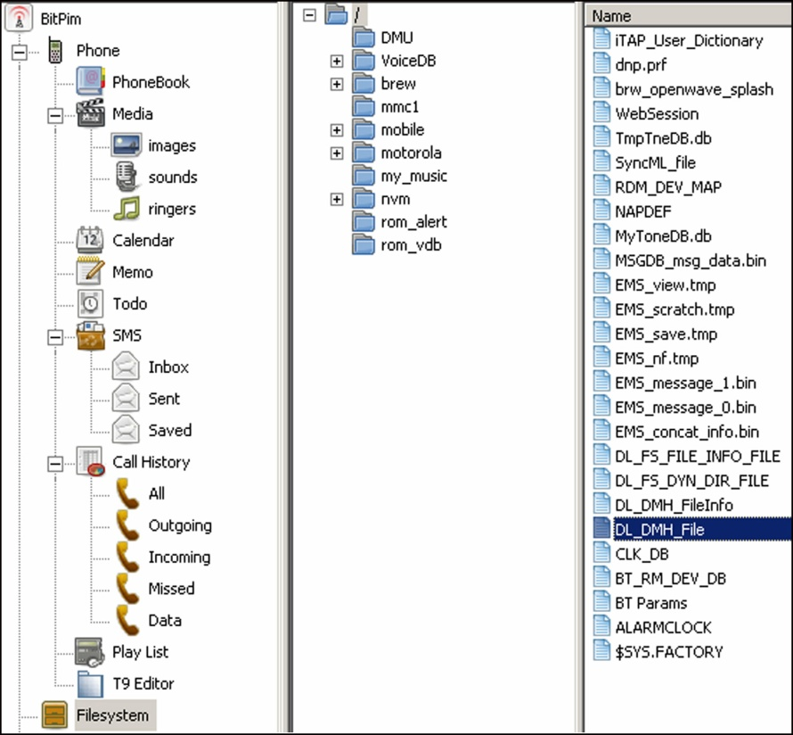
Some basic tools ...
BitPim (http://www.bitpim.org/) – Motorola CDMA

Slide 35
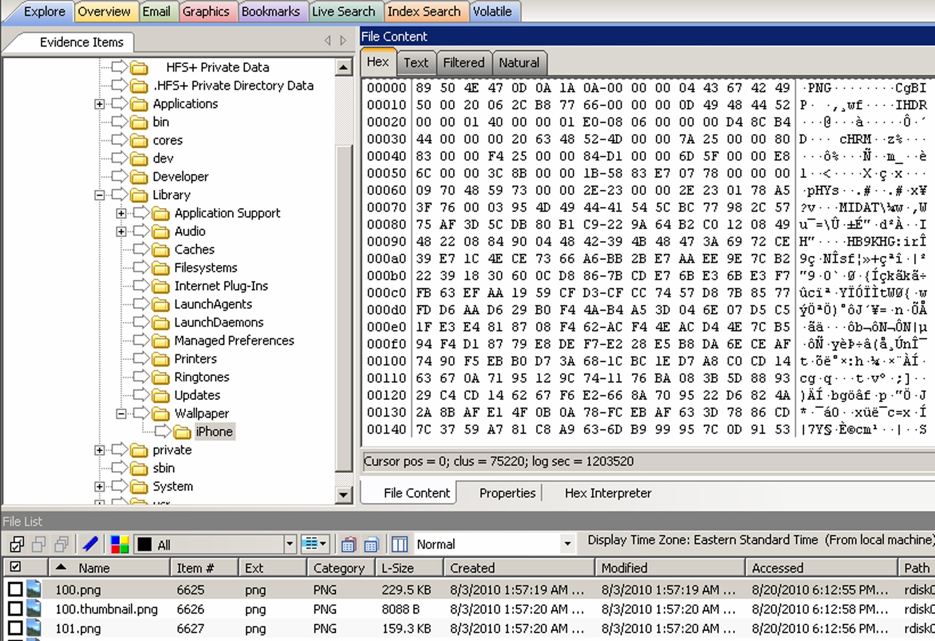
Some basic tools ...
Forensic Toolkit, FTK (http://accessdata.com/products/computer-forensics/ftk) – iPhone

Slide 36
Data recovery
even if we don’t have all the data we can recover partly deleted data from logical data

Slide 37
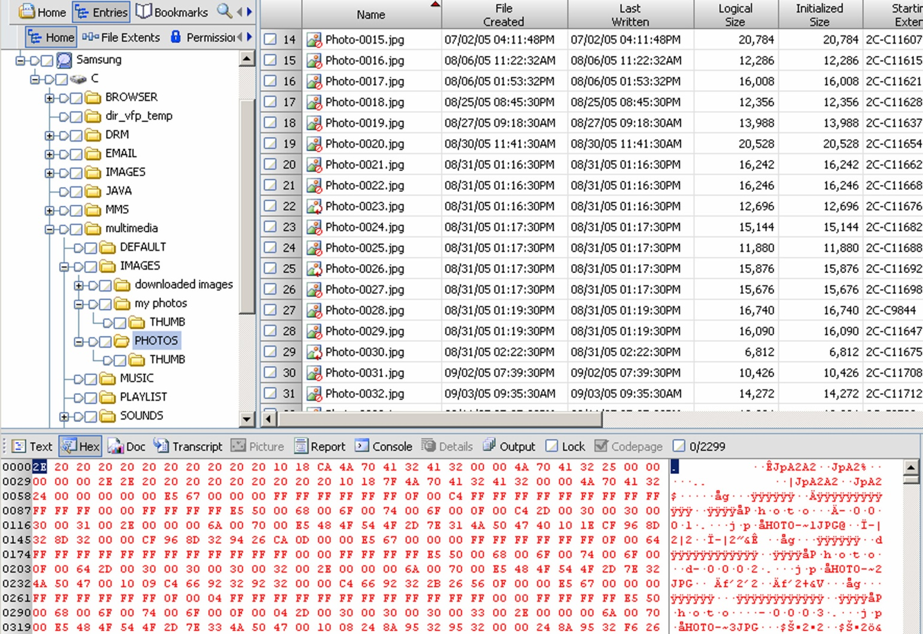
Data recovery
if it is usual file system (FAT, ext2, ext3, APFS, ...) already known tools
EnCase and deleted images

Slide 38
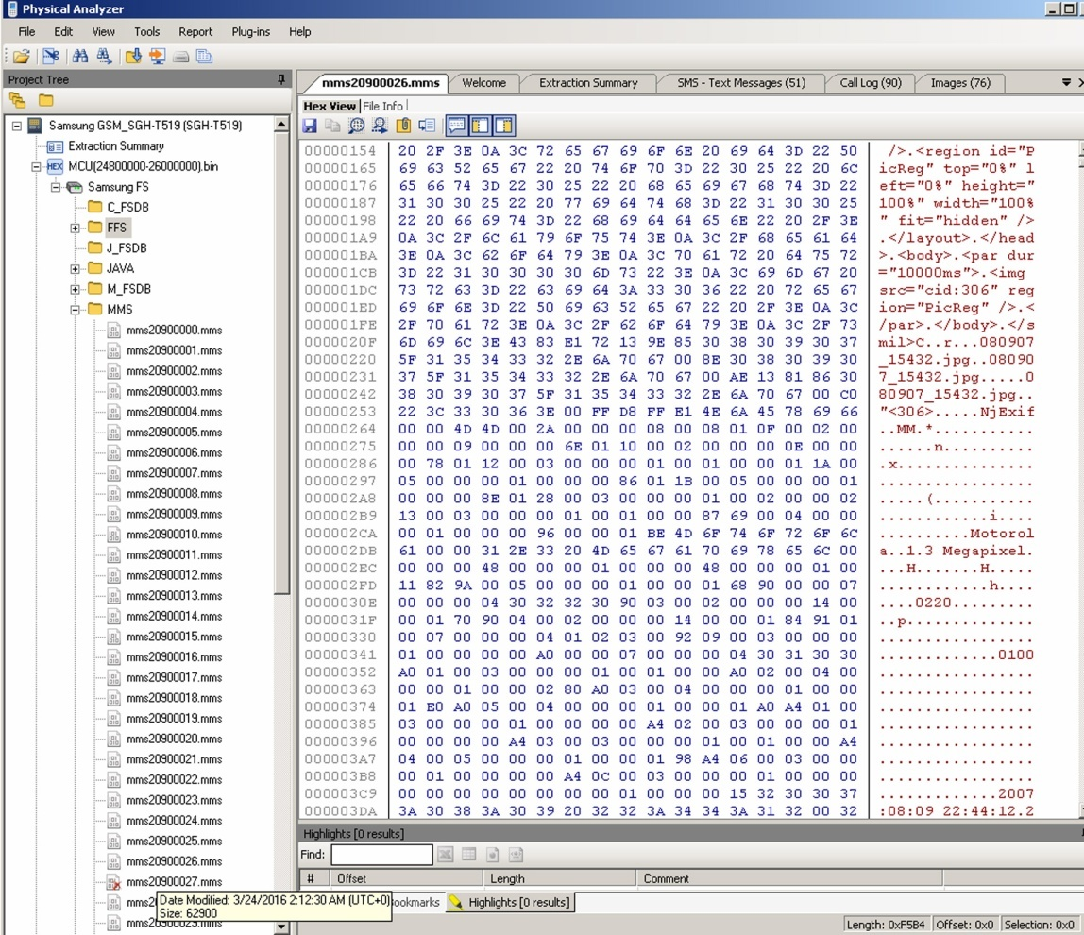
Data recovery
In this example of composite files (MMS, docx, ...) we can find parts of data

Slide 39
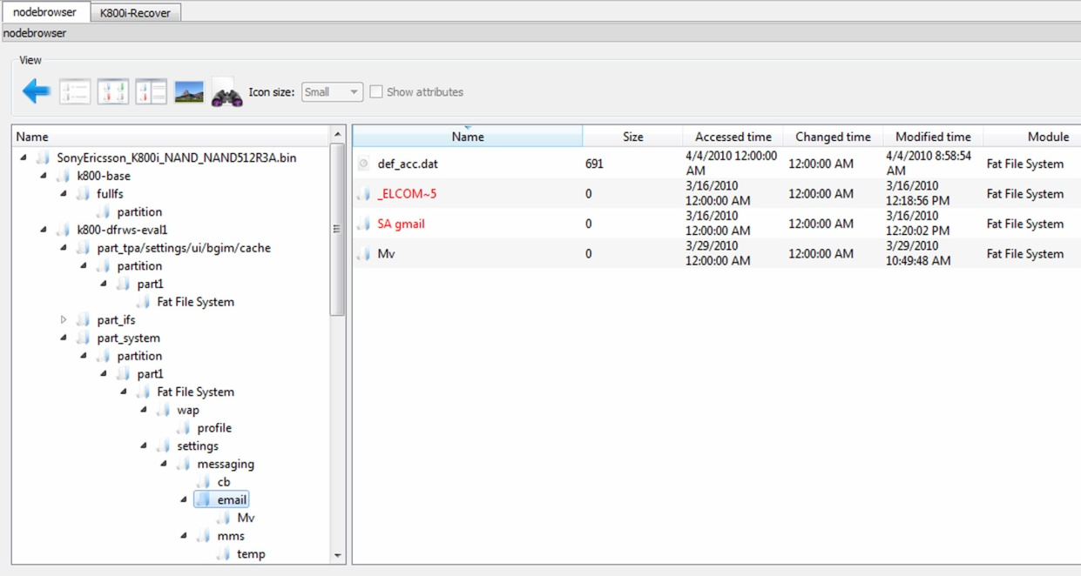
Data recovery
Example of data captured using DFF (Digital Forensic Framework, http://www.digital-forensic.org/)
Challenge: Study the enironment and how it is spread

Slide 40
Data Format SMIL
Synchronized Multimedia Integration Language
part of W3C standard - http://www.w3.org/AudioVideo/
versions 1, 2 in 3 (http://www.w3.org/TR/SMIL3/)
includes SVG items (enhanced vector graphics, Scalable Vector Graphics)
allows:
animation, integration of other images, modularization, ...
Challenge: Find SMIL file and study it.
Challenge: Make your SMIL file and send it to the forum.

Slide 41
Data recovery
SSD is used as storage
Data, which are in storage, but not structured
Partly deleted data
Data in deleted blocks which are scattered per unit
Challenge: look up forensic challenge and solution DRFWS2010 (Digital Forensic Research Conference) – http://www.dfrws.org/2010/challenge/
Examples of files with the unit are available
Challenge: look up forensic challenge and solution DRFWS2011 – http://www.dfrws.org/2011/challenge/
Challenge: look up forensic challenge DRFWS2012 – http://www.dfrws.org/2012/challenge/
Notes:
packet capture

Slide 42
Examination – other data
A lot of smart phones saves their data in data base
SQlite – Android, iPhone, Palm, ...
cemail.vol – Windows Mobile

Slide 43
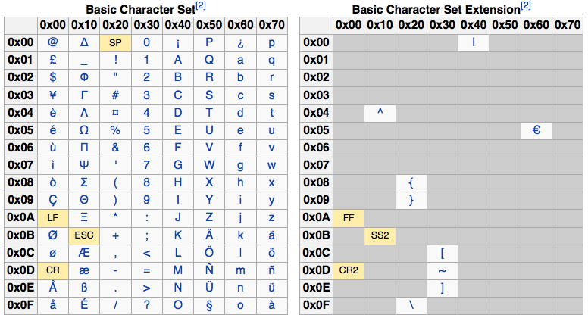
Examination – data formats
mostly standard formats:
7-bit standard; GSM 03.38: 160 characters
16-bit UCS-2 (Universal Character Set, UTF-16): 70 characters

Slide 44
Examination – data formats
big and little endian – depending on the processor
Motorola – big-endian format
debeli in tanki košček (nibble)
number 12036452774 is saved as 2130462577F4 (F is filler)

Slide 45
Examination – SIM card
SIM (Subscriber Indenty Module)
device is property of user, SIM card is owned by the operator
which allows the user to store certain data on it
detailed definition in:
ETSI (European Telecommunications Standards Institute): GSM, Global Mobile Communications, GSM 11.11, 1995.
www.ttfn.net/techno/smartcards/gsm11-11.pdf

Slide 46
SIM card
very simple interior structure
it consists of files and each file has its own identification 2-byte code
first byte represents type of file:
3F –Master File MF
7F –Dedicated File, DF
2F – partial file MF
6F – partial file DF

Slide 47
SIM card
Some files are defined in the standard
3F00:7F10 (DFTELECOM, dedicated file): records on the use of services (i.e. sent SMS, dialed numbers, ...)
3F00:2FE2 (EFICCID, elementary file): saves ICC-ID (Integrated Circuit Card ID)
3F00:7F20:6F07 EFIMSI: saves IMSI (International Mobile Subscriber Identity)
7F20:6F7E (EFLOCI): how the card was moving between operators
7F20:6F53 (EFLOCIGPRS): GPRS routing area

Slide 48
SIM card
tools for examining SIM card:
TULP2G: Netherlands Forensic Institute
http://tulp2g.sourceforge.net/
tool is not updated but it is fine for reading of the SIM card

Slide 49
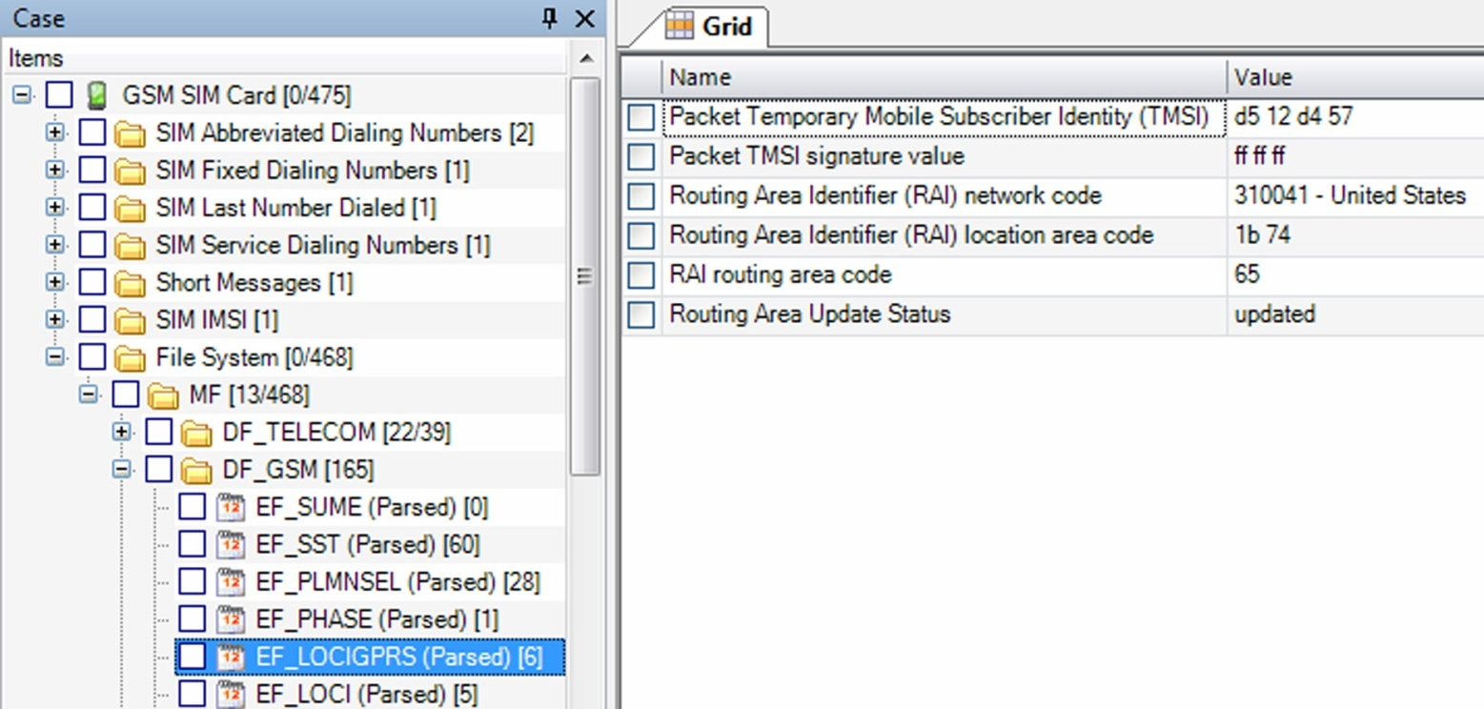
SIM card
example of information from SIM card (Paraben Device Seizure)

Slide 50
SIM card
Challenge: How can I access the data on your SIM card?
Challenge: Is the entire GPRS history saved?
Challenge: naštejtejte EF, v katere lahko piše uporabnik. List the EF in which user can write.

Slide 51
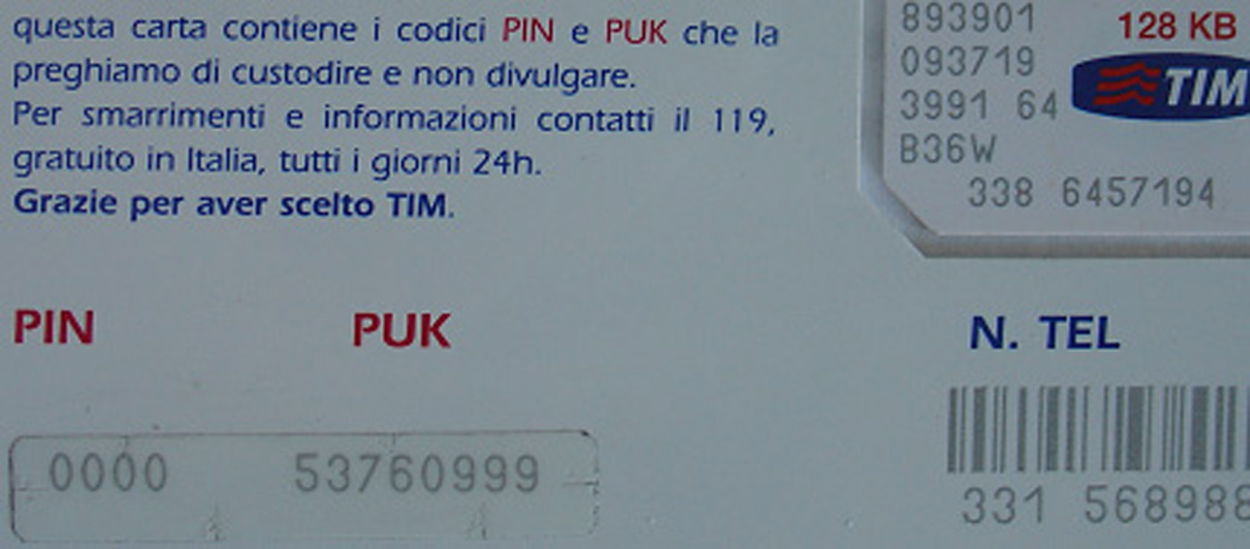
SIM card and security
card is protected with PIN (Personal Identification Number) code
if you make too many mistakes (cannot be checked), the card locked itself
for unlocking we need PUK (PIN Unlock Key) code
often operator has it

