Slide 1
Digital forensics
Andrej Brodnik

Slide 2
Conducting Digital investigations
chapter 6
(digital) investigation is conducted by following precisely defined steps
the steps are defined in manuals, instructions,...

Slide 3
Steps of Digital Investigation
Preparation: generating a plan of action to conduct an investigation
Survey/Identification: finding potential sources of digital evidence
Preservation: preventing changes of digital evidence
Examination and Analysis: the evidence is prepared for analysis, which is the application of scientific methods
Presentation: reporting of finding in a manner which satisfies the context of the investigation (legal, corporate, military, ...)

Slide 4
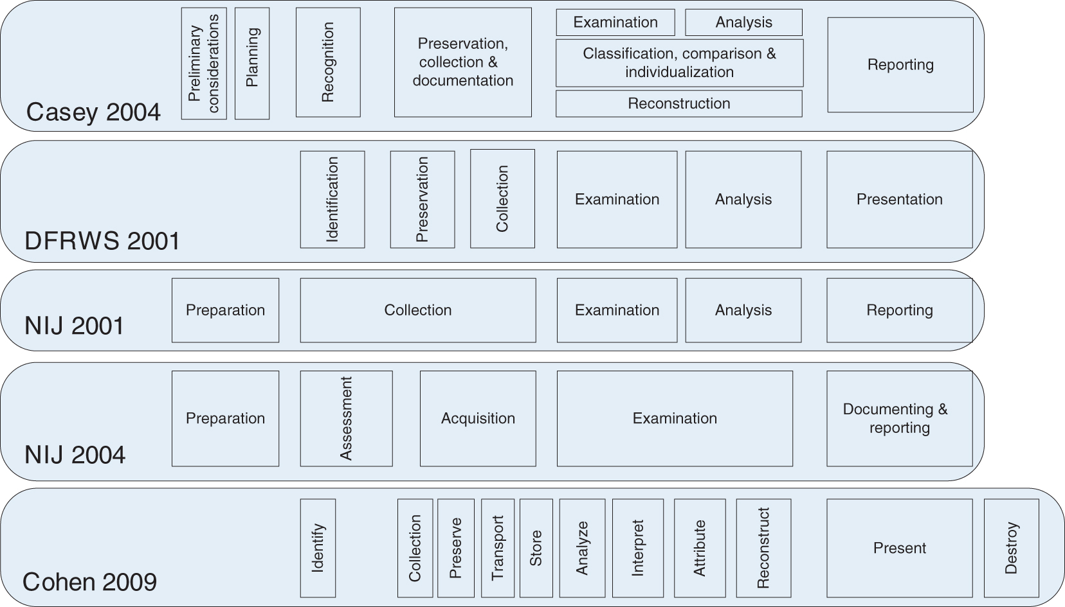
Steps of Digital Investigation

Slide 5
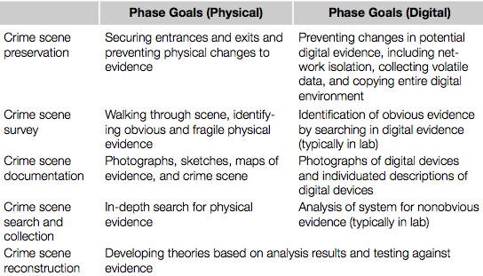
Digital Investigation Process Models – Physical Model
model with the more established investigative process (Carrier, 2003)

Slide 6
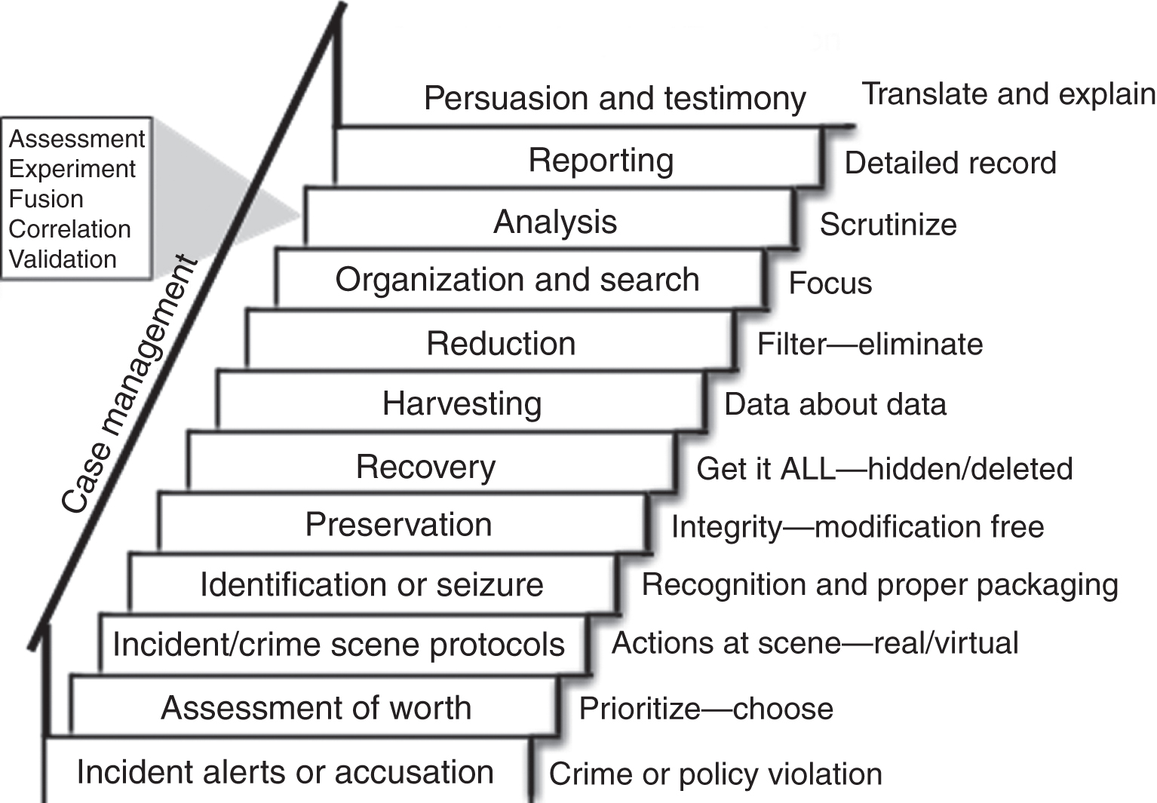
Digital Investigation Process Models – Staircase Model
Casey & Palmer, 2004
digital investigators, forensic examiners and attorneys work together
not a linear progression of events but it may be necessary to take certain steps more than once

Slide 7
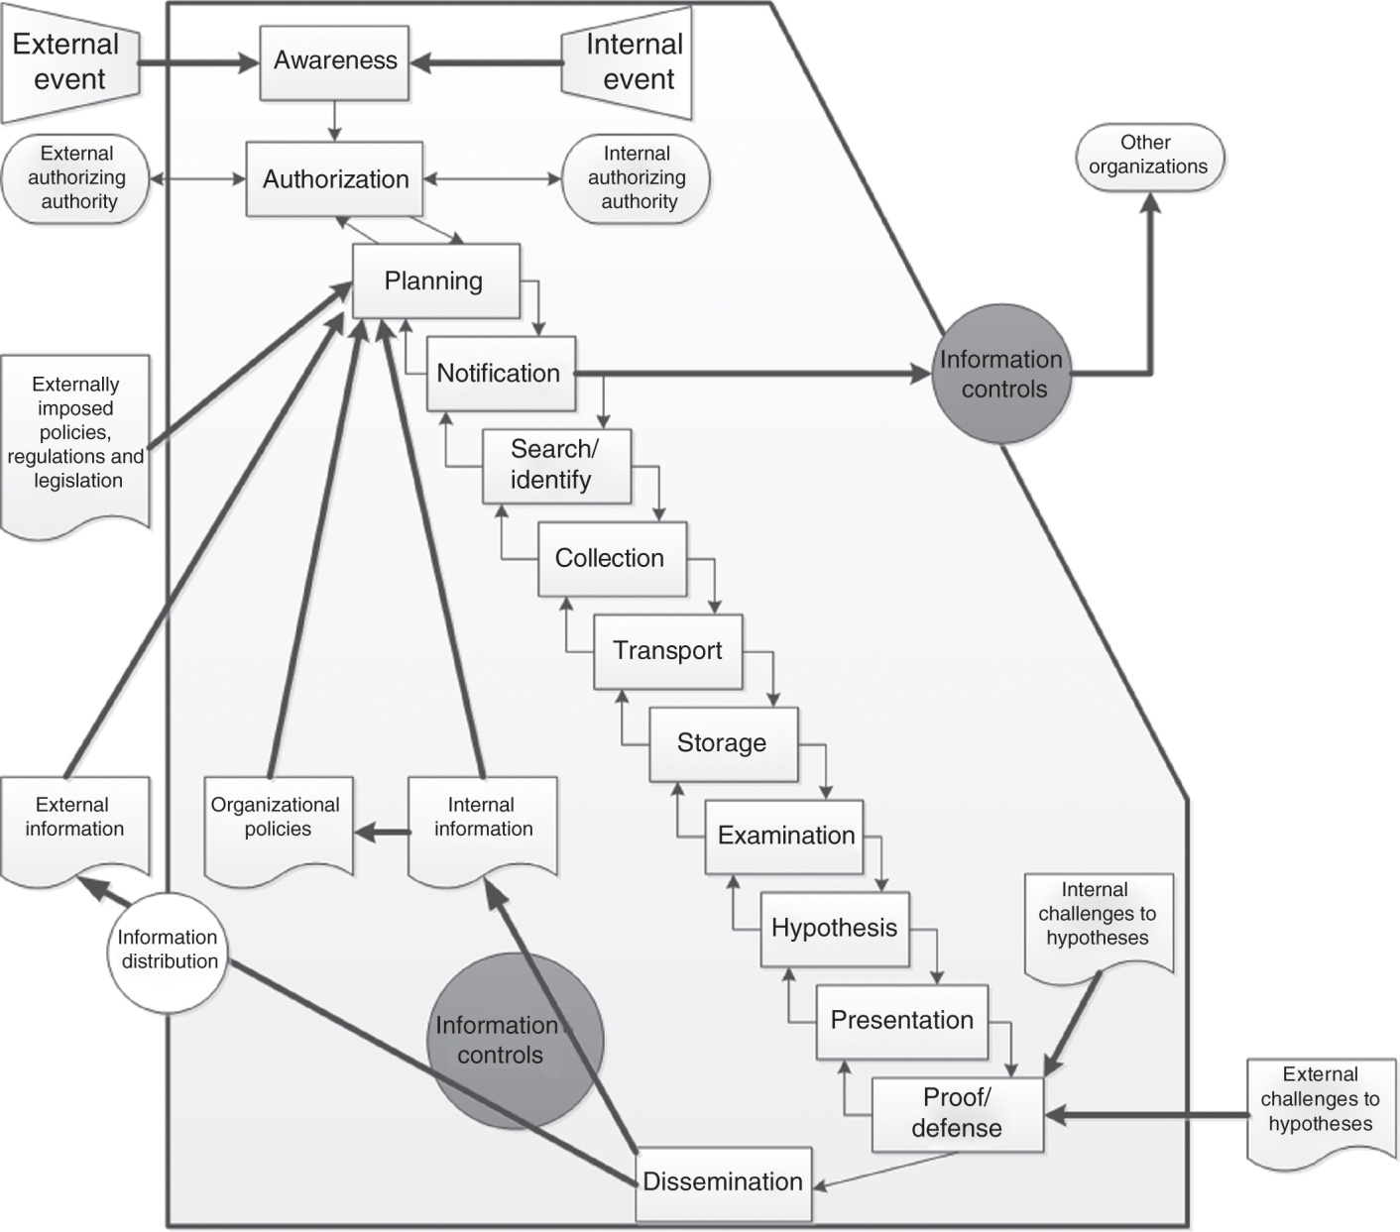
Digital Investigation Process Models – Evidence Flow Model
Ó Ciardhuáin, 2004
goes beyond the steps required to preserve and examine digital evidence
completely describes the flow of information in a digital investigation

Slide 8
Digital Investigation Process Models – Subphase Model
Beebe & Clark, 2005
a multilayered framework, taking the steps common in other models and adding subphases with defined objectives to help investigators implement each step properly
main phases are:
preparation
incident response
data collection
data analysis
findings presentation
incident closure

Slide 9
Digital Investigation Process Models – Subphase Model
example: objectives for file system analysis
reduce the amount of data to analyze
assess the skill level of suspect(s)
recover deleted files
find relevant hidden data
determine chronology of file activity
recover relevant ASCII data
recover relevant non-ASCII data
ascertain Internet (non-e-mail) activity history
recover relevant e-mail and attachments
recover relevant „personal organizer“ data (calendar, address books, ...)
recover printed documents
identify relevant software applications and configurations
find evidence of unauthorized system modification (malware)
reconstruct network-based events

Slide 10
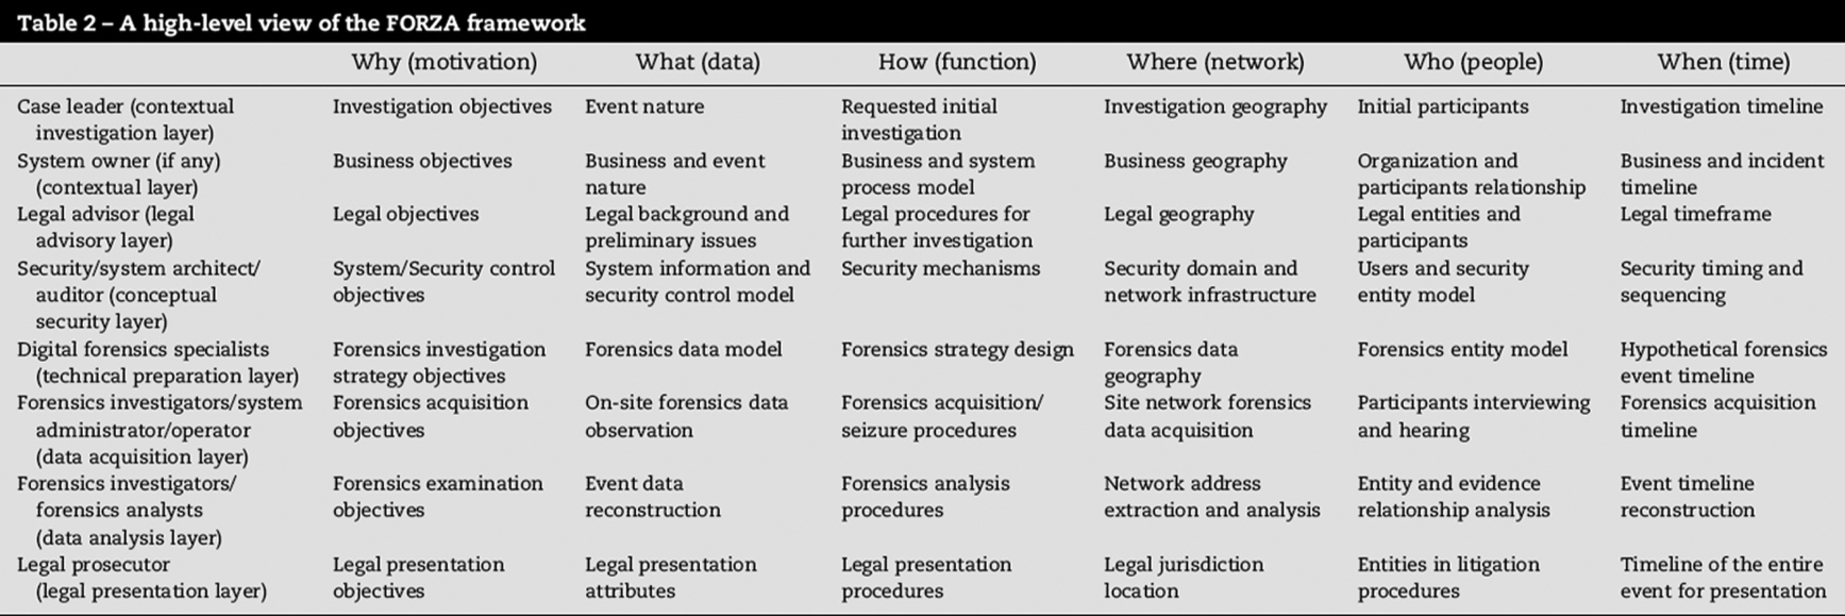
Digital Investigation Process Models – Roles and Responsibilities Model
Ieong, 2006
FORZA – providing the framework of roles and responsibilities in digital investigation

Slide 11
Data Acquisition
starting point of every investigation is the accusation or incident alert
authorization of investigation
written authorization from attorneys
search warrant
threshold considerations – decision is made, whether or not the investigation will continue
transportation – chain of custody
verification of gathered evidence
case management – binds together all of the activities and outcomes

Slide 12
Applying the Scientific Method in Digital Investigations
investigation must be based on scientific methods
formation and evaluation of Hypotheses
steps:
preparation
survey
preservation
examination
analysis
reporting and testimony

Slide 13
Scientific method
observation (browser crashed and right after the antivirus program was turned on)
hypothesis
prediction
experimentation/testing
conclusions
Example: employee is accused of stealing information after quitting the job

Slide 14
Challenge: think of a case including the process of committing the crime and write it in a file. This file should also include the description of the crime scene. Write the accusation of the crime on forum and the others will investigate the case. Work in groups!

Slide 15
Preparation for Digital Investigation
observation: number of systems, types of systems, ...
hypothesis: systems use ATA and SATA interfaces
experimentation/testing: scanning computers
conclusion: plan of how to gather the evidence, including the needed equipment and procedures
after the conclusion we can start gathering the actual evidence - ad hoc procedures should not be used

Slide 16
Survey of a Crime Scene
observation: survey of a crime scene
hypothesis: inconsistencies – why are thing missing or are out of place
prediction: hypothesis of the importance of information and prediction where the evidence is located
experimentation/testing: checking if the hypothesis of relativeness of information and its location is correct
conclusion: the evidence is gathered

Slide 17
Preservation of Evidence
depends on the data form
example: e-mail is saved on a server with a 30 day archive
observation: ...
hypothesis: ...
prediction: ...
experimentation/testing: ...
conclusion: ...

Slide 18
Examination
stages of forensic examination:
Survey/Triage Forensic Inspection
Preliminary Forensic Examination
In-Depth Forensic Examination
stages can be repeated on same evidence
includes: preparation for forensic examination, survey, forensic examination, data acquisition, harvesting of evidence, thorough examination

Slide 19
Analysis
example:
observation: a hard drive contains a lot of documents which may be important in an investigation
hypothesis: documents have .doc file extension
prediction: if we gather all of the .doc files on the hard drive, we will get all the necessary materials
examination/testing: we do gather all the .doc files, but we also fined .pdf and .tiff files
conclusion: after obtaining all the documents we have done a satisfactory and comprehensive investigation

Slide 20
Analysis
application of the scientific method and critical thinking to address the fundamental questions: who, what, where, when, how, why
observation: a suspect has been seen on an ATM camera near a crime scene, right after the crime occurred. The suspect withdrew the money from the victims account.
hypothesis: ...
prediction: ...
examination/testing: ...
conclusion: ...

Slide 21
Reporting and Testimony
court is usually not adept to understand scientific methods used in investigation
reporting should be precise, credible and transparent
when describing procedures
when submitting conclusions

Slide 22
Challenge: read the case example from the book and study the investigation.
In this case, Jill observes unusually high numbers of failed logon attempts to a server that contains plans and details of Corporation X’s newest product, code named FastJet . She contacts the system administrator for the system and, after a quick review of recent system logs, he confirms that there has been unauthorized use of the administrator account on the system. There is a strong indication that a security breach has occurred.
Comment on the forum.

Slide 23
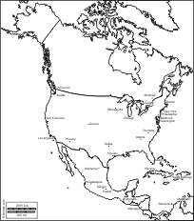
Handling a Digital Crime Scene
evidence is digital, the crime scene is strictly physical
There are a number of published guidelines that present fundamental principles of handling a crime scene

Slide 24
Handling a Digital Crime Scene
chapter 7
one of the most practical guideline documents:
The Good Practice Guide for Computer Based Evidence, (ACPO guide, Association of Chief Police Officers)
http://www.afentis.com/forensic-science-articles/acpo-guide-electronic-evidence
http://7safe.com/electronic_evidence/index.html#

Slide 25
Fundamental Principles
No action should change data held on a computer or storage media.
If a person finds it necessary to access original data held on a computer or on storage media, that person must be competent to do so and be able to give evidence explaining the relevance and the implications of their actions.
A record of all processes applied to computer-based electronic evidence should be created and preserved, an independent third party should be able to examine those processes and achieve the same result.
The person in charge of the investigation has overall responsibility for ensuring that the law and these principles are adhered to.
example: turning on a device, ...

Slide 26
Fundamental Principles
The UK authorities, in consultation with industry experts, have created a ‘GUIDE FOR COMPUTER BASED EVIDENCE’ which defines minimum levels of standard for the preservation and analysis of electronic evidence exhibits. The ACPO Guide Electronic Evidence is built upon four (4) main principles:
PRINCIPLE 1: No action taken by Police or their agents should change data held on a computer or other media which may subsequently be relied upon in Court;
PRINCIPLE 2: In exceptional circumstances where a person finds it necessary to access original data held on a target computer that person must be competent to do so and to give evidence explaining the relevance and the implications of their actions;
PRINCIPLE 3: An audit trail or other record of all processes applied to computer based evidence should be created and preserved. An independent third party should be able to examine those processes, assess an exhibit, and achieve the same result;
PRINCIPLE 4: The Officer in charge of the case is responsible for ensuring that the law and these principles are adhered to. This applies to the possession of and access to, information contained in a computer.
http://www.7safe.com/electronic_evidence/ACPO_guidelines_computer_evidence.pdf

Slide 27
Authorization
Investigation is done with instructions and written authorization
court, prosecution, head of department, ...
the instructions must contain what we are investigating and which evidence we can collect
example:
check if person A send an e-mail to person B
this instructions allows only to collect data about send e-mails and not their content
similar with calls (phone, VoIP, ...)

Slide 28
Authorization
court must/should ensure that the investigation is not going to violate privacy laws
The suspect is innocent until proven guilty
and even then his privacy must be respected

Slide 29
Preparing to handle digital crime scenes
preparing a strategy (game plan) before investigating a crime scene
a plan is very important for protecting the credibility of evidence

Slide 30
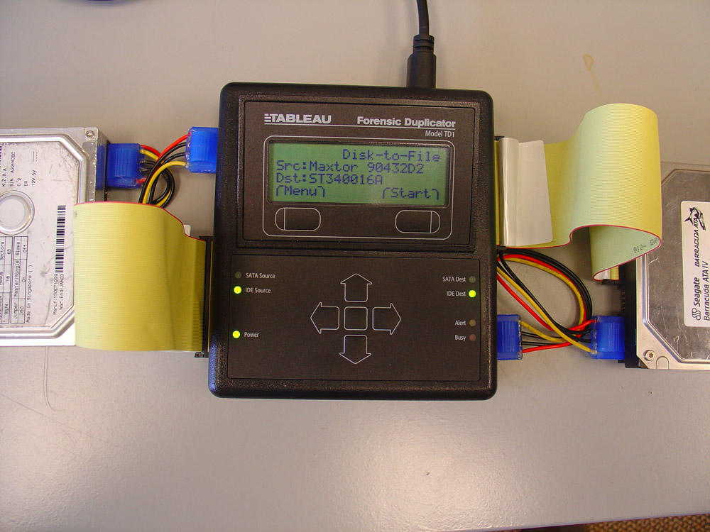
Preparing to handle digital crime scenes – ACPO Guide
consider the offender‘s technical skill level
bringing specific materials, tools and equipment to help preserve and document digital evidence
consideration of data vulnerability: wireless and network devices, working devices (computers),...

Slide 31
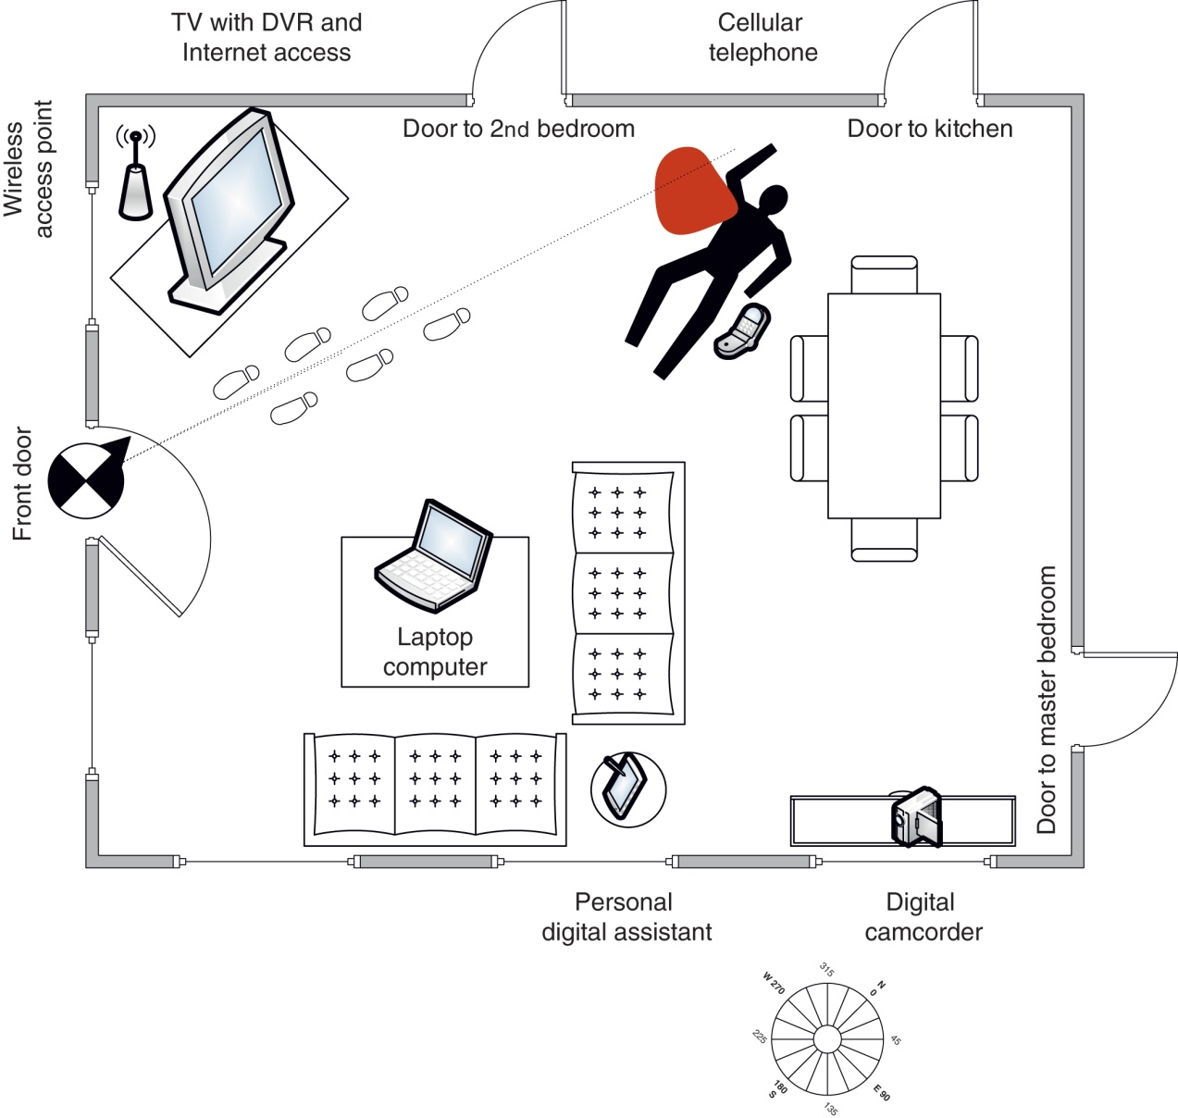
Surveying the Digital Crime Scene
digital evidence can be found in different places - important to be methodical
O/I units, manuals for hardware and software, ...

Slide 32
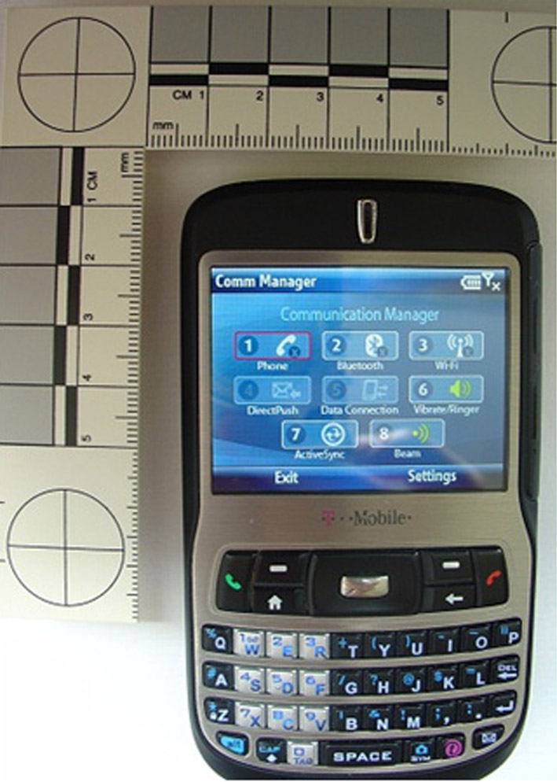
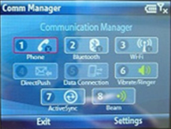
Surveying the Digital Crime Scene
shut down the device
record of device shut down

Slide 33
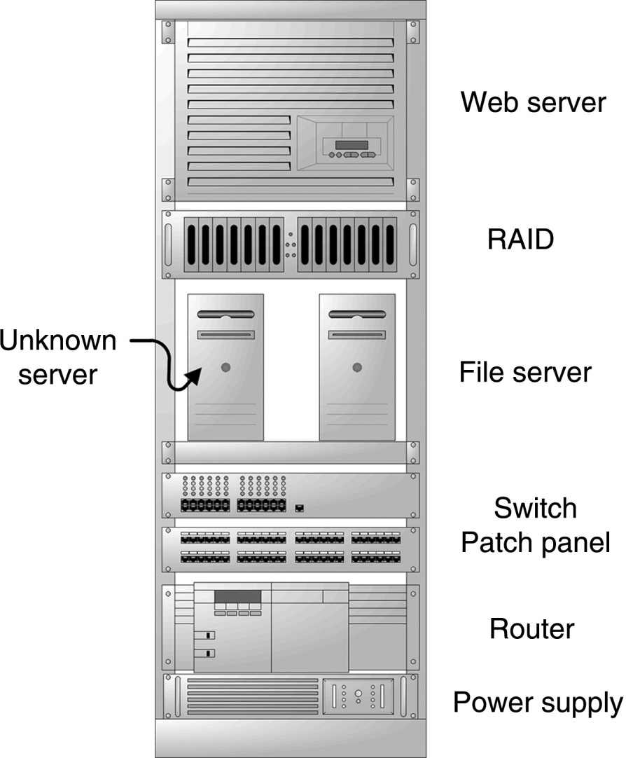
Surveying the Digital Crime Scene
precise inventory of all devices and their characteristics
password for access and encryption
recording findings in accordance with the plan

Slide 34
Preserving the Digital Crime Scene
controlling entry points:
video surveillance equipment: disable to protect from outside invasion and saving the information recorded
(wireless) networks: disable to prevent remote access
freezing the networked crime scene
copy all evidence, make inventory list and save the evidence
securing remote data
securing non-digital evidence (fingerprints and biological evidence)

Slide 35
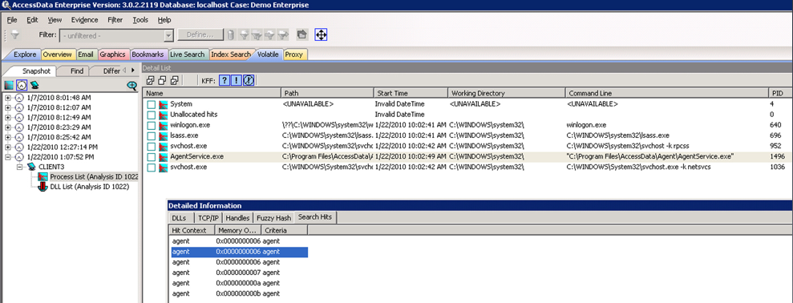
Preserving the Digital Crime Scene
preparing a plan for preservation of evidence
remote preservation

Slide 36
Preserving the Digital Crime Scene
What about currently running devices?
preserving information on RAM is hard
but:
currently running processes give information about the intrusion into the system
encrypted file system is connected and the password is entered
unlocked access to remote locations or services
...

Slide 37
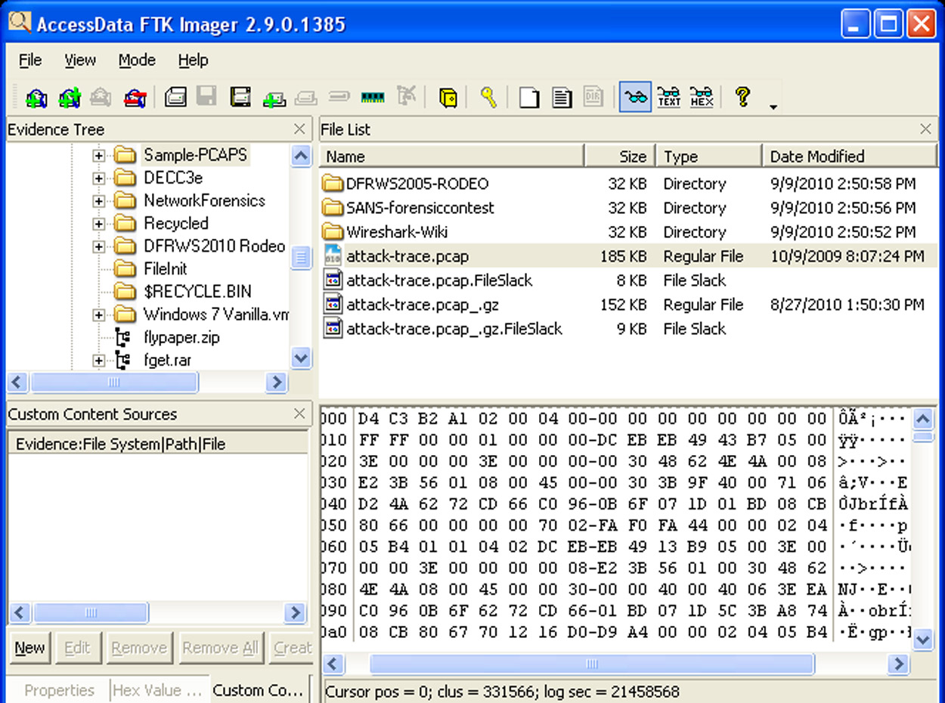
Preserving the Digital Crime Scene
on currently running we use conventional forensics tools (FTK)
second principle of ACPO!!

Slide 38
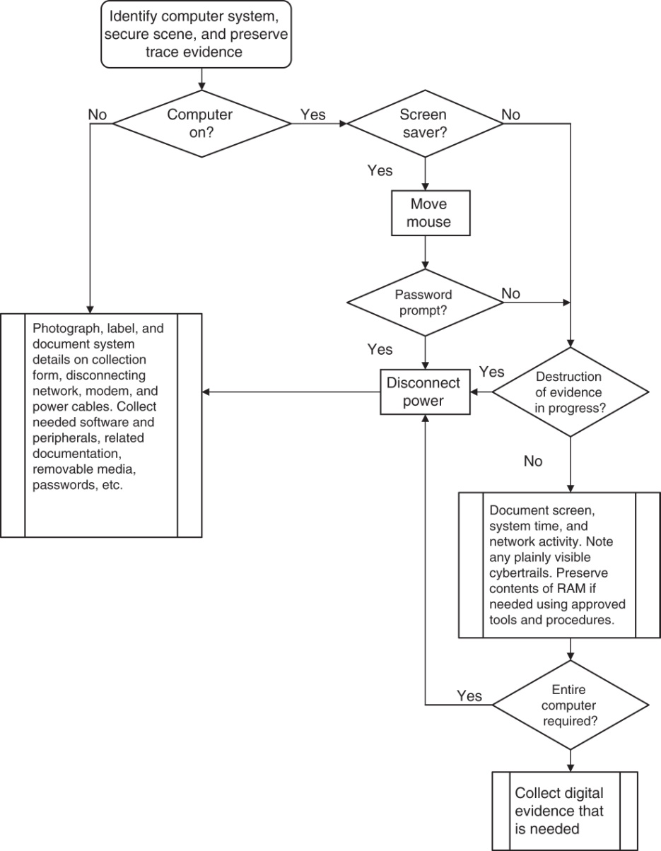
Preserving the Digital Crime Scene
shut down the system
disconnect power – where?
on PC case – why?
removing the casing and viewing the interior
missing parts, ...
disconnect power to the disks
in all interventions be aware of the position of the situation :
shutting down a computer can cause an explosion ☹
consider the offender‘s technical skill level☺

Slide 39
Challenge: Let‘s say there has been a crime in the lecture room, in the lobby, in a computer room, ... Make a plan for securing the digital crime scene.
Challenge: Work with a colleague. The crime has taken place on his property. The evidence is a picture of the criminal Cefizl that your colleague hides somewhere. Make a plan for preservation of the crime scene and conduct an investigation. Afterwards replace the roles.

